Slide 1
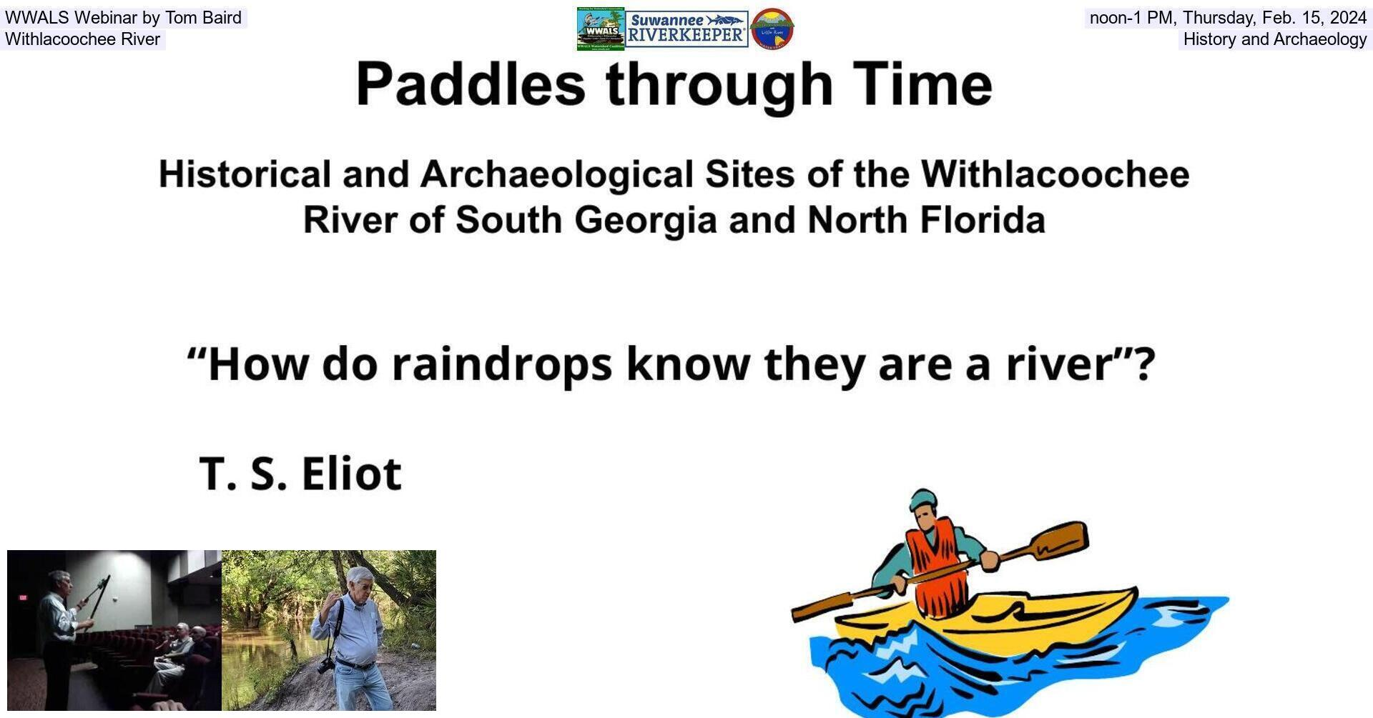
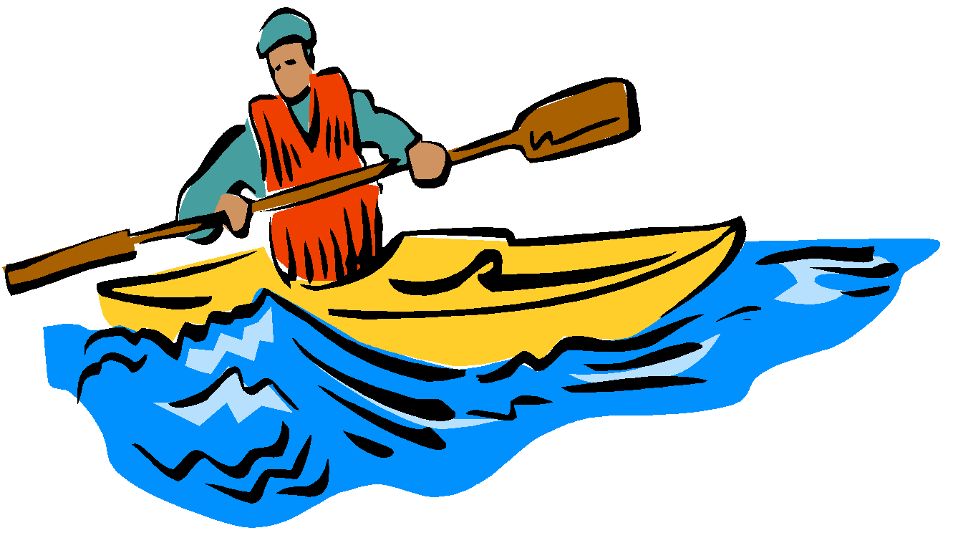
Paddles through Time
Historical and Archaeological Sites of the Withlacoochee River of South Georgia and North Florida
“How do raindrops know they are a river”?
T. S. Eliot

Slide 2
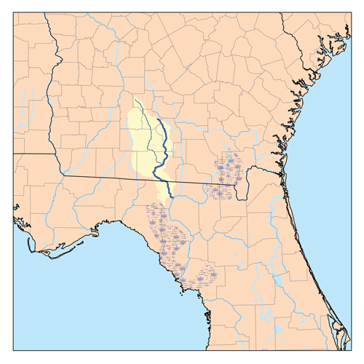

Slide 3
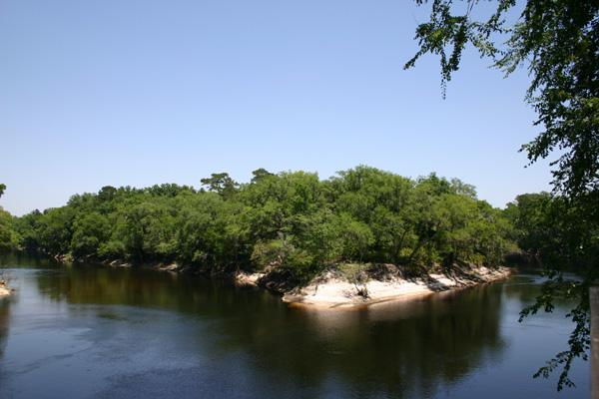
Notes:
Withlacoochee River (left) Confluence with the Suwannee River

Slide 4
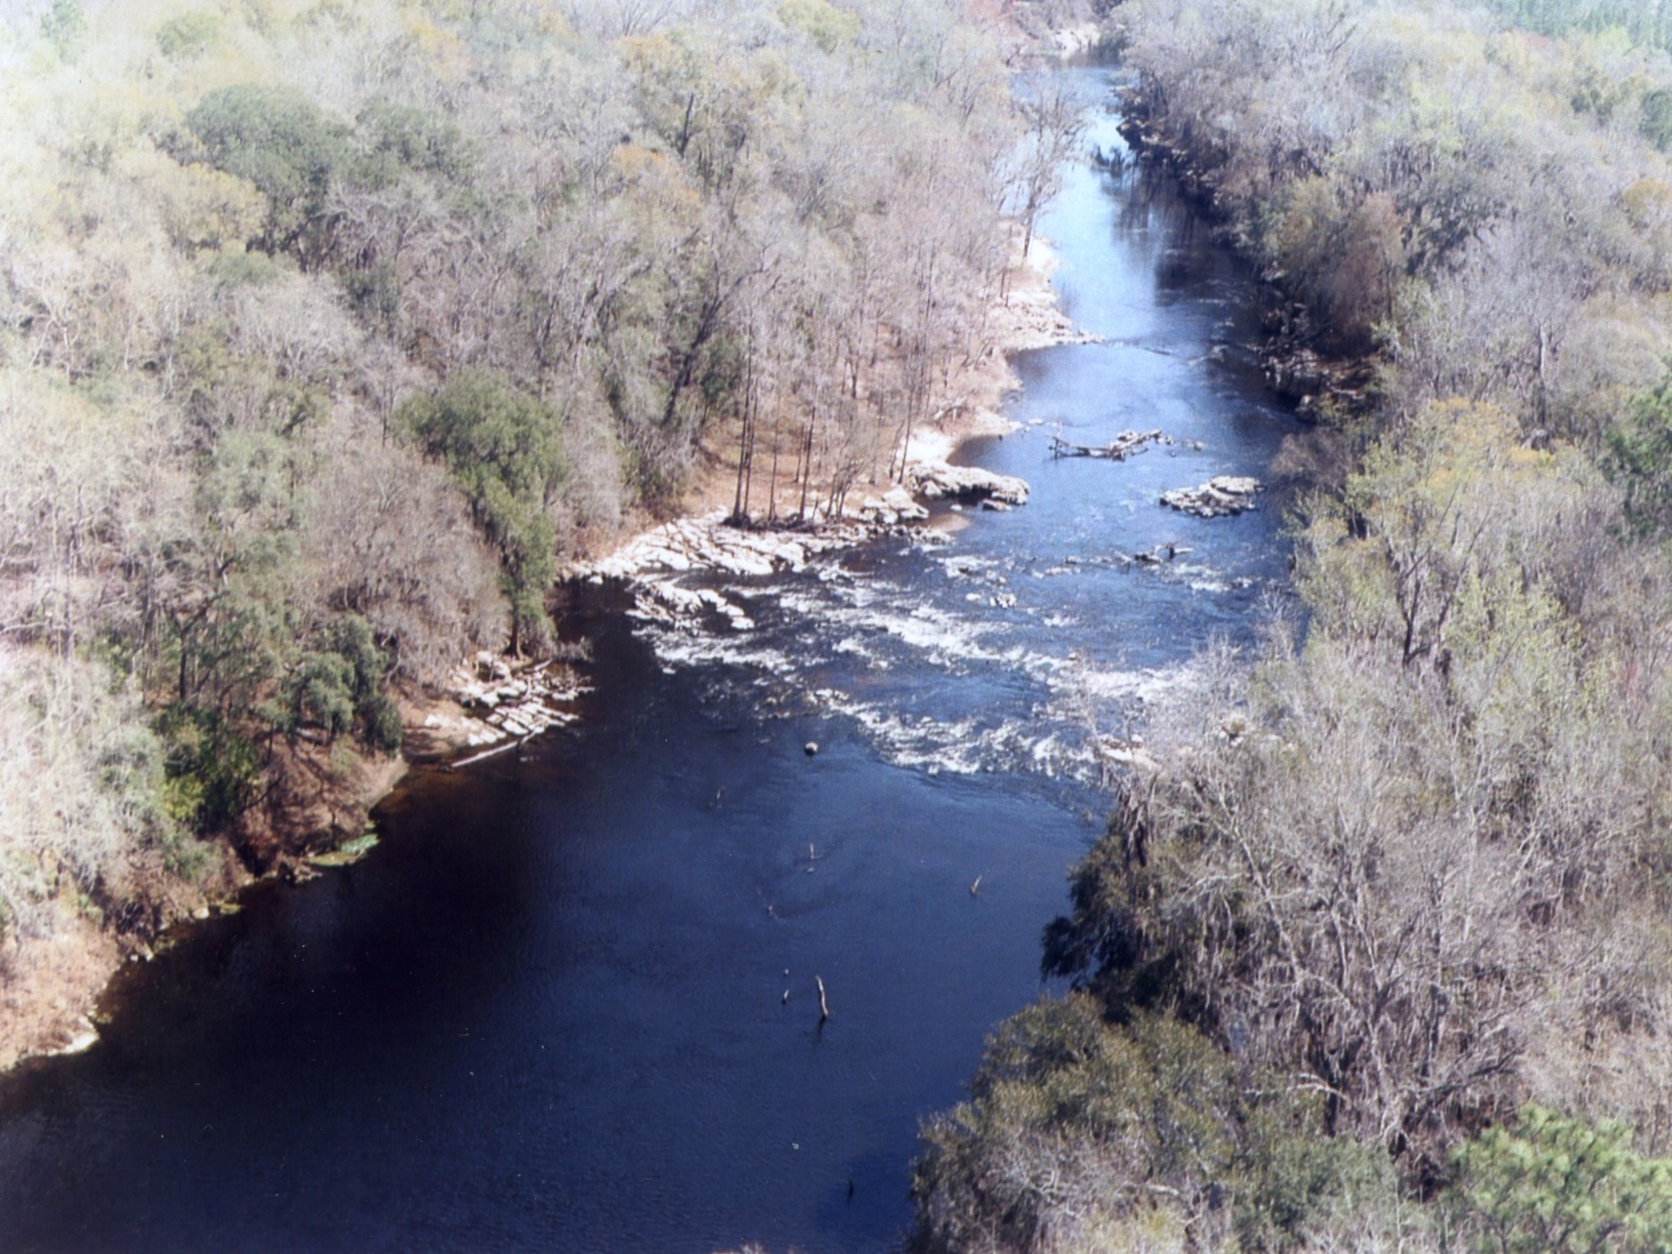
Notes:
Melvin Shoals, Withlacoochee River

Slide 5
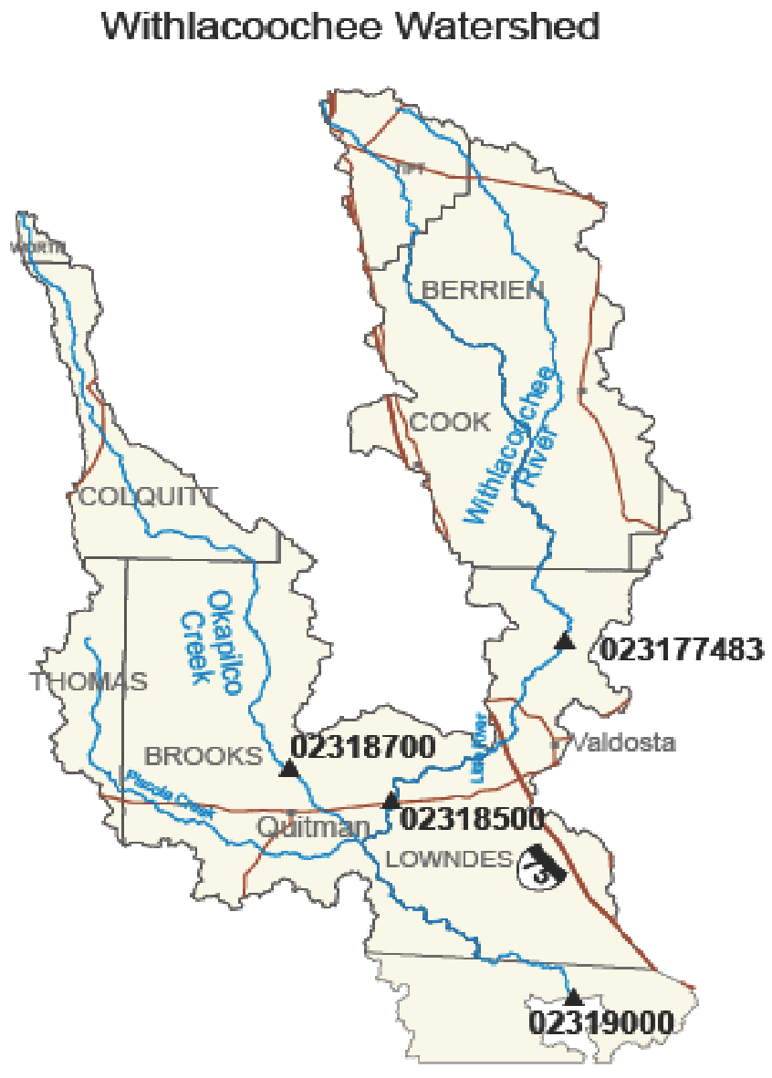

Slide 6
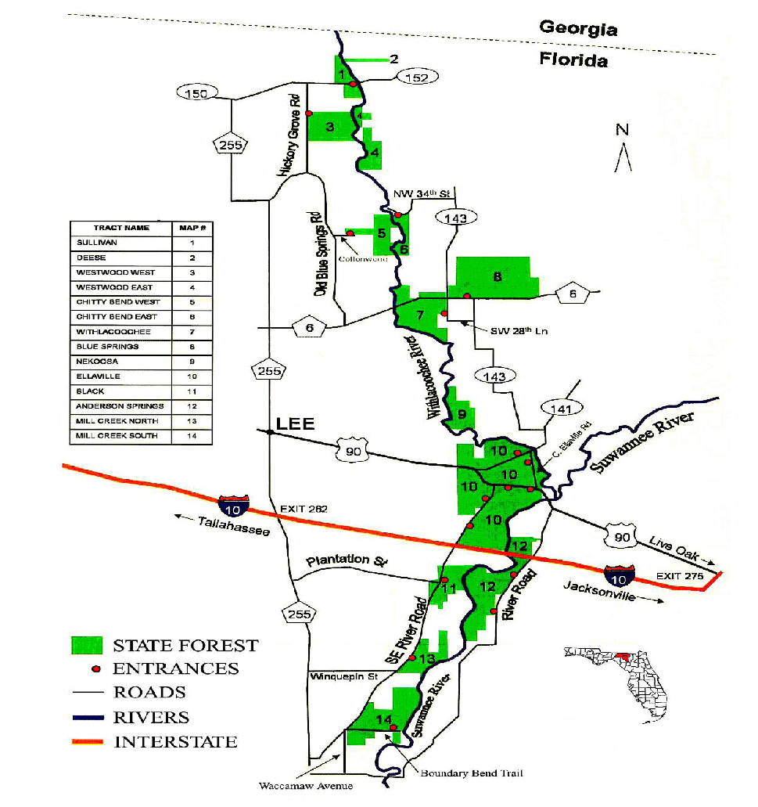

Slide 7

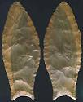
Paleo-Indian Era: 12,000 – 14,000 years ago
Climate was much cooler and dryer than now – the river may not have existed as a permanent feature
• Lived in small mobile groups – followed the game
• Hunted various animals, including the mega-fauna, with spears tipped with flint/chert points
• May have collected plant food as deciduous forest replaced Ice Age
coniferous forest
• Occupied small temporary camps in response to seasonal availability of
food
• Made their distinctive tools in workshops located near outcrops of chert – numerous quarry sites on the Withlacoochee
Present day springs may have been watering holes at that time

Slide 8
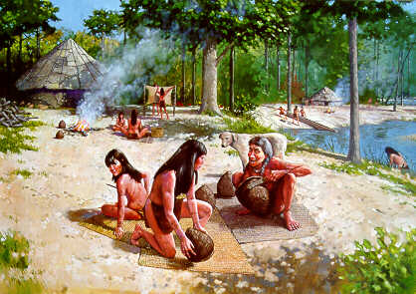
Archaic Period: 8000 to 2000 years ago
Less arid conditions – climate approaches present-day
Established camps around water sources
Larger populations; occupy sites for longer periods
The “container revolution” – they could fashion vessels out of fired clay
Mastered the ability to weave fine cloth, and make baskets
By middle to late Archaic, the river probably had a consistent flow
Weirs – fish traps – established on the river – one below Madison Blue Springs
Numerous archaic sites on the Withlacoochee in Florida

Slide 9
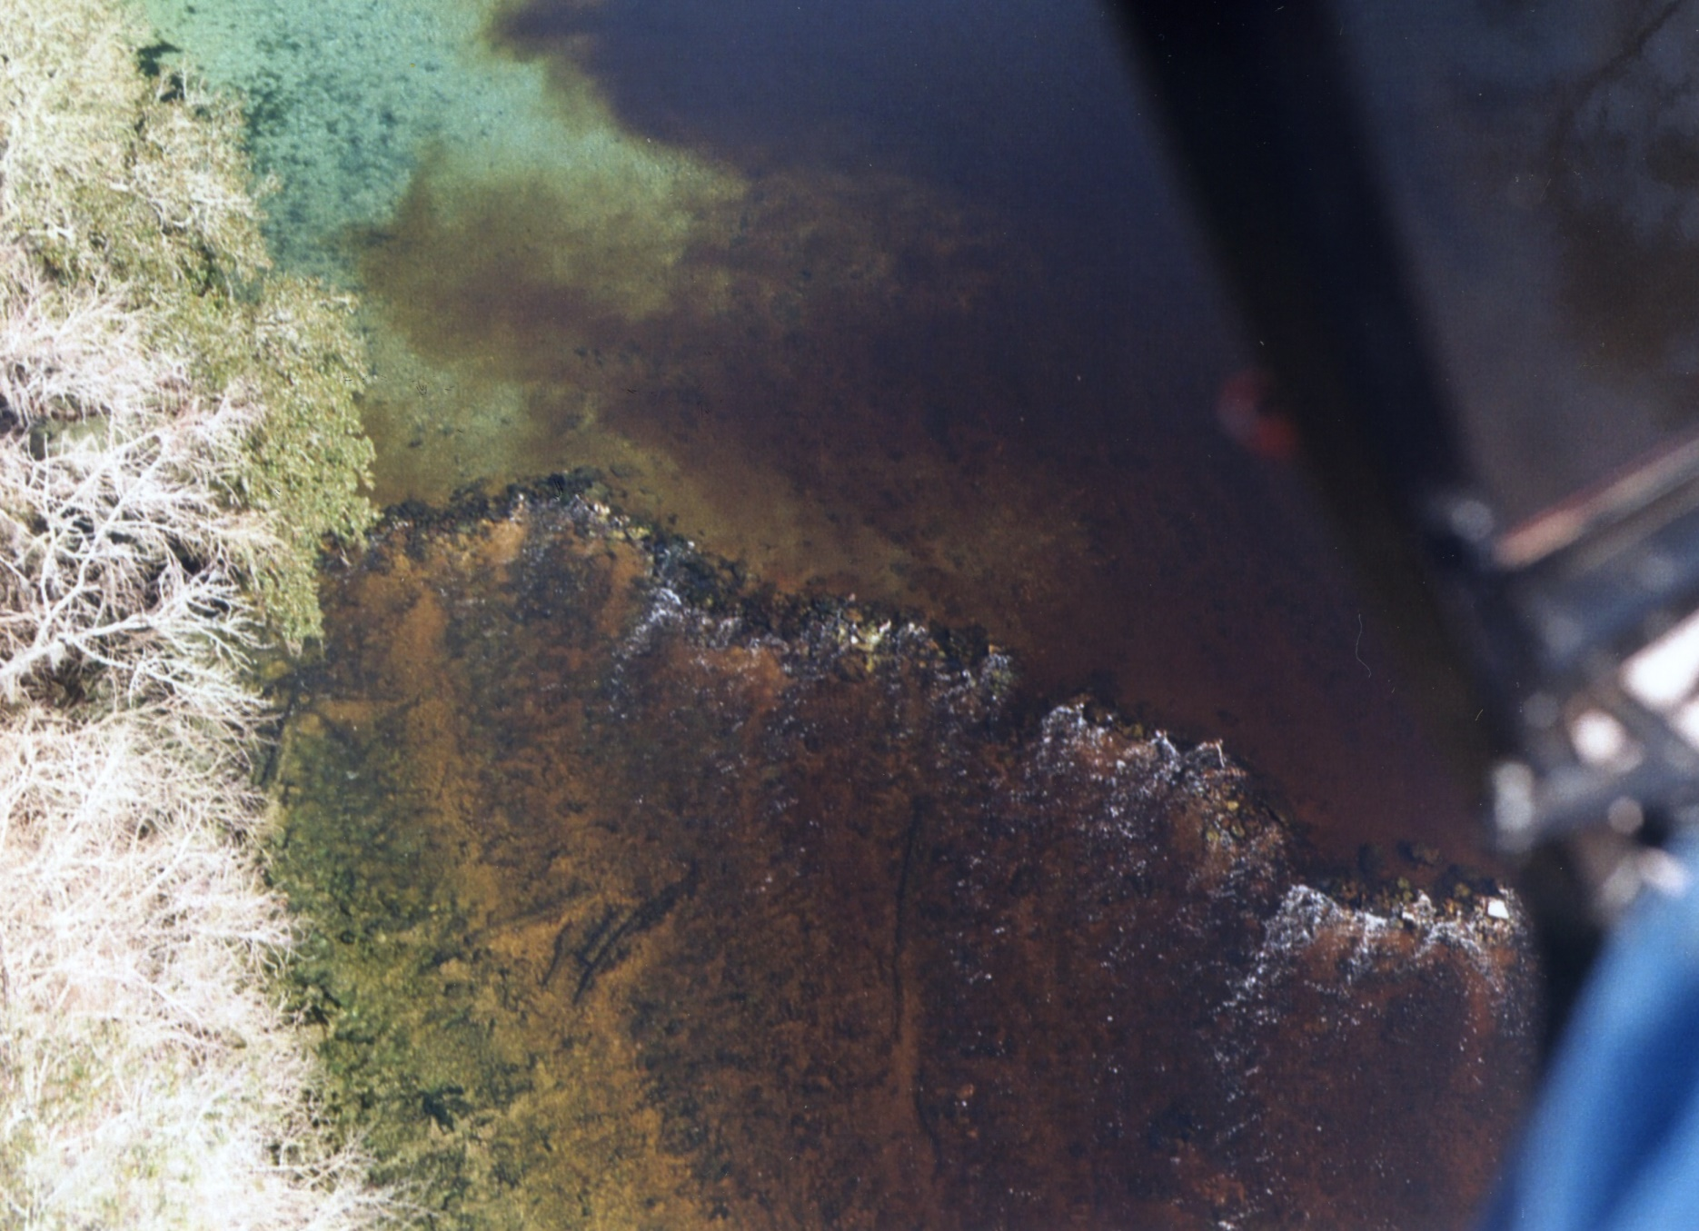
Notes:
Fish Weir just downstream of Madison Blue Spring, helicopter view by Tom Baird

Slide 10
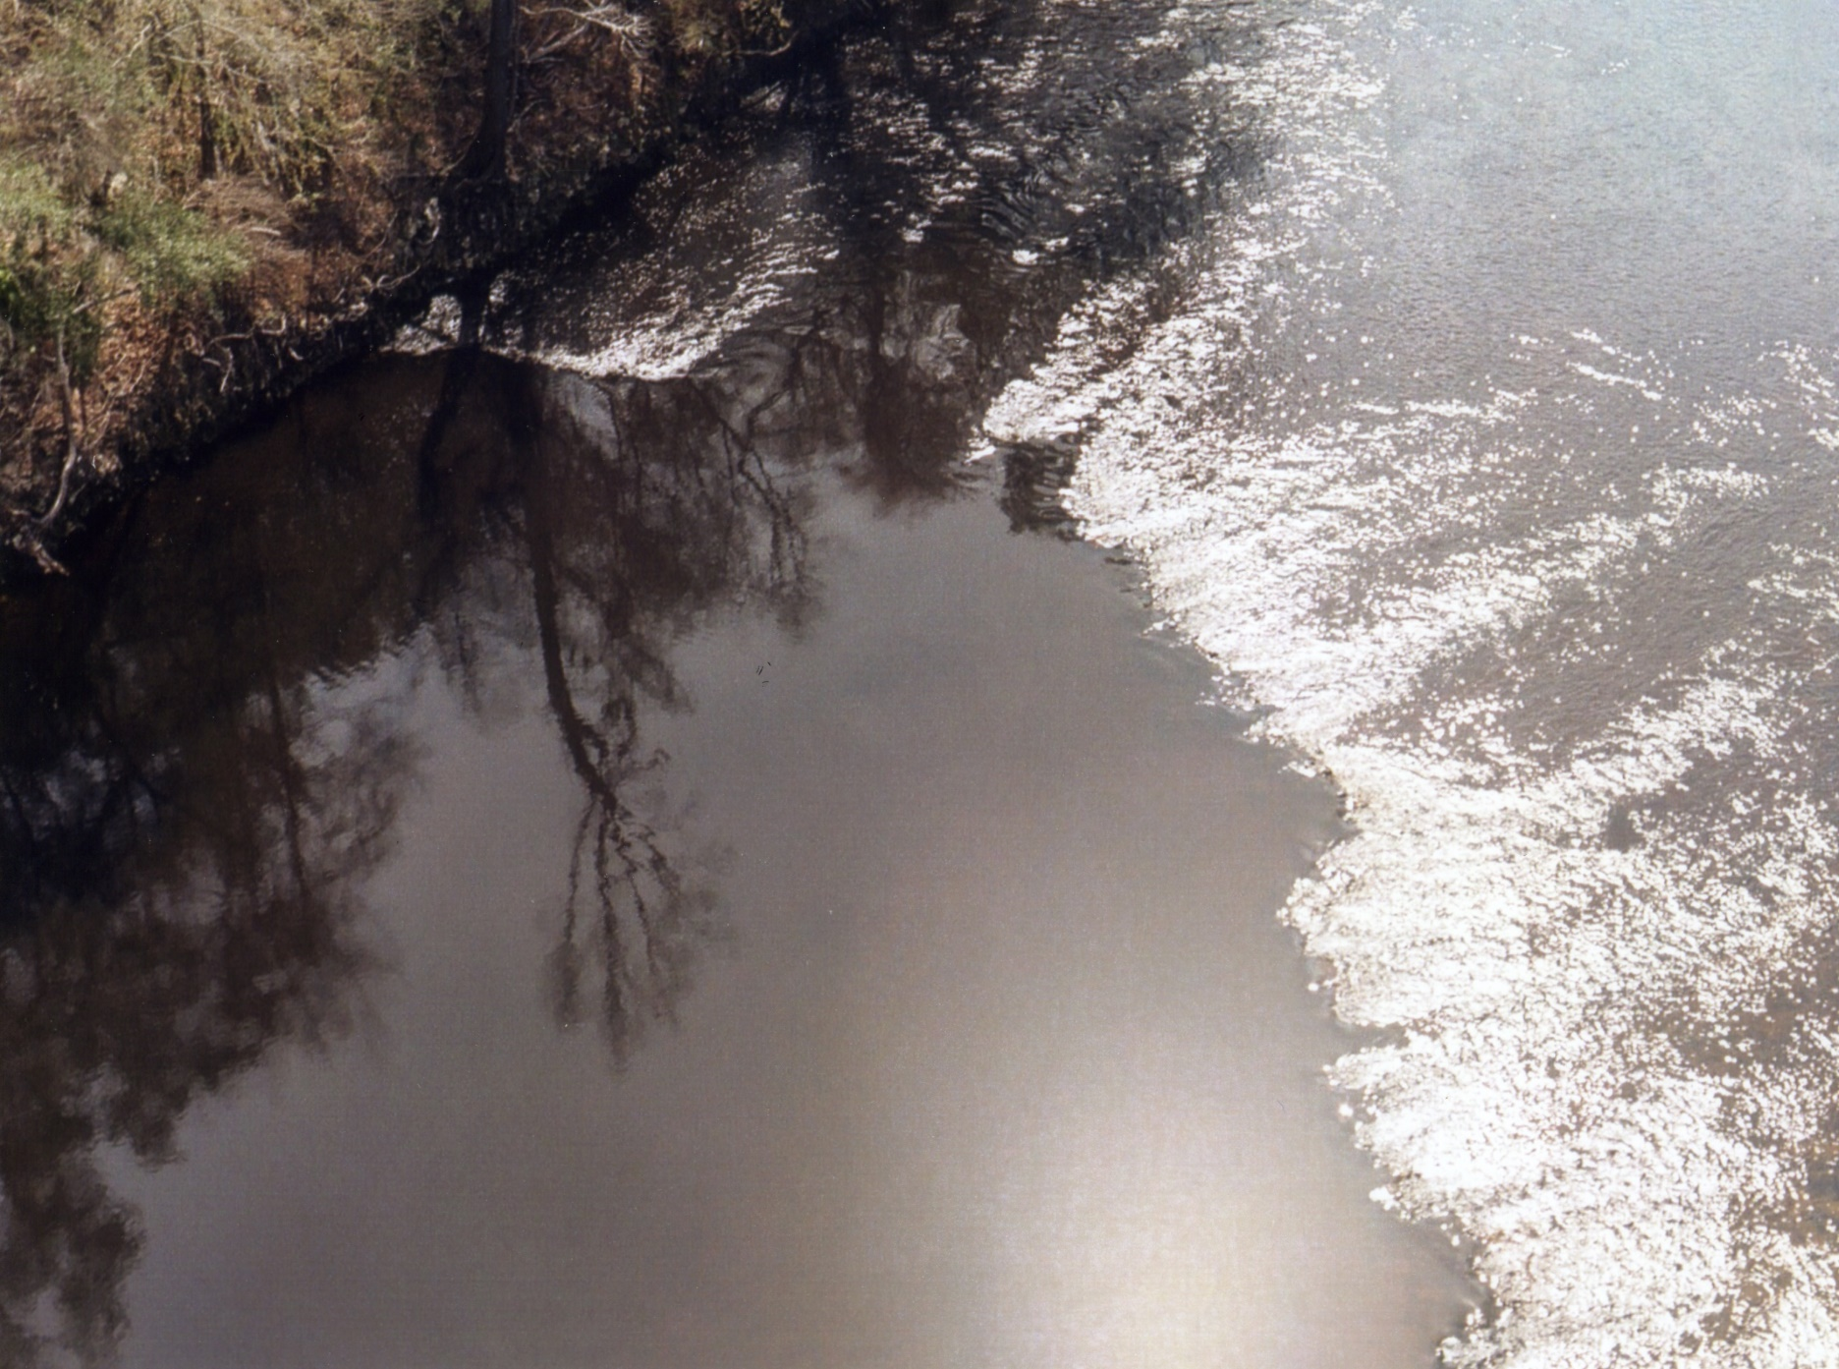
Notes:
Aerial view, fish weir

Slide 11
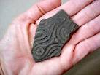
The Woodland Period: (In Southeast @ 1000 B.C.- A.D. 1000)
Emergence of a distinct pottery-making tradition with definite vessel forms and decoration
Distinct regional cultures – Deptford, Santa Rosa/Swift Creek, Weeden Island
Archaic-style spears and atlatls until the Late Woodland period (circa A.D. 800) when these were replaced by bow and arrow technology
Increasing social stratification – political elites
Middle Woodland sites with burial mound graves of elite individuals buried with exotic mortuary gifts
Extensive trade networks covering most of the eastern United States
Mounds on the Withlacoochee – especially in Hamilton Co. – most have been plowed down – Source: old photographs, oral histories, one Florida Master Site File entry, one intriguing newspaper article

Slide 12
Later peoples and how the river was used -
  Mission period – Timucuan missions near the river or within the watershed
Santa Cruz de Cachipile, a Spanish Franciscan mission situated near twin sinkhole lakes. The mission existed from 1625 to 1657.
Mission San Francisco de Chuaquin existed from 1625 to 1657, and like other missions upriver, fell victim to the resettlements following the Timucuan Revolt. Located near the confluence of the Withlacoochee and Suwannee.

Slide 13
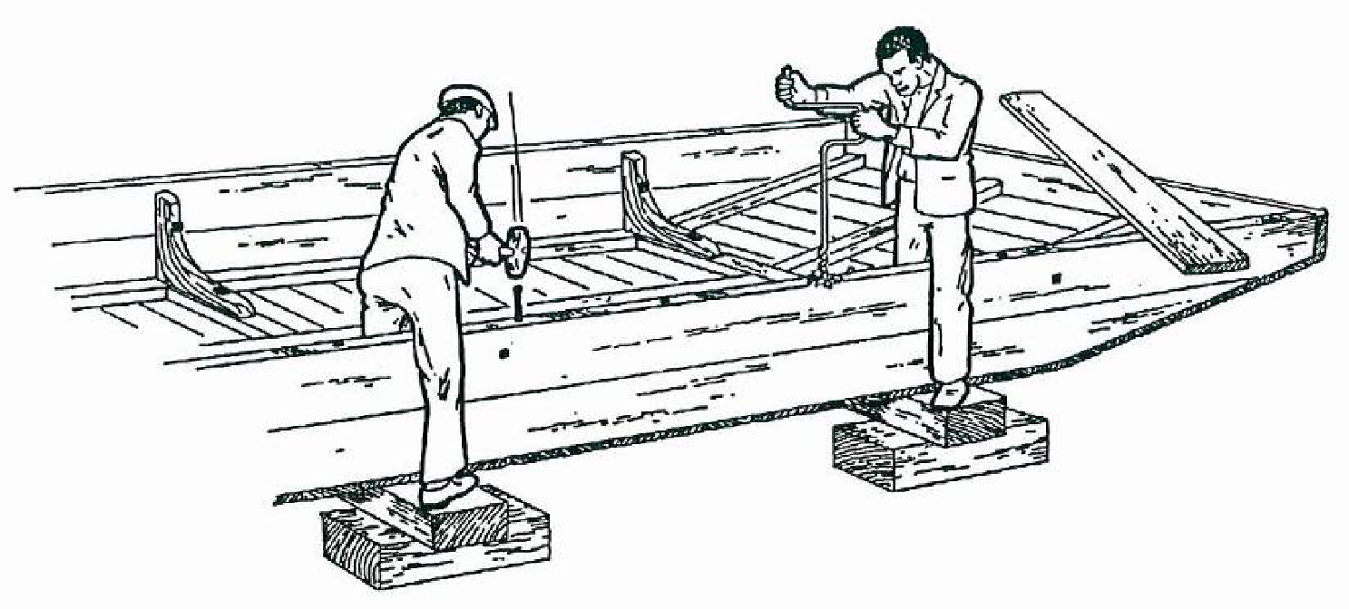
Thwartship planking of 8HA410, the Little Jack Shipwreck
Notes:
Somewhere between Madison Blue Spring and Melvin Shoals. Maybe the boat from Troupville.

Slide 14
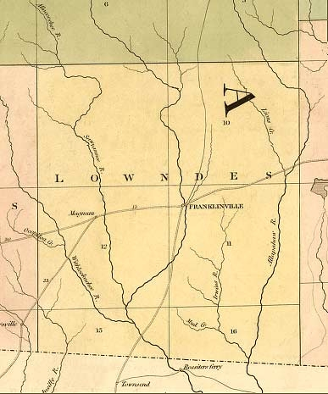
Notes:
Lowndes County and Franklinville 1839

Slide 15
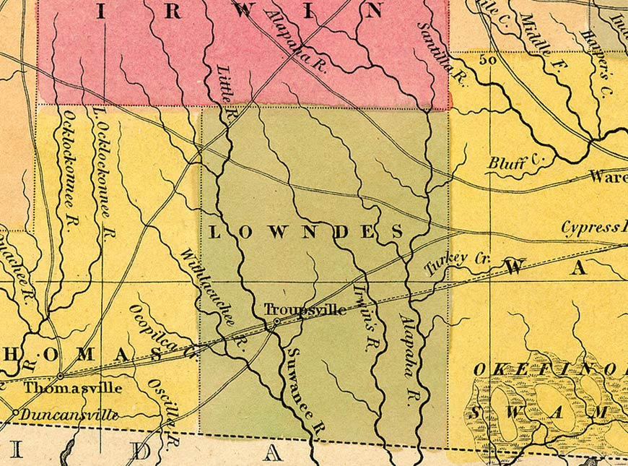
S. Augustus Mitchell Map of Georgia, 1846
Notes:
Lowndes County and Troupville 1846

Slide 16
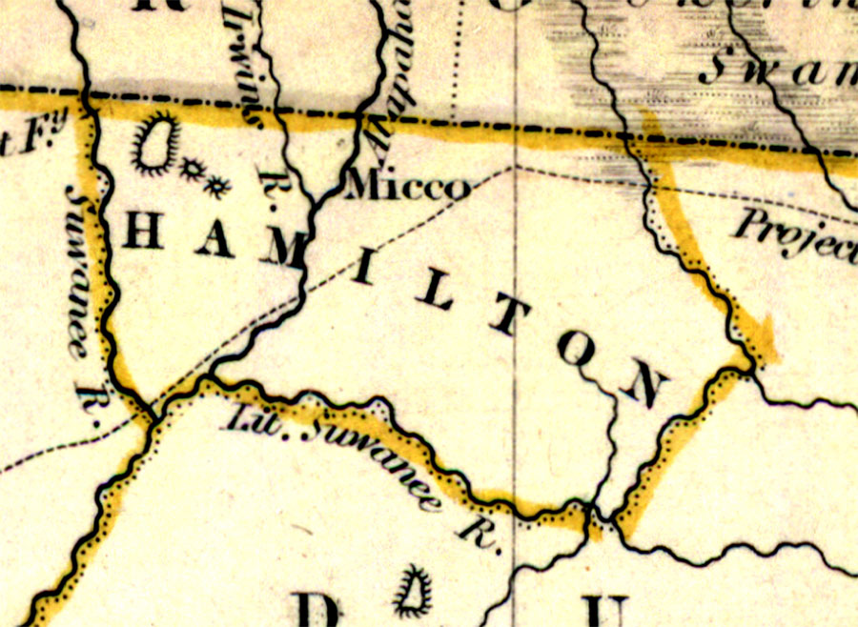
1834 Hamilton Co.
From hand-colored map of Florida
Notes:
Hamilton County 1834

Slide 17
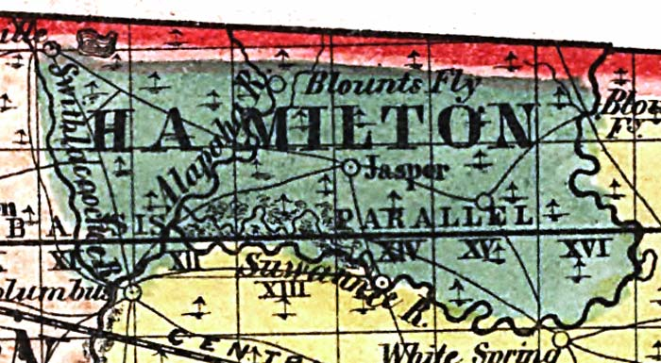
Hamilton Co. 1856
From the annual report of the Surveyor General
Notes:
Hamilton County 1856

Slide 18
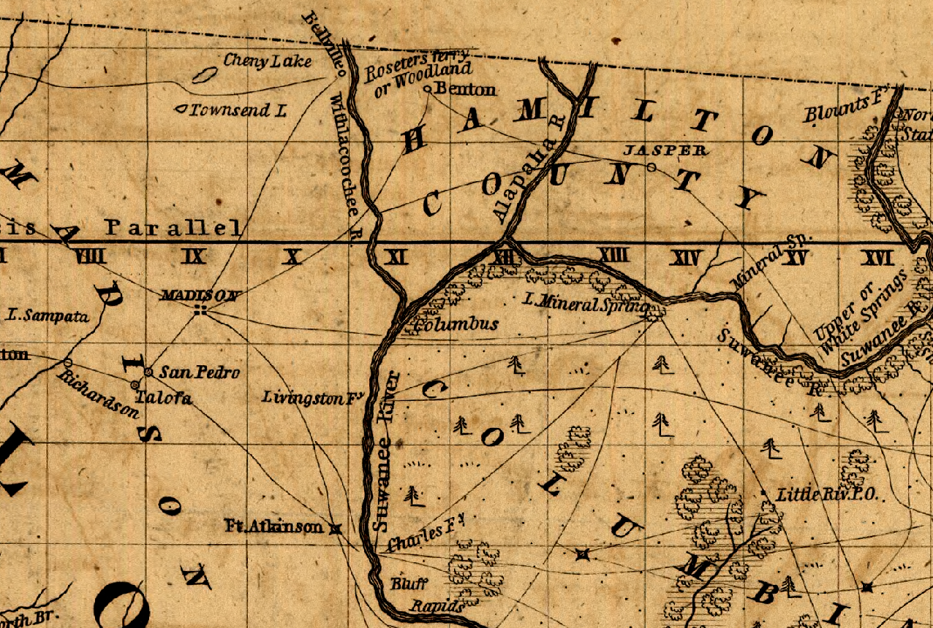
Notes:
Madison, Hamilton, Columbia Counties

Slide 19
Ghost Towns -
Franklinville – Original county seat – on river at site of a good spring and bridge crossing.
Troupville - In Lowndes County, at the junction of the Withlacoochee River and the Little River. Troupville replaced the short-lived Lowndesville. When the railroad came, Troupville residents picked up their houses and moved to the railroad, founding Valdosta.
Olympia – Railroad and sawmill town built on the river along the Georgia & Florida RR (G&F – Nickname - Ole God Forsaken). On Georgia side of river. Trestle remains on the river.
Bellville - A community by the name of Benton was originally established here in the early 1840’s, but the name was changed to Bellville in 1847 to honor James S. Bell, an early settler. Bellville is always prominently displayed on early maps, although one map labels it Rossetters. Rossetters Ferry Landing still visible.
Forrest or Echo – Opposite Madison Blue Springs. A boom town that grew up around the turpentine industry and existed from late 19th century to early 20th. Appears on old maps and in oral history.
Ellaville – At confluence of the Withlacoochee and Suwannee. Largest sawmill in Florida at the time. Home of Gov. George F. Drew.

Slide 20
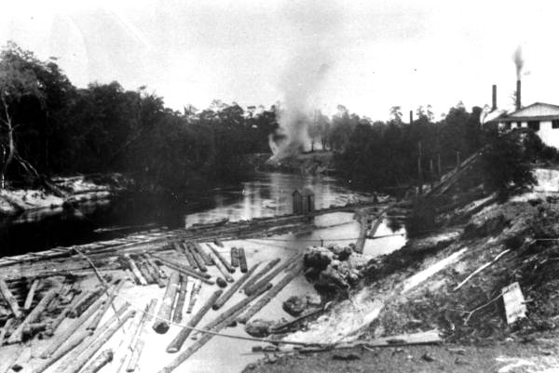

Slide 21
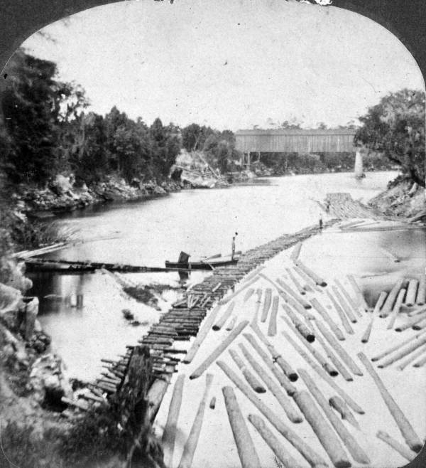

Slide 22
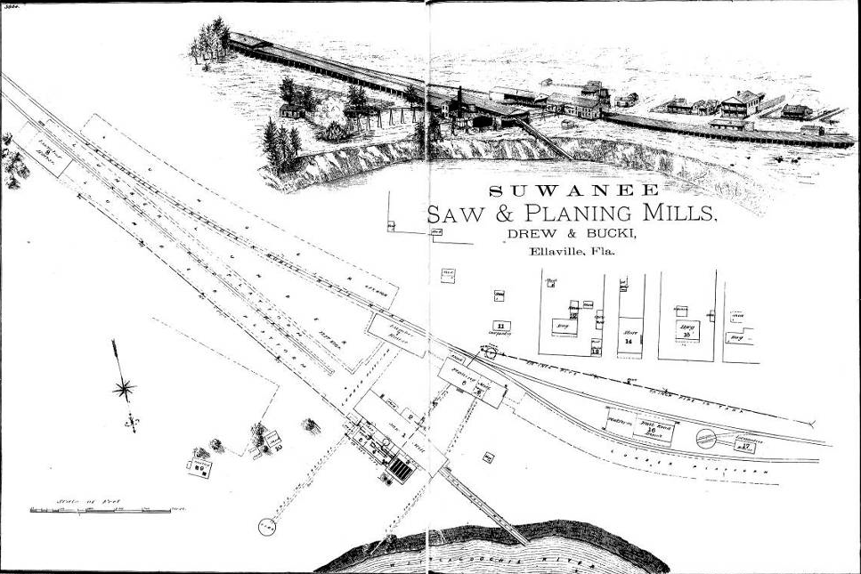

Slide 23
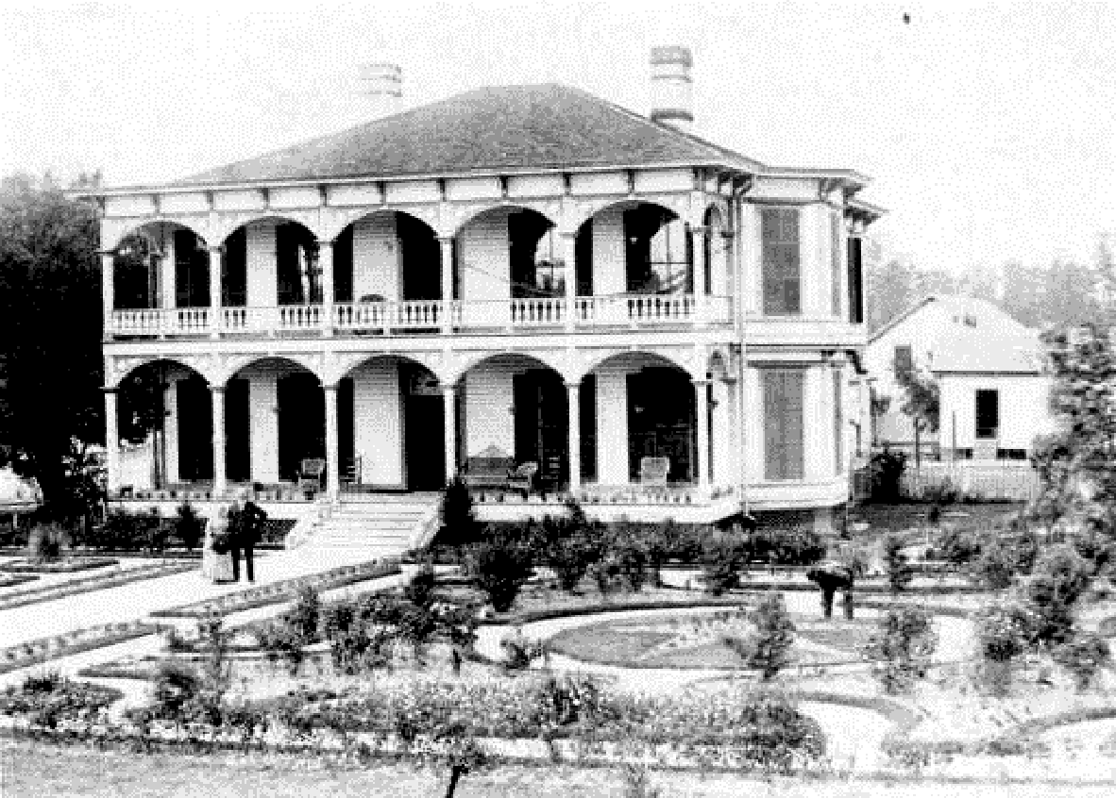

Slide 24
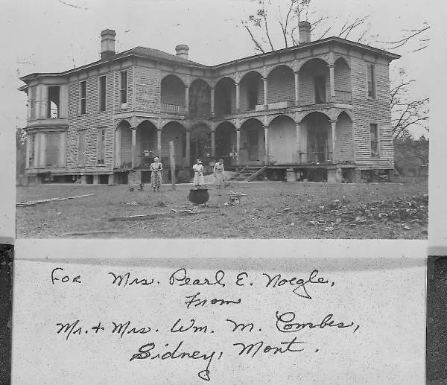

Slide 25
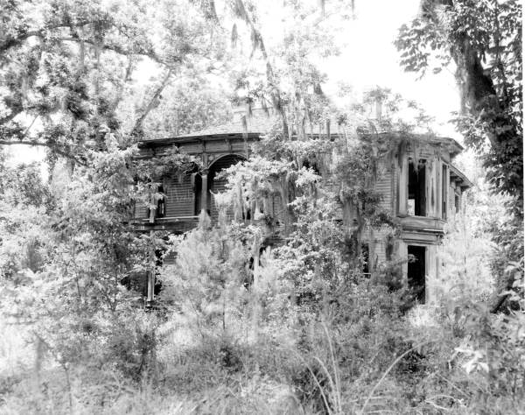

Slide 26
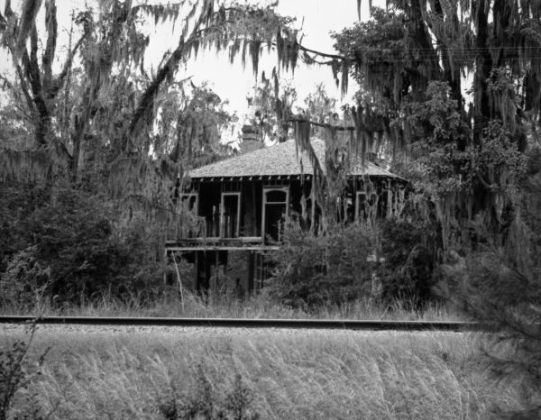

Slide 27
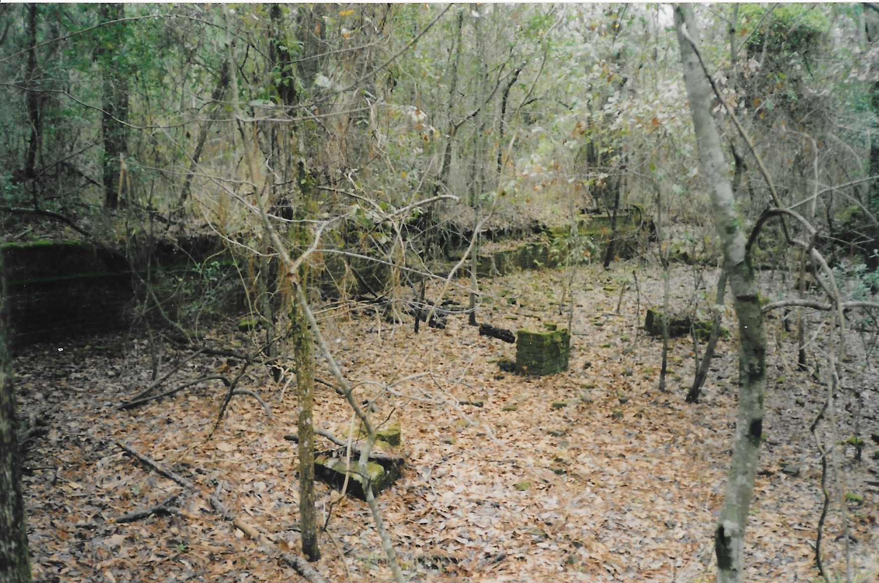

Slide 28
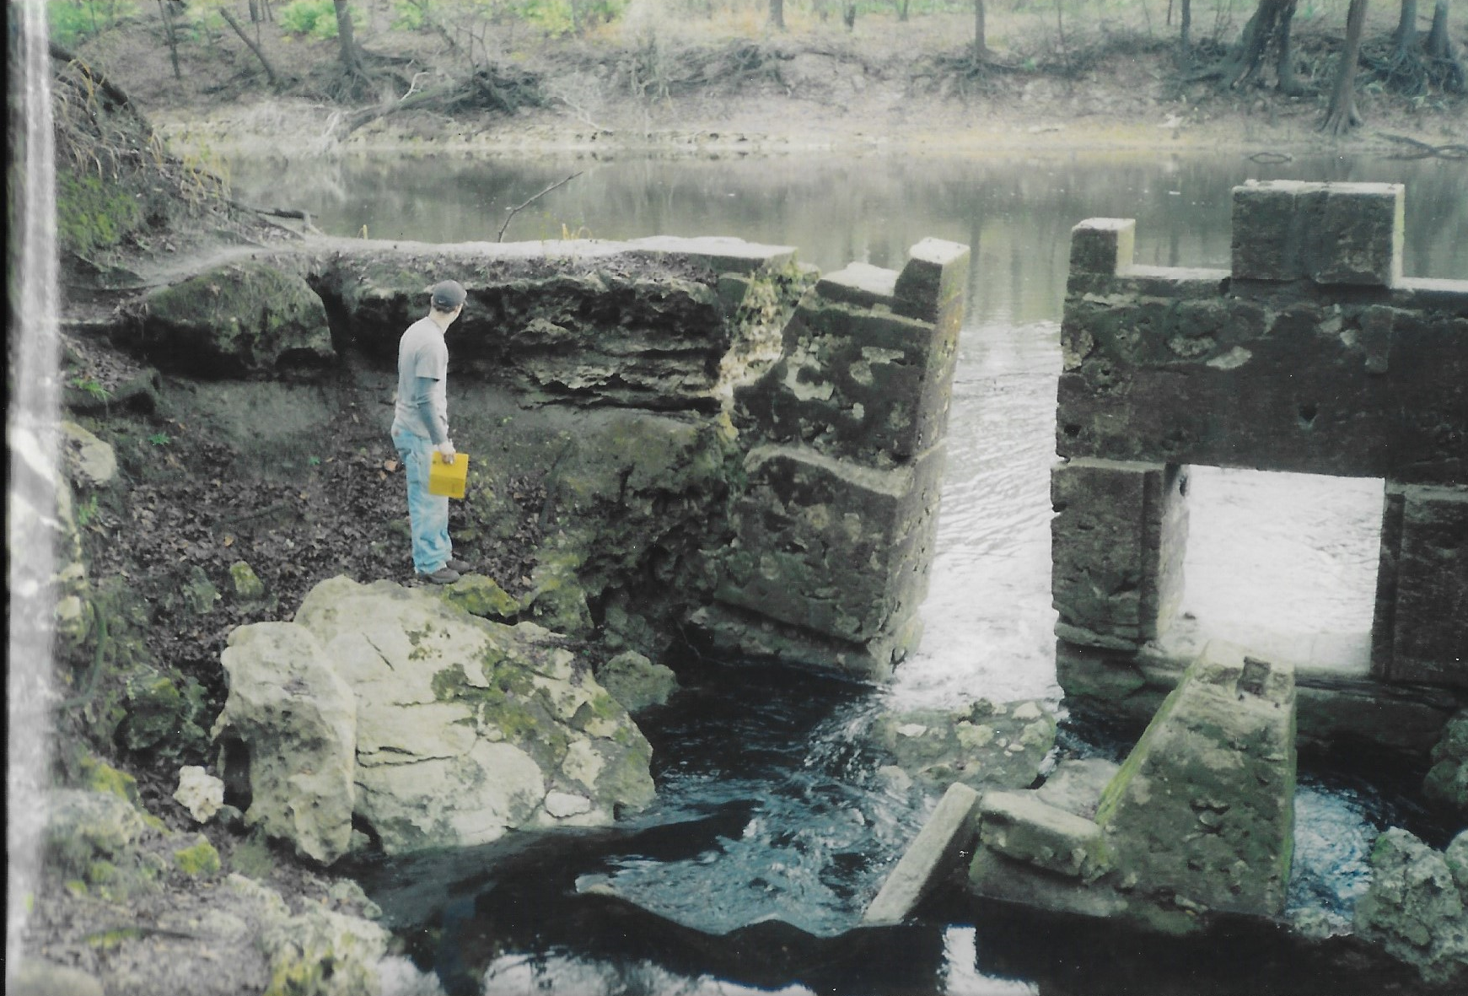

Slide 29
Some Current Threats to the River
Agricultural run-off – mainly fertilizers, herbicides (prometon) and pesticides; high mercury levels
Over-pumping the aquifer – historic springs have disappeared
Introduced exotic plants (Ex. Water Hyacinth in 2007)
Point sources – municipal sewage effluent
Artifact hunters - looters

Slide 30
Archaeological Opportunities on the Withlacoochee
Numerous Paleo and Archaic Sites – abundant spring sites - first and second magnitude - frequent quarry sites and lithic scatter, deep “lakes” may have preserved evidence of early humans, flora and fauna – not just “stones and bones”
Fish Weirs and the possibility of documenting earlier harvesting cycles
One (and possibly other) Spanish mission sites – could illuminate life in the “fringe” missions away from the Camino Real
Nineteenth and early Twentieth Century sites – all relatively unstudied
Naval Stores and Timber Industries – numerous sites
Drew/Bucki Mill Site – several puzzling features
“ Madison County remains almost terra incognita……” Jerald Milanich, 1994

Slide 31
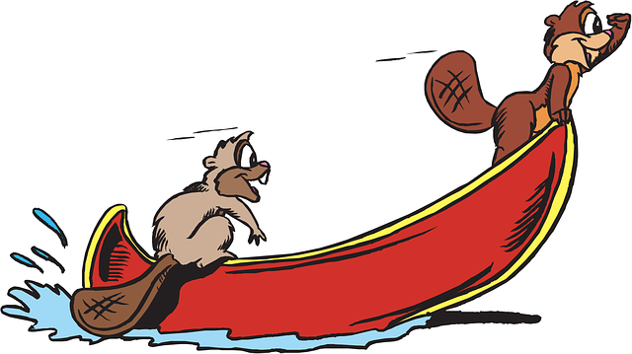
Just remember -
“There is nothing, absolutely nothing, half so much worth doing as simply messing about in boats.”
The Wind in the Willows - Kenneth Grahame

Slide 32
About WWALS
WWALS Watershed Coalition, Inc. (WWALS) is an IRS 501(c)(3) educational nonprofit corporation registered in Georgia and Florida.
WWALS Vision: A healthy watershed with clean, swimmable, fishable, drinkable water.
WWALS Mission: WWALS advocates for conservation and stewardship of the surface waters and groundwater of the Suwannee River Basin and Estuary, in south Georgia and north Florida, among them the Withlacoochee, Willacoochee, Alapaha, Little, Santa Fe, and Suwannee River watersheds, through education, awareness, environmental monitoring, and citizen activities.
Since 2016, Suwannee Riverkeeper® is a project and a staff position with WWALS as the Waterkeeper® Alliance Member for the Suwannee River Basin and Estuary.

Slide 33
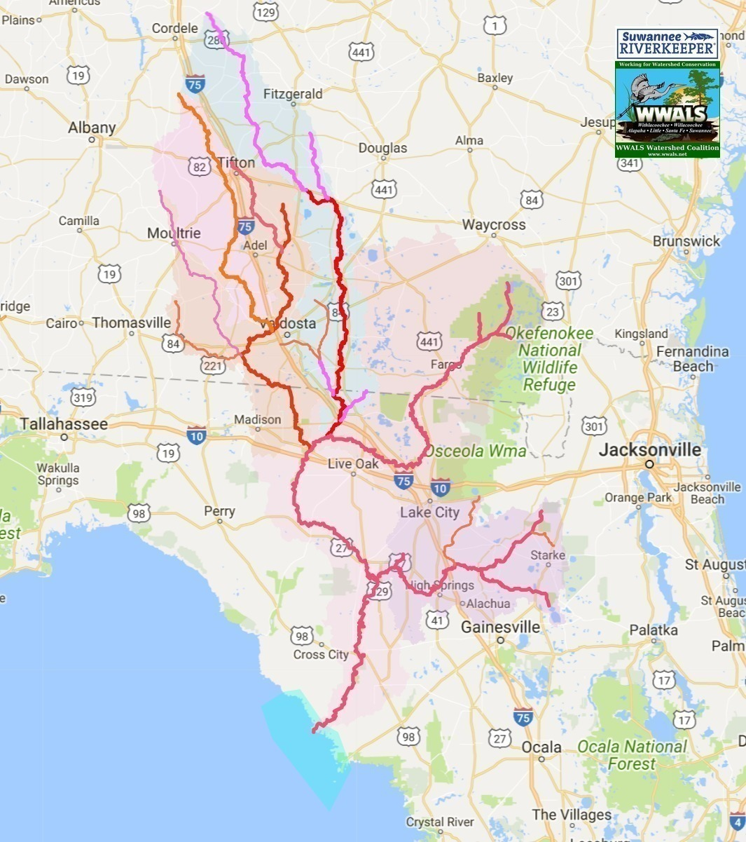
Suwannee River Basin
10,000 square miles
maybe 500,000 people
Bigger than six states
Fewer people than any
Fifteen rivers, including
Withlacoochee, Little, Willacoochee, Alapahoochee, Alapaha, Little Alapaha, Dead, Black, Suwannee, Little, Santa Fe, New, Sampson, Ichetucknee, Gopher, and sometimes Okapilco Rivers.

Slide 34
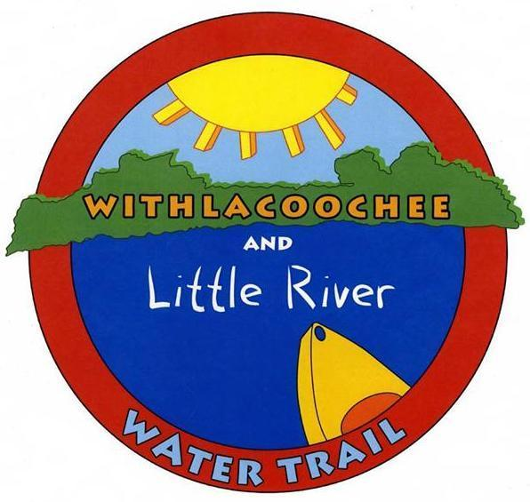
Withlacoochee and Little River Water Trail (WLRWT)
https://wwals.net/maps/withlacoochee-river-water-trail/
Two dozen landings on two tea-colored blackwater rivers in two states,
plus Reed Bingham State Park on the Little River and Langdale Park on the Withlacoochee River,
two of only six second magnitude springs in Georgia (McIntyre Spring and Arnold Springs),
and in Florida first-magnitude Madison Blue Spring State Park and many other springs all the way to the Suwannee River.
With beaches, shoals, and bridges.
Online maps and web pages, and z-fold printed brochure

Slide 35
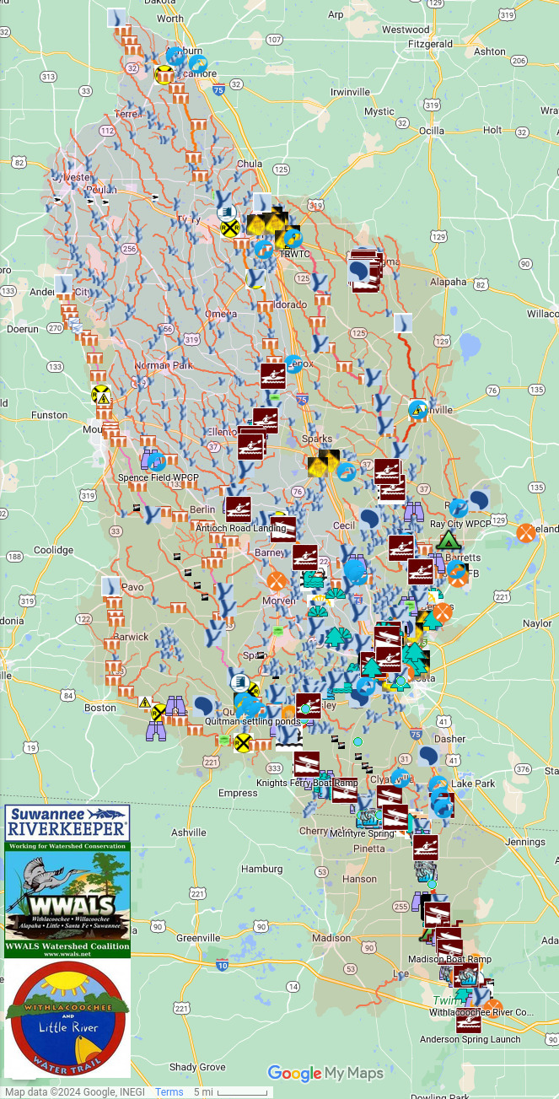
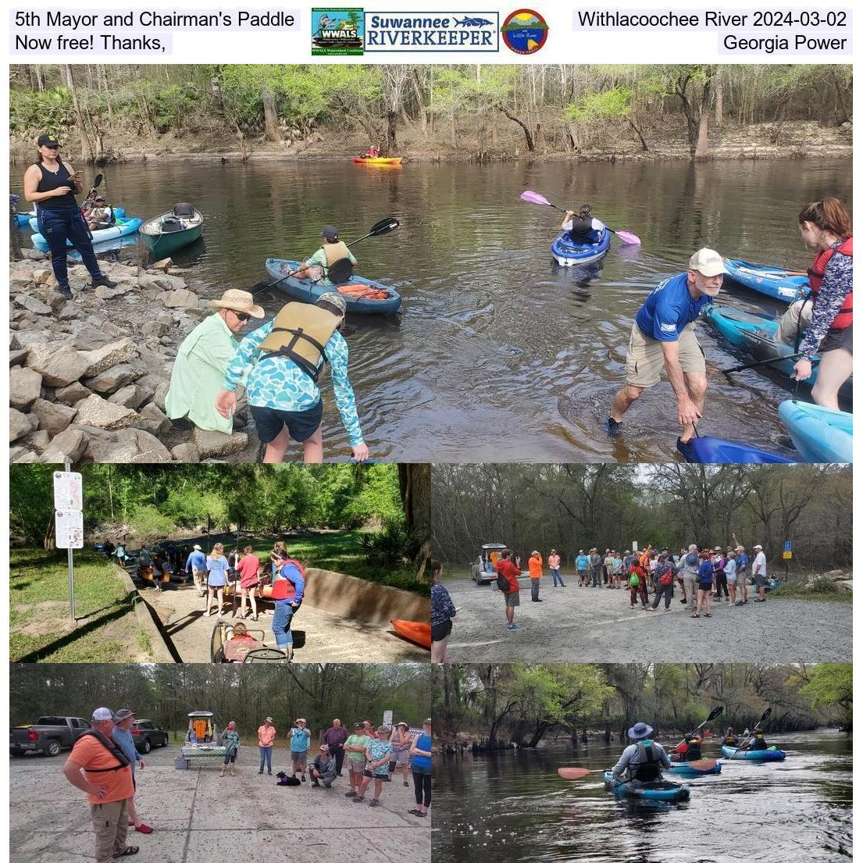

Slide 36
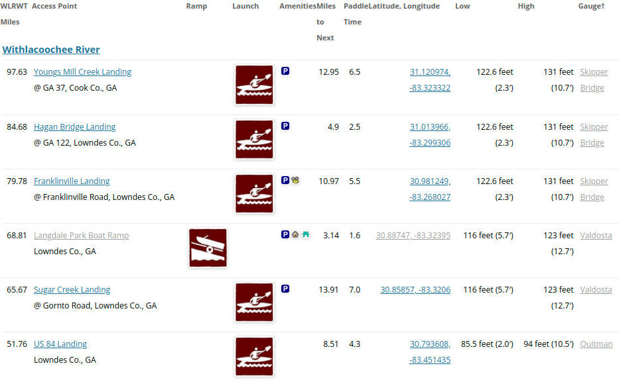
WLRWT Access

Slide 37
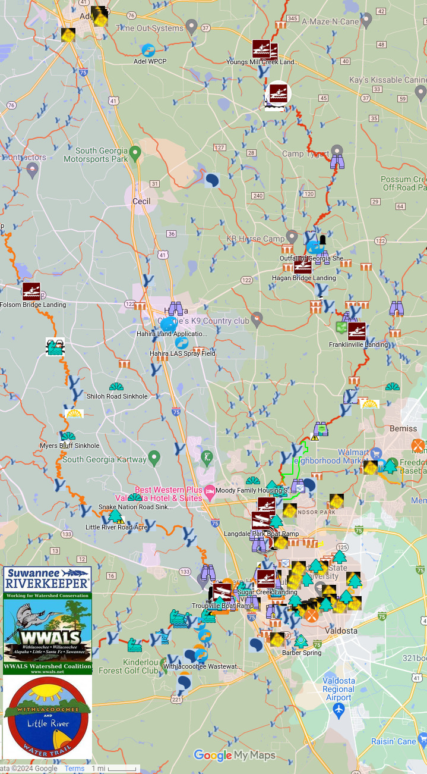
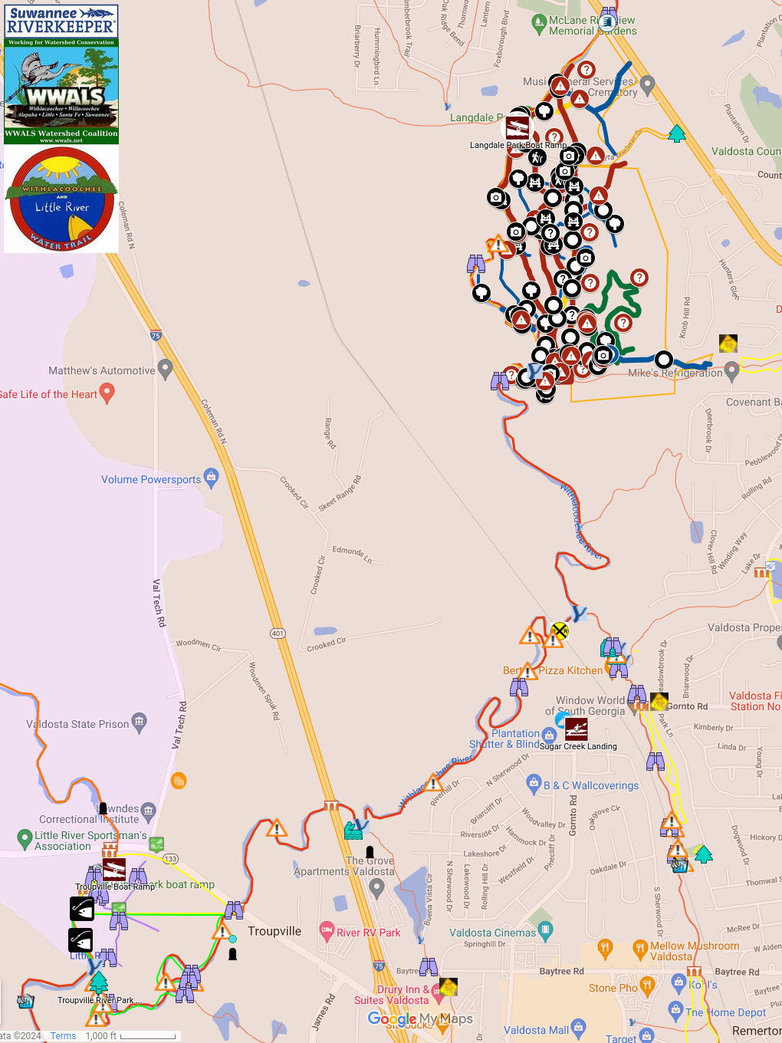

Slide 38
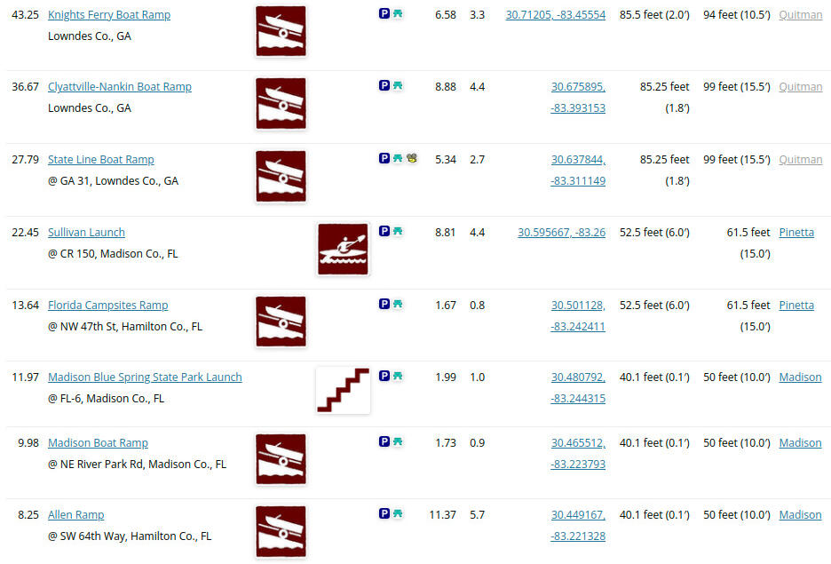

Slide 39
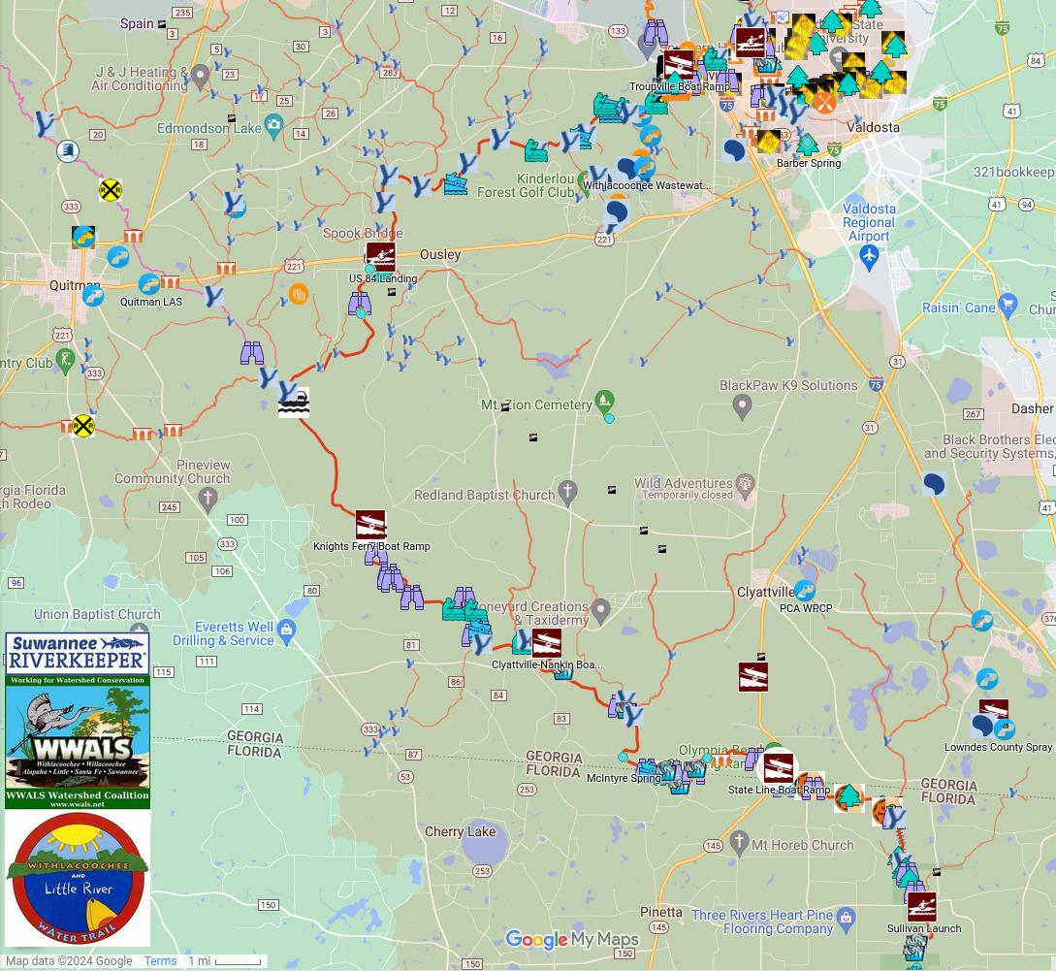

Slide 40
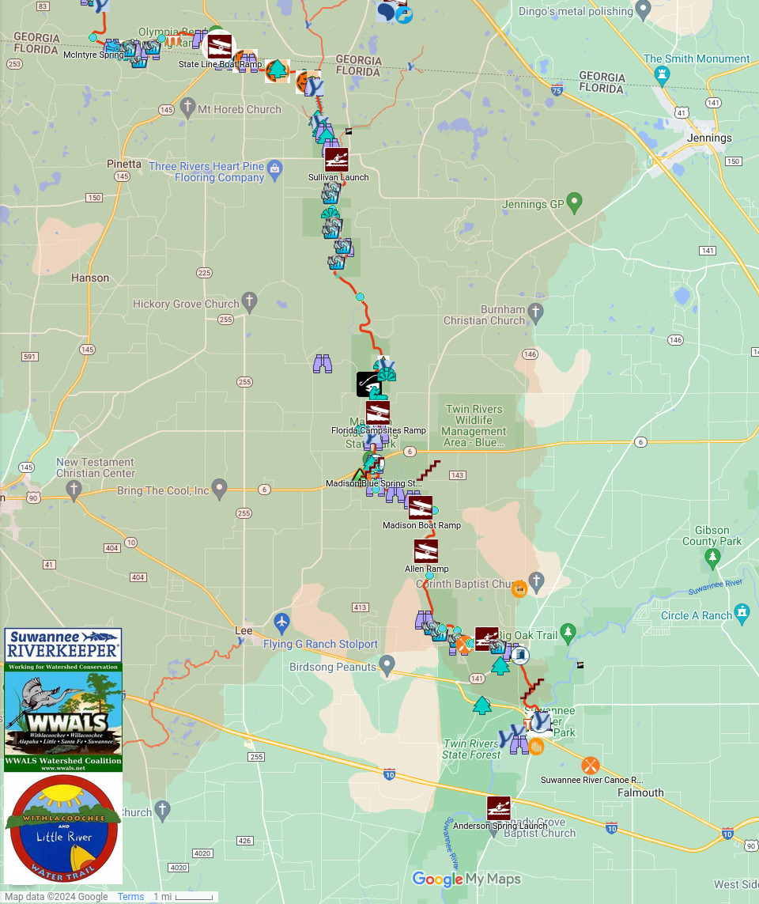

Slide 41
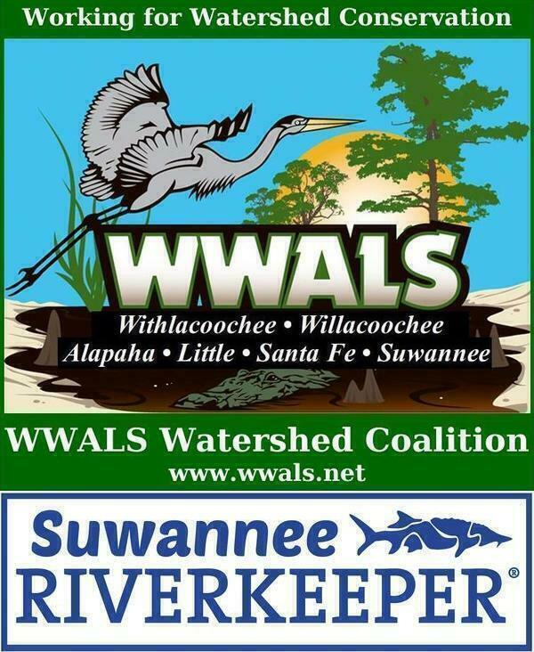
Contact
We’re all ears for suggestions & participation.
wwalswatershed at gmail.com
850-290-2350 or 229-242-0102
WWALS, P.O. Box 88, Hahira, GA 31632
WWALS Webinars:
https://wwals.net/about/wwals-webinars/
Become involved:
https://wwals.net/donations/
Social Media:
https://www.facebook.com/Wwalswatershed
https://www.instagram.com/wwalswatershed/
https://www.youtube.com/channel/UCqxmnH1Qbz9f-BTz0HQ7QaQ
http://www.meetup.com/Withlacoochee-Alapaha-Suwannee-RIvers-WWALS-Outings/

