Slide 1
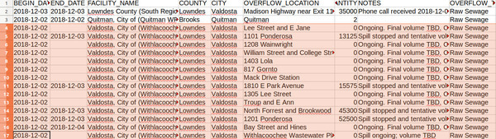
Daily GA-EPD Sewage Spills Reports:
How that happened, What’s in them,
And what to do about them

Slide 2
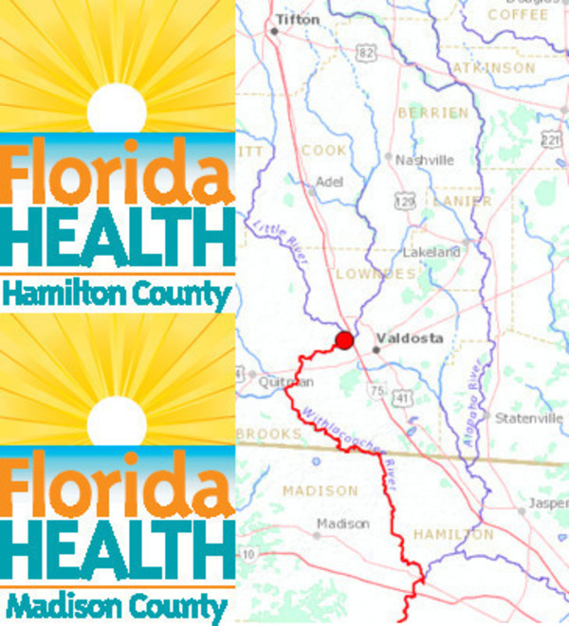
Spills damage
Fishing, Swimming,
Boating, Drinking.
Wastewater permits
require:
Publicity only for >= 10,000 gallons.
Testing only after major spills.
So Florida counties pay
for Georgia spills (testing, economic damage).

Slide 3
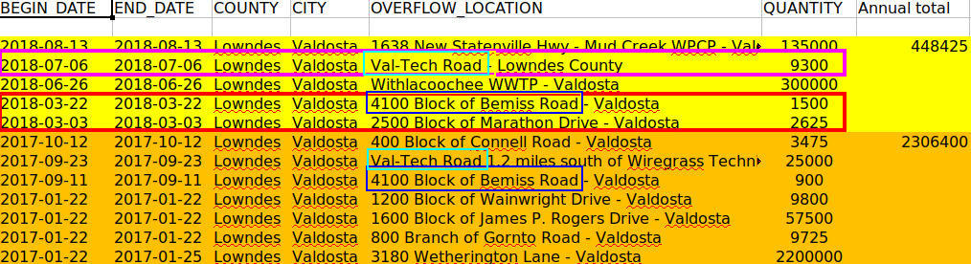
Locals not happy, either.
Valdosta and Lowndes County told EPD,
but not local people, again and again,
millions of gallons, or smaller amounts at many places.

Slide 4
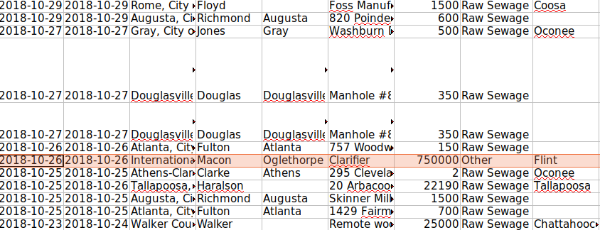
Some October 2018 spills all over Georgia

Slide 5
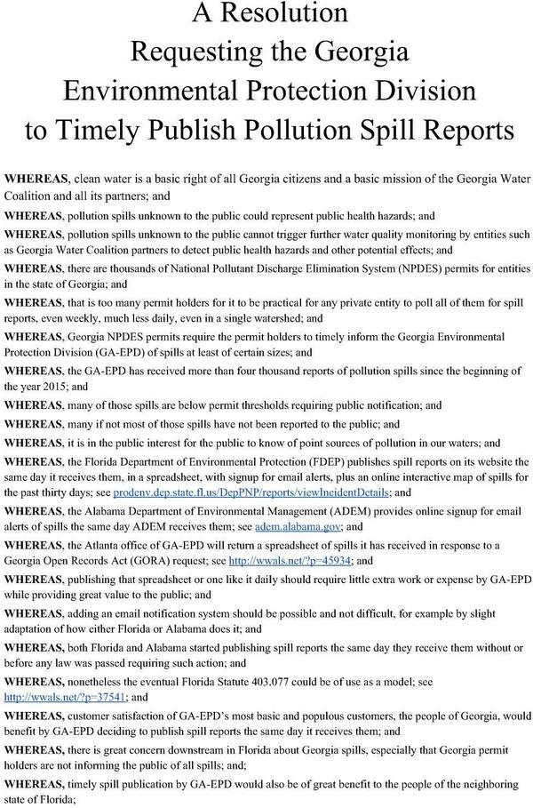
GA-EPD has the spill reports in spreadsheets, so:

Slide 6
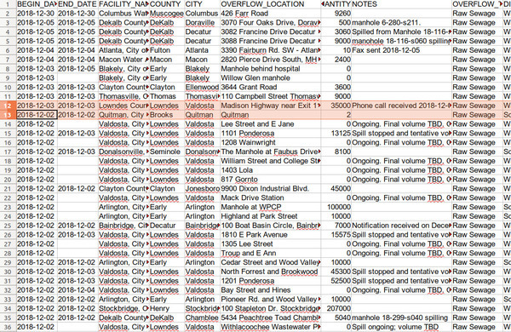
Using GA-EPD spreadsheets, can see that:
More than
two thirds
of all GA spills one week
(2-5 Dec 2018) were Valdosta

Slide 7
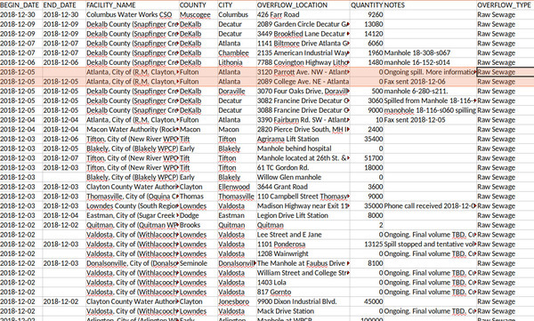
Tifton: 3; more GA spills through 9 Dec 2018,
But many Valdosta spills still not ended

Slide 8
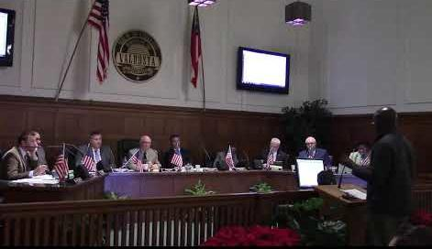
Valdosta City Council >$60 million
Another
$1/2 million for fixes
2018-12-06
Yet spills.
And spills they don’t tell us about.

Slide 9
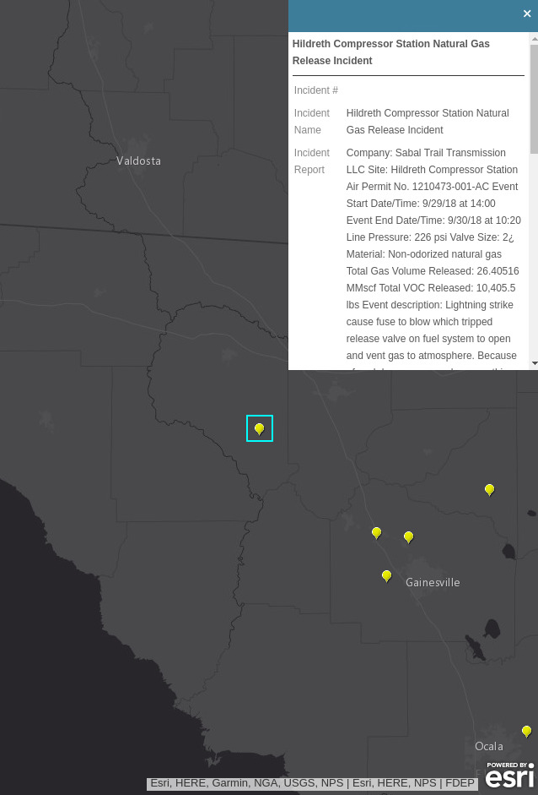
Florida does it
No sewage spills in many months
In the Suwannee River Basin in Florida.
But a Sabal Trail pipeline leak.
We only know about that because of
Florida’s daily Notices of Pollution.
Has Sabal Trail leaked in Albany, GA?

Slide 10
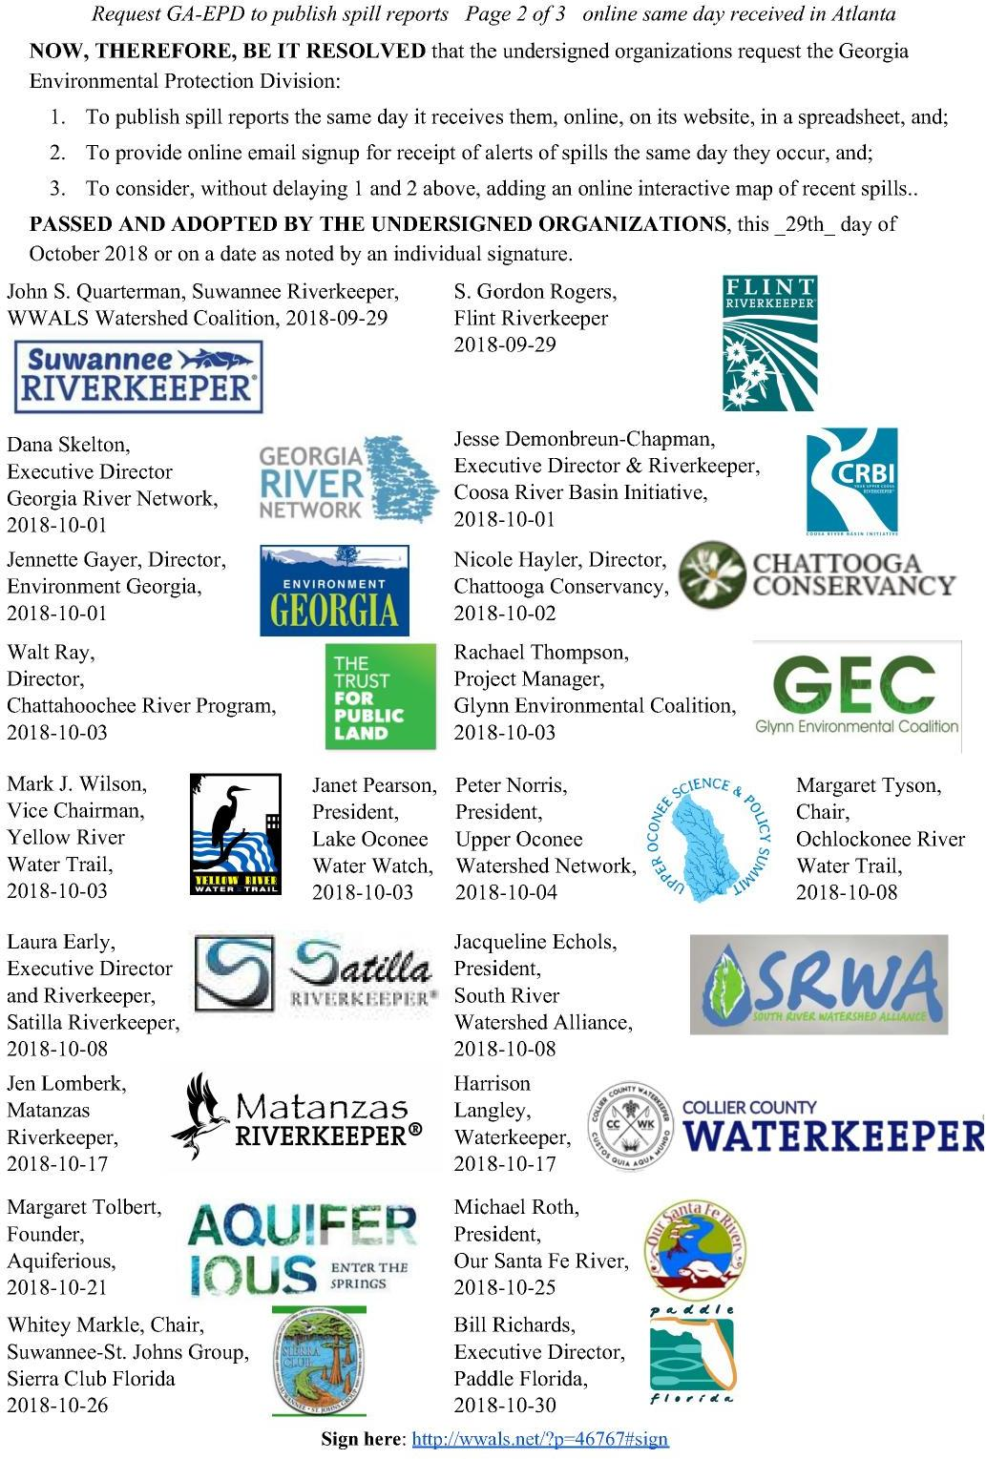
20 groups signed on by Halloween
Sent it to GA-EPD.

Slide 11
GA-EPD did answer on November 2, 2018
John – good idea. We will get to work immediately
on the logistics to see how we can make this happen.
I’ll keep you informed of our progress.
Rick Dunn
EPD
Kept collecting sign-ons.
Even put up a petition for individuals to sign.

Slide 12

Thirty Groups:
Thanks to Georgia Water Coalition (GWC) and Georgia River Network (GRN) for helping get signers, especially Flint Riverkeeper Gordon Rogers, to Dana Skelton of GRN, to Satilla Riverkeeper Laura Early, to Matanzas Riverkeeper Jen Lomberk, to Collier County Waterkeeper Harrison Langley, to Aquiferious Founder Margaret Tolbert, to Our Santa Fe River President Michael Roth, to SSJG Sierra Club Chair Whitey Markle, to Paddle Florida Executive Director Bill Richards, to April Lipscomb of SELC, to Jennette Gayer of Environment Georgia, and to Mike Worley of Georgia Wildlife Federation for mentioning the idea to Dick Dunn before we even sent him the resolution.

Slide 13
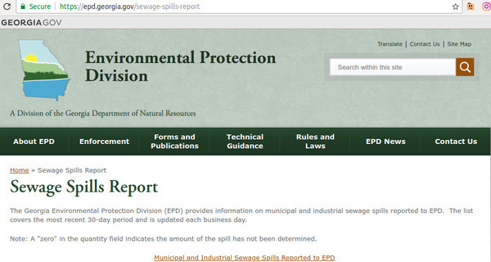
Surprise!
Starting
December 20, 2018

Slide 14
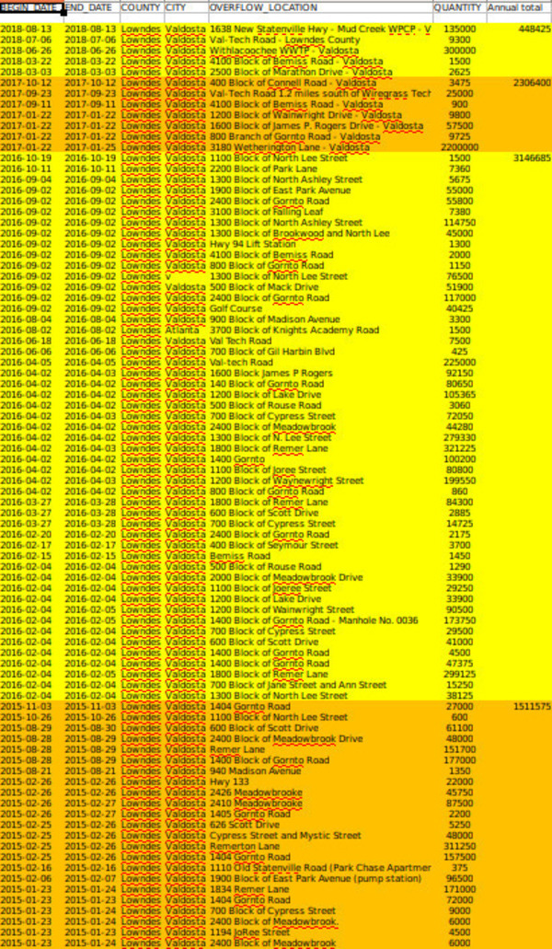
I asked Valdosta
for this list for years
FInally got it from GA-EPD.
Things are getting better.
But we never would have known
Without this EPD data.
And still there are spills.
Some Valdosta and Lowndes County
did not tell us about….
wwals.net/issues/vww/ga-spills

Slide 15
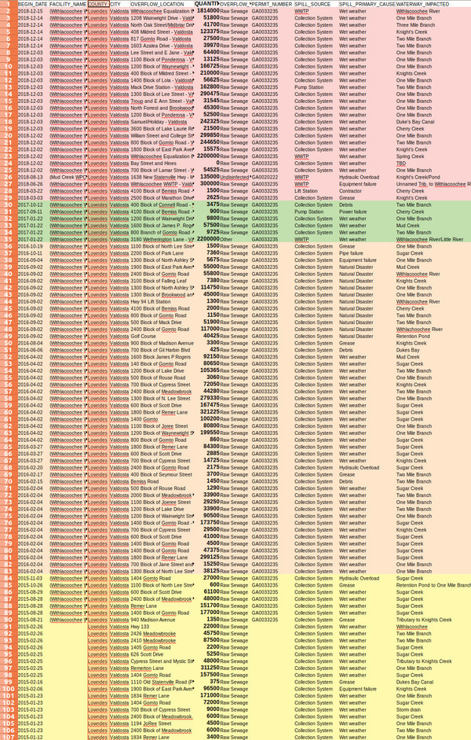
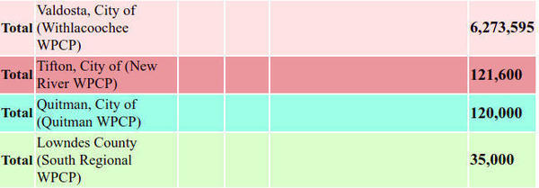
Actually, not better:
Valdosta spilled more in
December 2018 than
In all of 2017.
And we never would have known
without the GA-EPD data

Slide 16
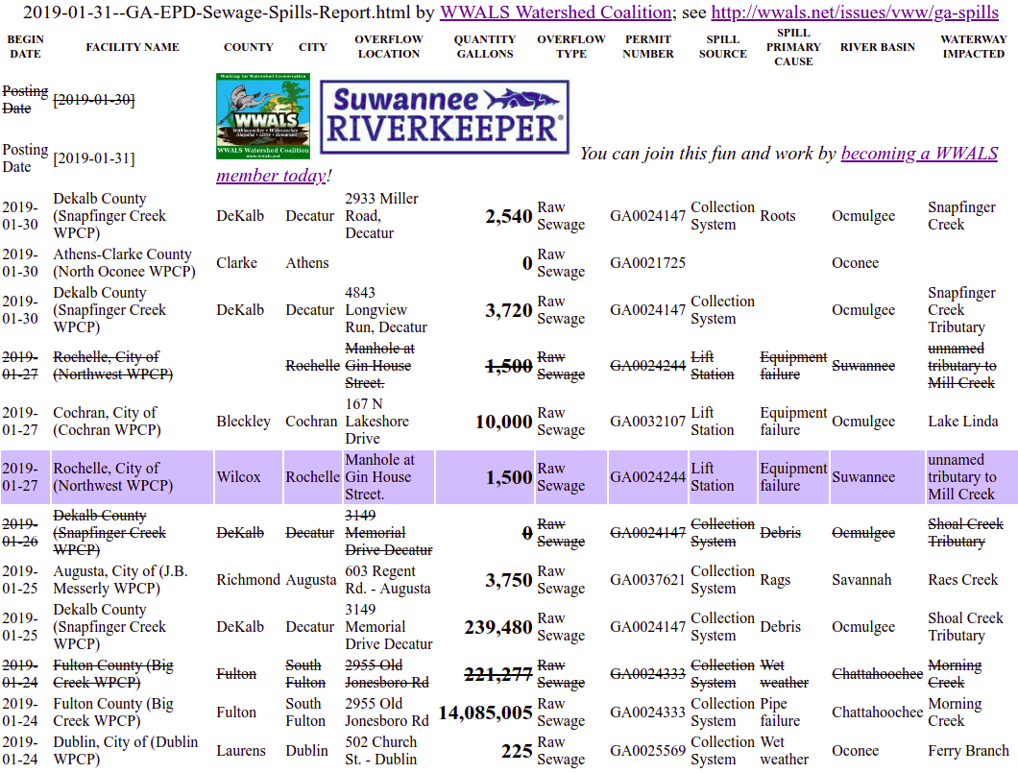
Daily differences, automated by WWALS
Highlighting new spills and updates on old ones.
wwals.net/issues/vww/ga-spills

Slide 17
How do we
Get GA-EPD to fine offenders?
Get spillers to fix their infrastructure?
Find how far spills went downstream?
Or underground into wells?
How do we get spillers to do water quality testing
Or to find others doing it?

Slide 18
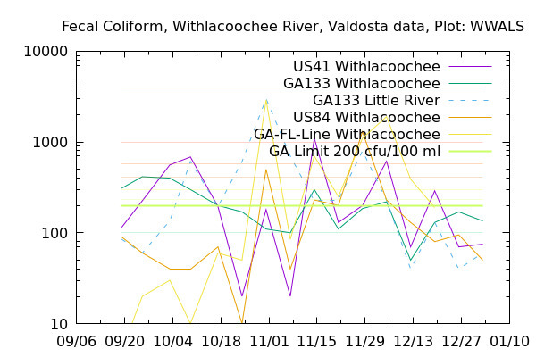
Not just spills.
E. Coli and
Fecal coliform
Spike
Other times,
Other places.
Wildlife?
Cows? Horses?
Cats and dogs?
Septic tanks?
More testing can find out
So we can find fixes.

Slide 19
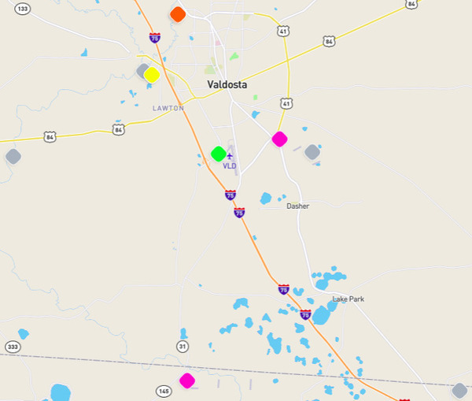
Valdosta test stations
Need verification. Gaps need covering.
Valdosta reducing from weekly to monthly.
WWALS water quality testing program. wwals.net/vww/testing
Shouldn’t permit holders and states be doing this?

Slide 20
PFAS and PFOS (firefighting chemicals)
spilled from Air Force Bases, carpet factories, ….
AF Bases say fishing was affected.
Their own water wells are deep and fine, but they didn’t test private wells.
An AJC story went AP and nationwide: http://wwals.net/?p=47812
Private wells closed by PFAS in Florida and Pennsylvania.
Michigan and North Carolina have allocated funds and set limits.
What should Georgia do?

Slide 21
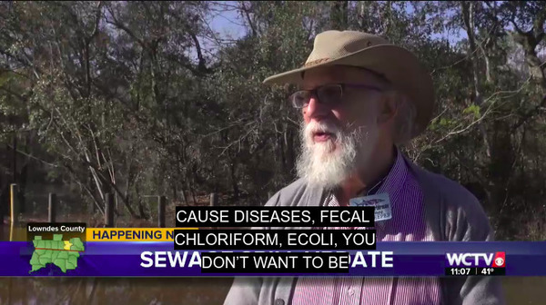
We all do what we can
But everything depends on water: shouldn’t states be doing more?

Slide 22


Contact:
John S. Quarterman
Suwannee Riverkeeper®
contact@suwanneeriverkeeper.org
229-242-0102
WWALS Watershed Coalition, Inc. (WWALS)
www.wwals.net
wwalswatershed@gmail.com
850-290-2350
PO Box 88, Hahira, GA 31632

