Slide 1
WWALS Webinar
January 11, 2024
Brooks County Georgia Settlers,
Little River, Okapilco Creek,
Juneteenth, and
Quitman Sewer Problems
Fannie Marie Jackson Gibbs

Slide 2
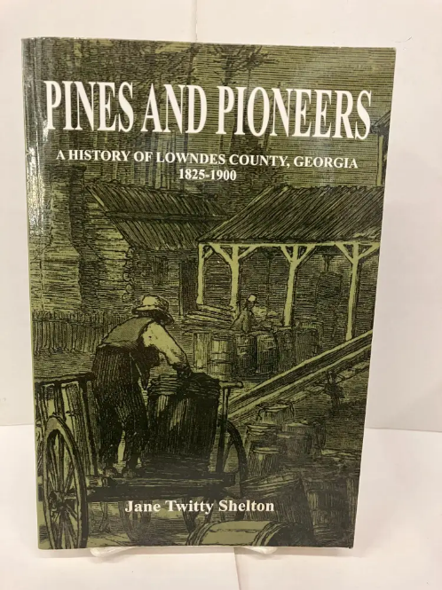
Ancestors Entrance
Around 1818-1825 with the Early Settlers Sion Hall, Hamilton W. Sharp, Nathan Gornto, and Pliney Sheffield

Slide 3
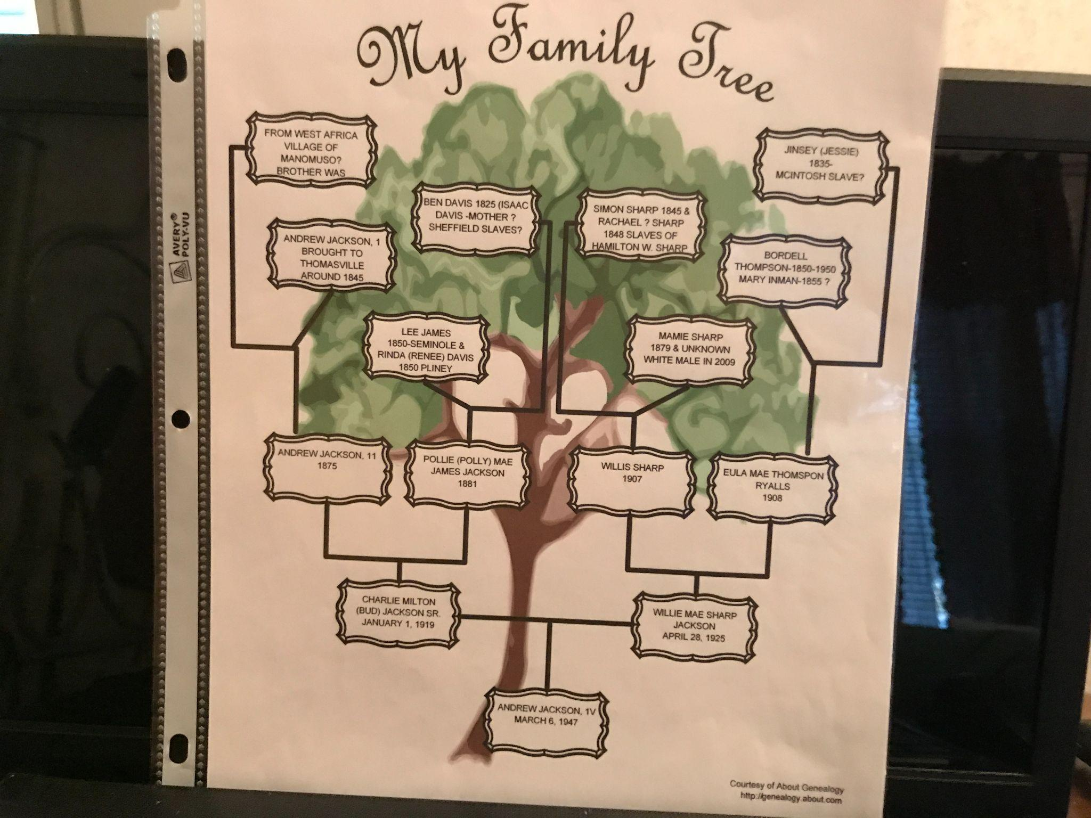
Fannie Lineage

Slide 4
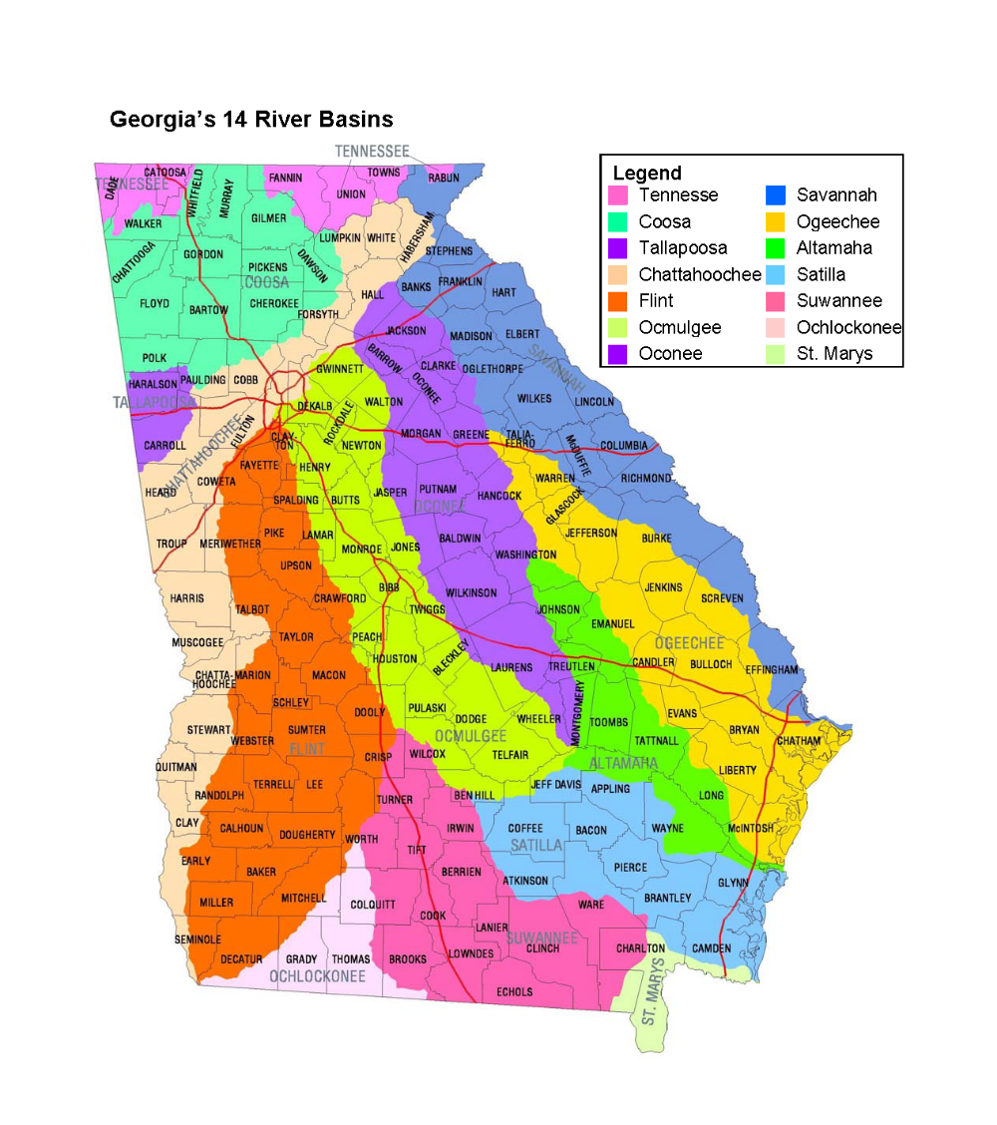

Slide 5
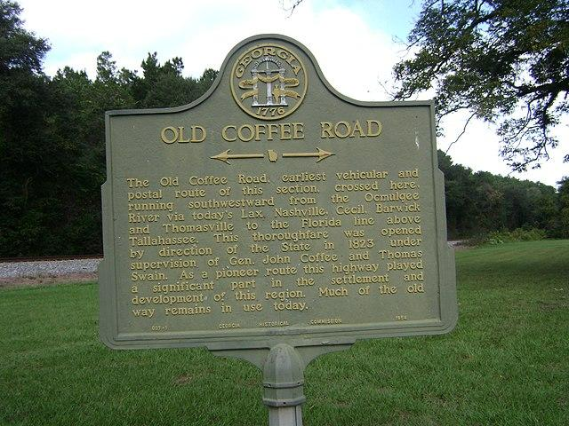
Establishing Coffee Road
The Old Coffee Road, earliest vehicular and postal route of this section, running southwestward from the Ocmulgee River to the Florida Line, passed through today’s Lax, Nashville, Cecil, Barwick and Thomasville. The thoroughfare was opened by direction of the State in 1823 under supervision of Gen. John Coffee and Thomas Swain. Over this pioneer route the products of the region were carried to the coast to be sold and imported goods brought back. Sections of the original route are in use today.

Slide 6
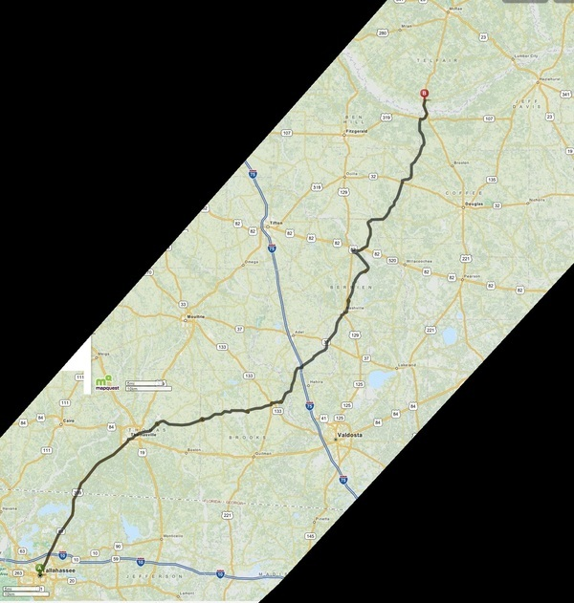
Old Coffee Road
Ray City History Blog

Slide 7
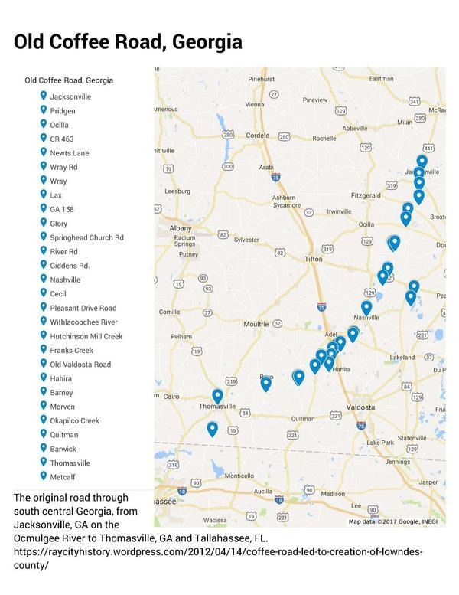

Slide 8
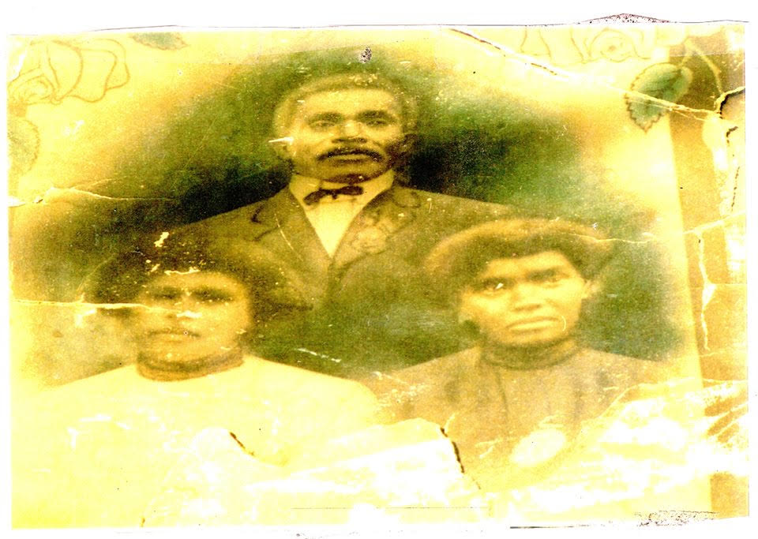
Civil War history
Andrew 1 and daughters

Slide 9
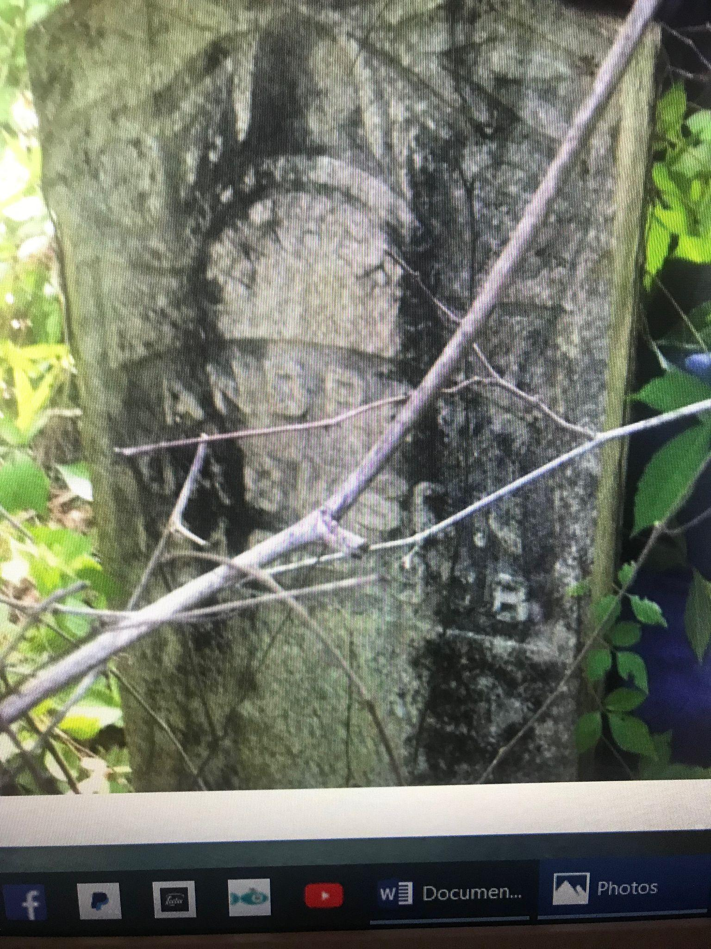
Andrew Jackson tombstone

Slide 10
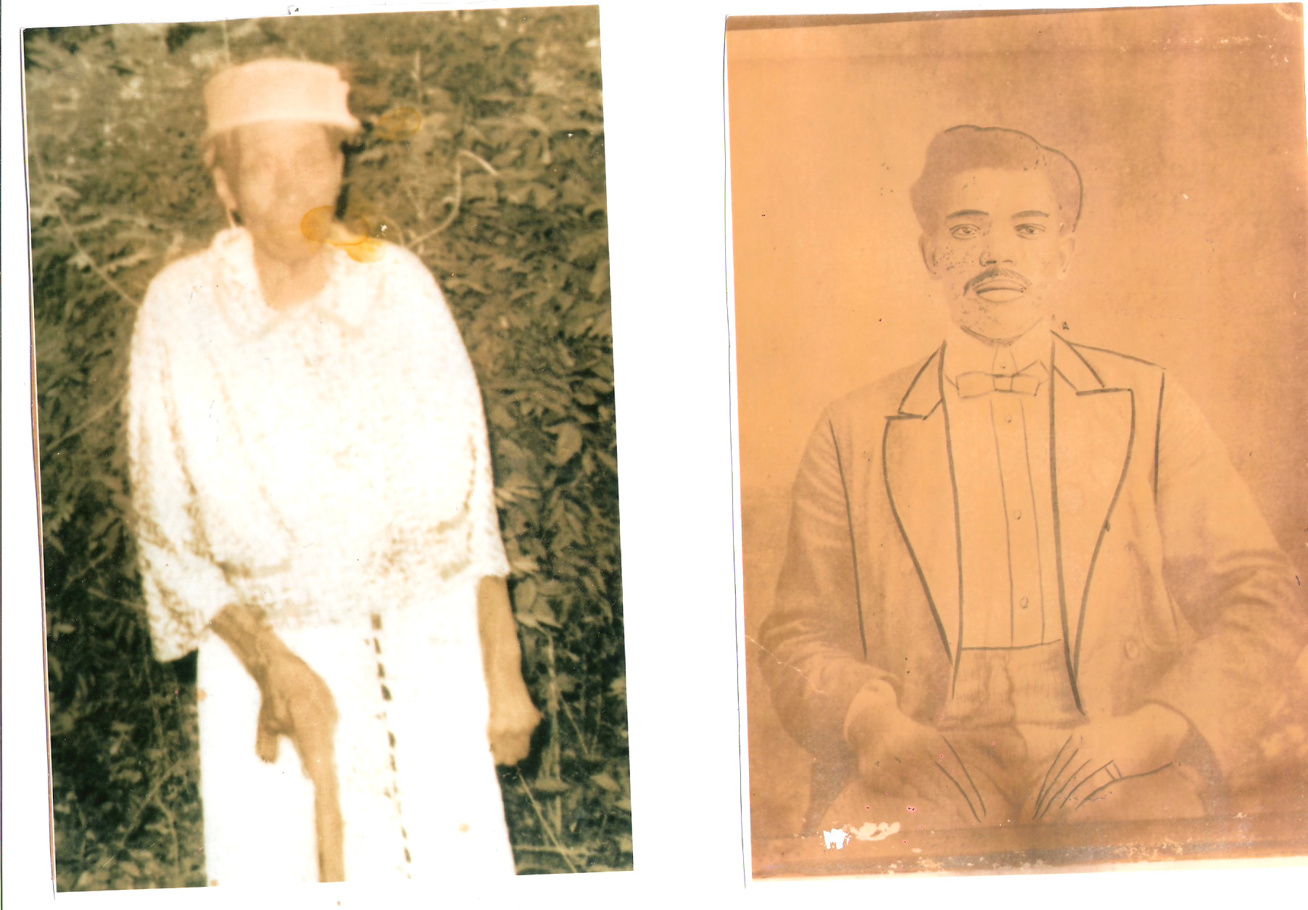
Grandma and Andrew

Slide 11
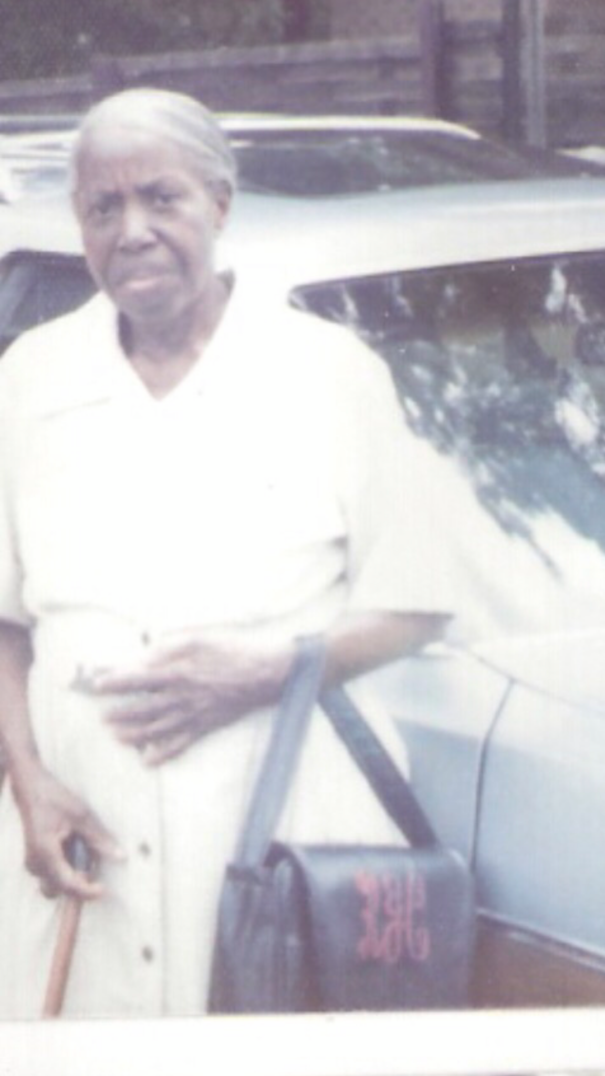
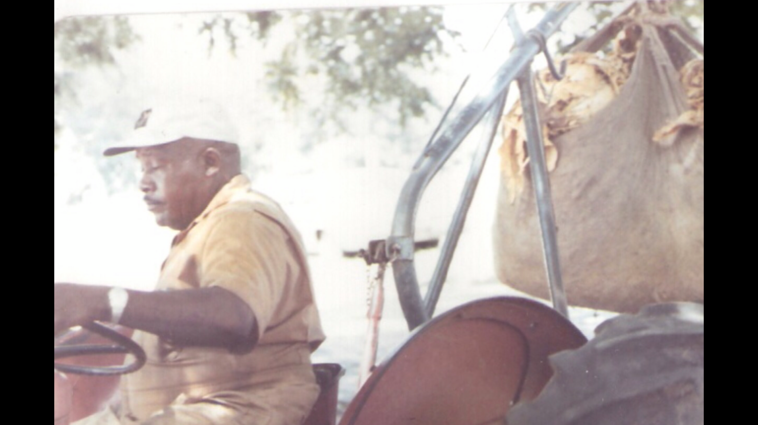
Ben Davis and Aunt Rinda

Slide 12
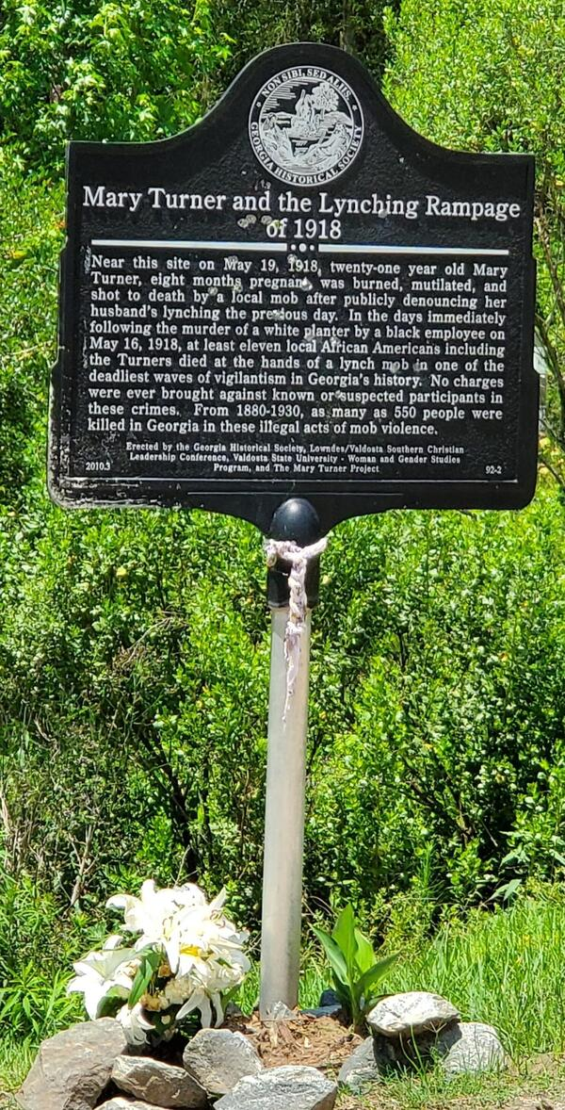
Mary Turner and The Little River
Mary Turner and the Lynching Rampage of 1918
Near this site on May 19, 1918, twenty-one year old Mary Turner, eight months pregnant, was burned, mutilated, and shot to death by a local mob after publicly denouncing her husband’s lynching the previous day. In the days immediately following the murder of a white planter by a black employee on May 16, 1918, at least eleven African Americans including the Turners died at the hands of a lynch meb dn one of the deadliest waves of vigilantism in Georgia’s history. No charges were ever brought against known or suspected participants in these crimes, From 1880-1930, as many as 550 people were killed in Georgia in these illegal acts of mob violence.
Erected by the Georgia Historical Soclety, Lowndes/Valdosta Southern Christian Leadership Conference, Valdosta State University - Woman and Gender Studies Program, and The Mary Turner Project

Slide 13
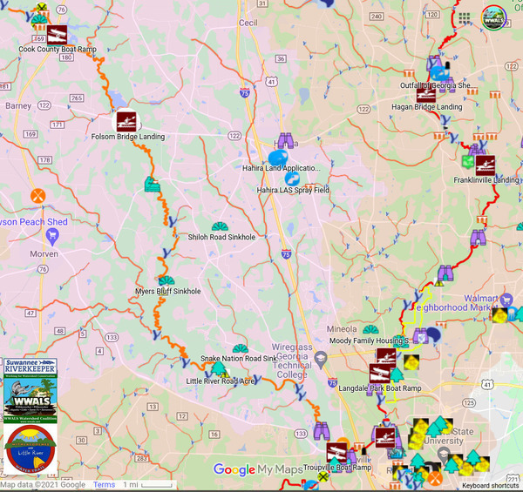

Slide 14
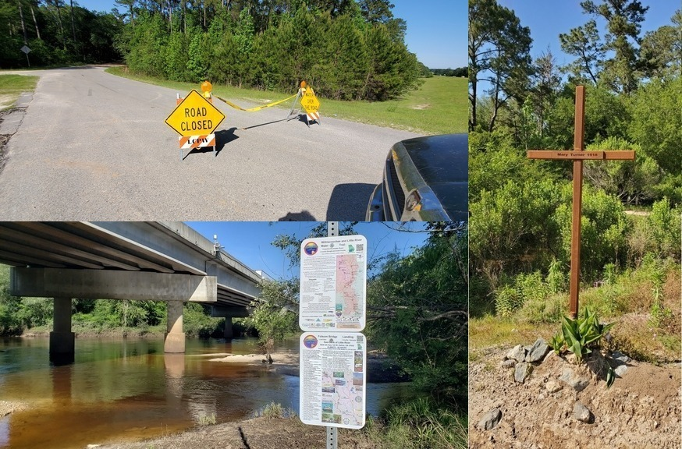

Slide 15
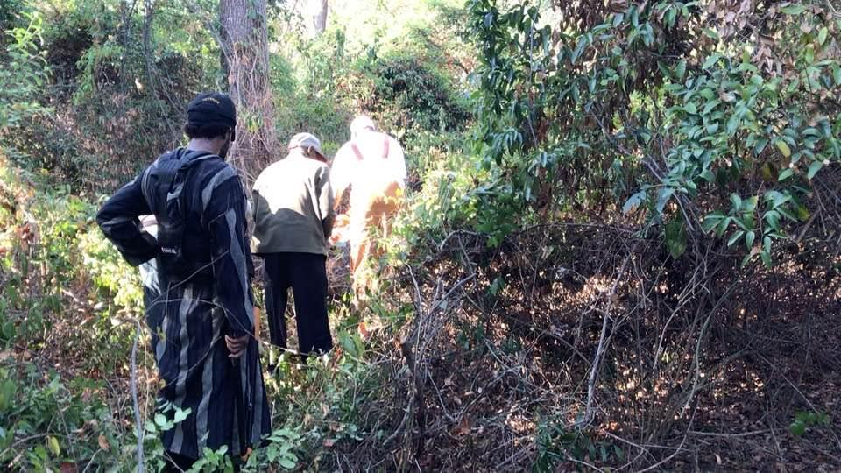
Macedonia Cemeteries
Dre and Hope

Slide 16
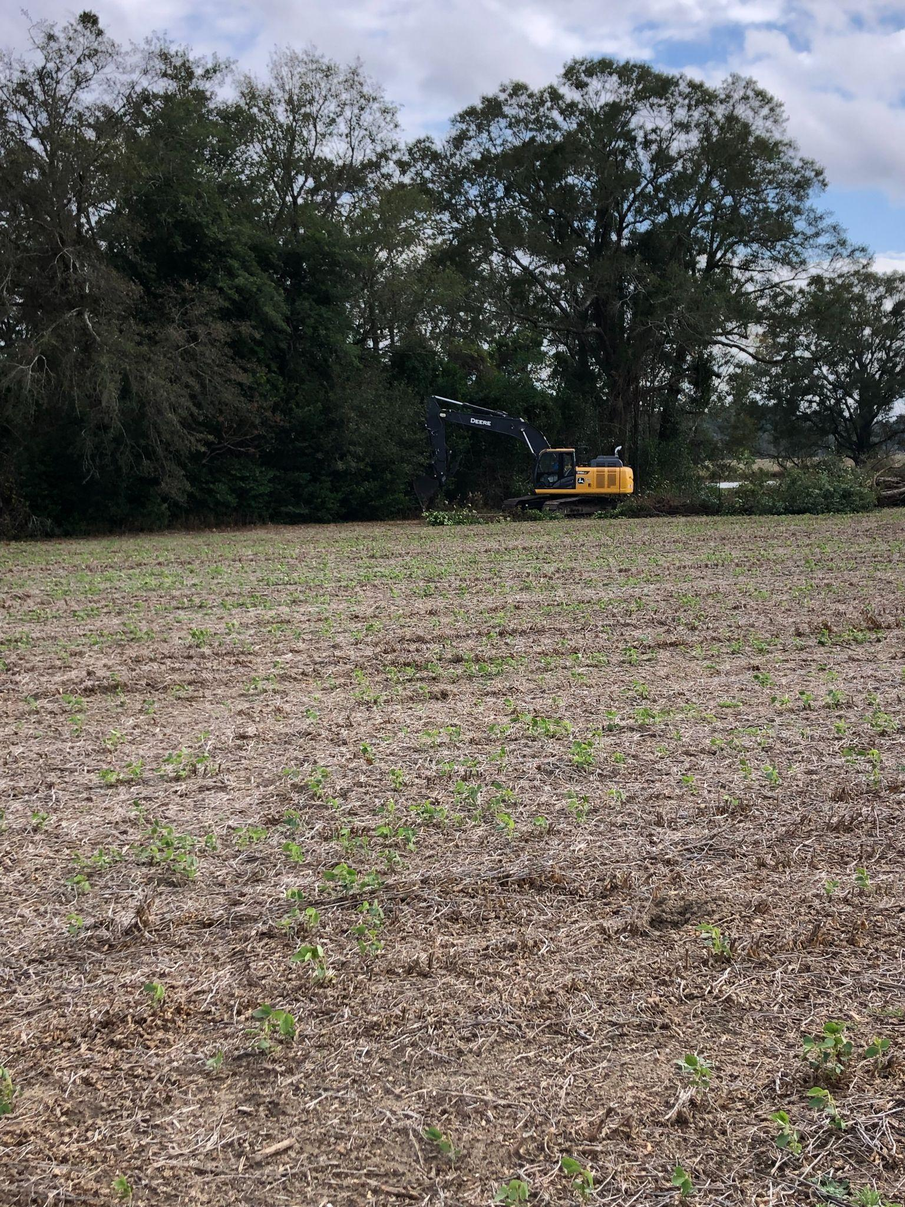
Backhoe at Old Macedonia Cemetery
November 13
2023

Slide 17
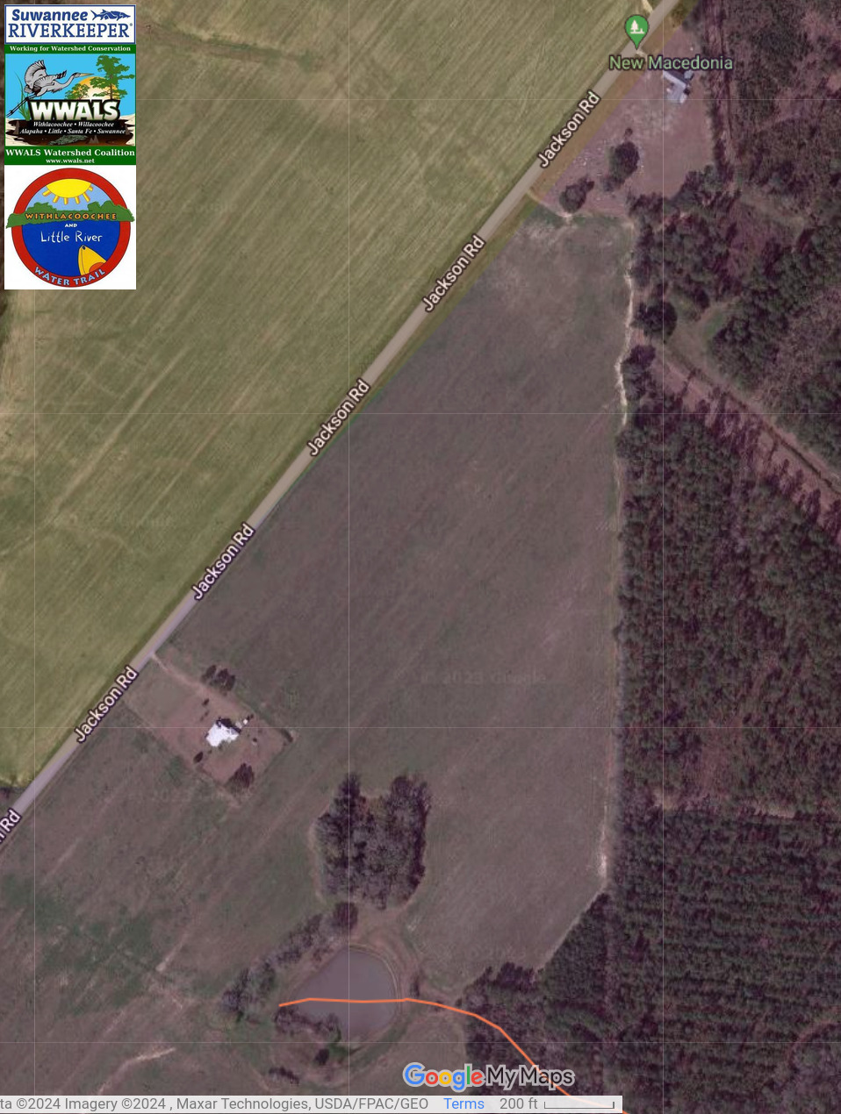
Map: Macedonia Cemeteries
Notes:
https://www.google.com/maps/d/u/0/viewer?mid=1n4Q4zSxir_T8o4kdkOCRxeCeOrA&ll=30.88238107906181%2C-83.55255240069731&z=17

Slide 18
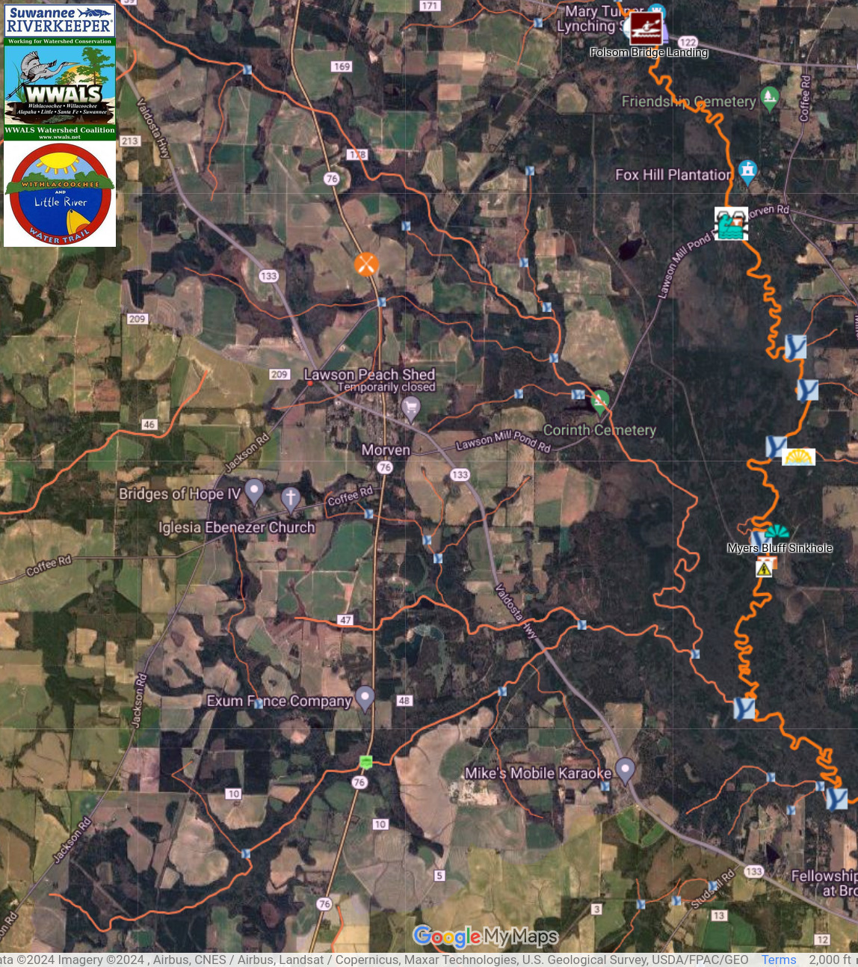
Macedonia Cemeteries and Little River
Notes:
https://www.google.com/maps/d/u/0/viewer?mid=1n4Q4zSxir_T8o4kdkOCRxeCeOrA&ll=30.936769597668192%2C-83.48281086631583&z=13

Slide 19
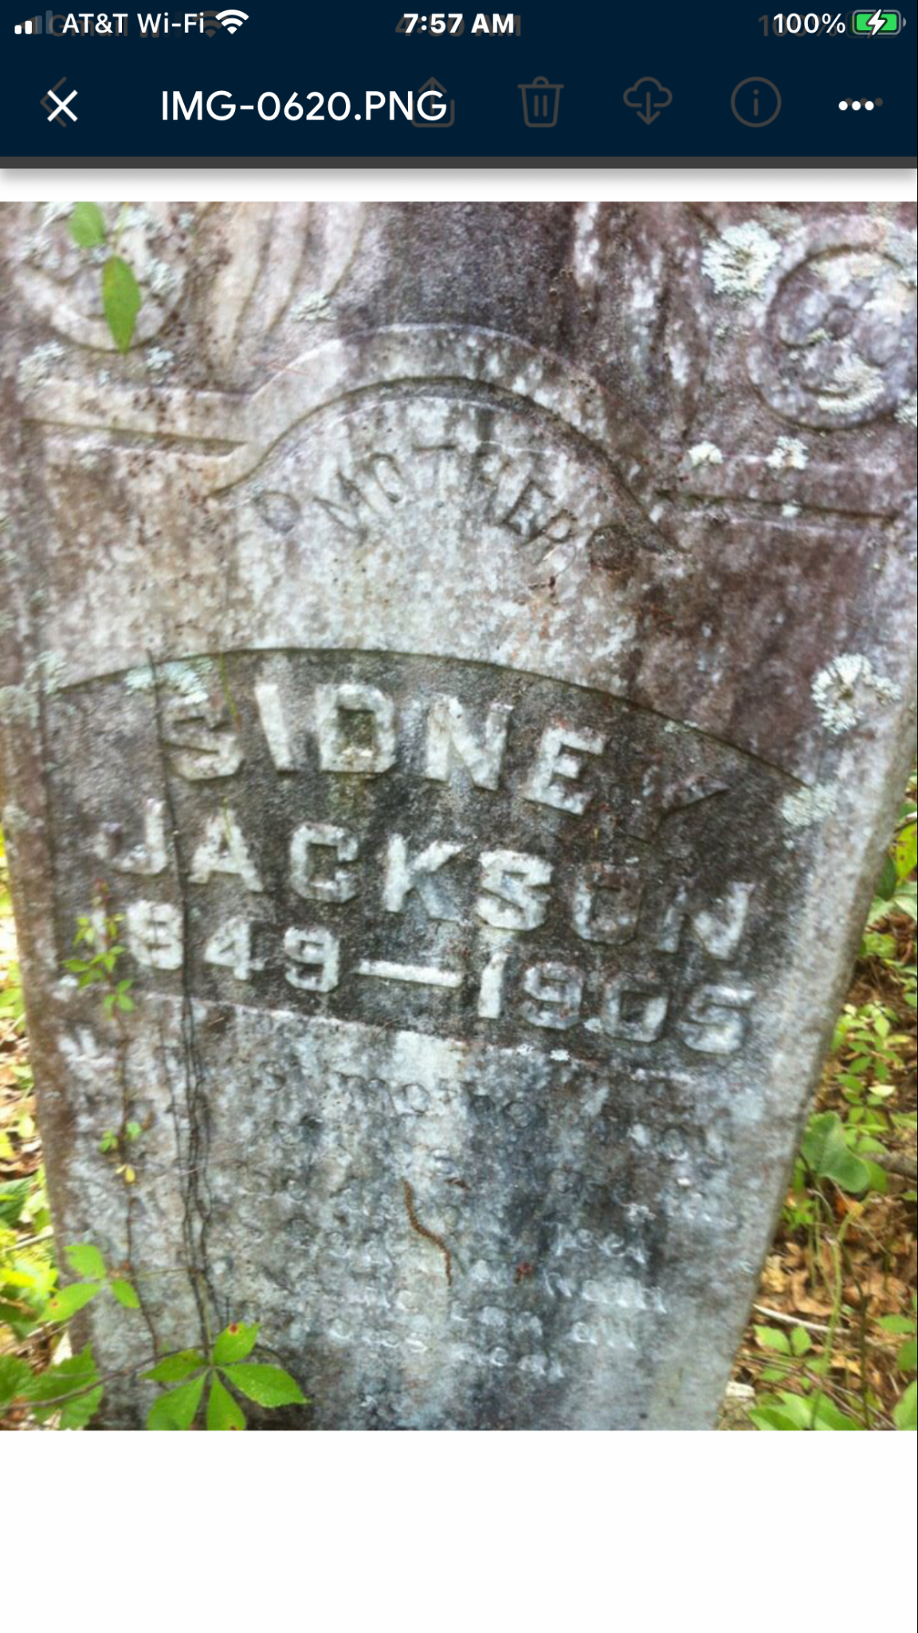
Sidney Jackson 1849-1905

Slide 20
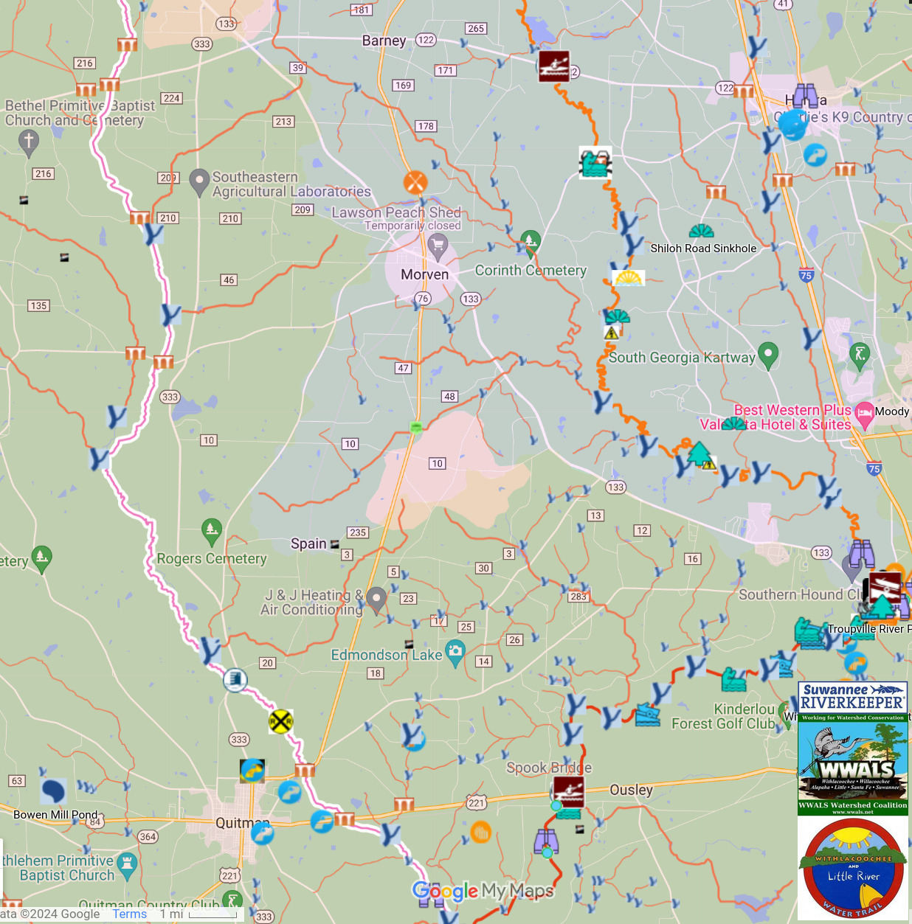
Following Okapilco Creek
Where Osby ran away
from the Brooks County Courthouse
to escape the KKK pursuit in 1966.
Notes:
https://www.google.com/maps/d/u/0/viewer?mid=1n4Q4zSxir_T8o4kdkOCRxeCeOrA&ll=30.893006640541135%2C-83.47981401580648&z=12

Slide 21
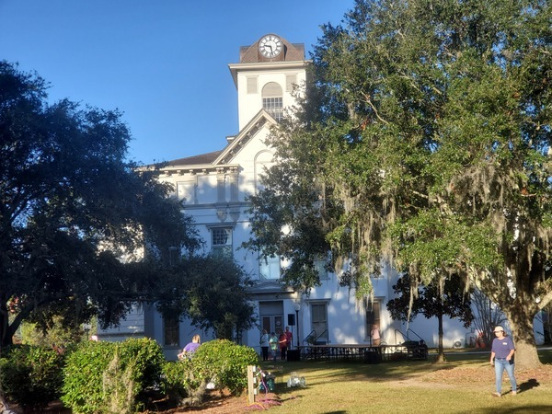
Juneteenth at the Brooks County Courthouse
in 2010

Slide 22
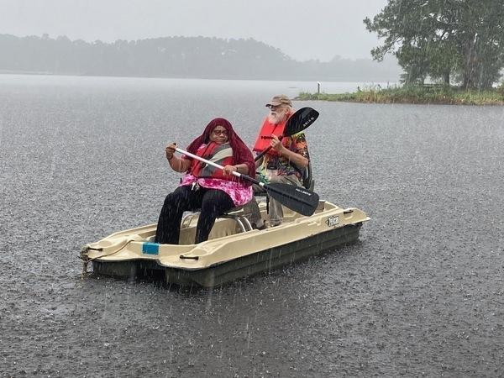
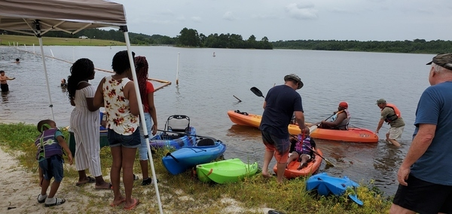
Juneteenth and WWALS at Reed Bingham State Park

Slide 23
Juneteenth 2024
South Georgia Juneteenth June 19-23, 2024
Healing Waters for Regenerative Living
Come see our South. Come for a day. A week. A year. Life. Come see our Historic Churches and Cemeteries and Buildings and Rivers and Trails and Family and Friends. Take your shoes off. Set a spell. Sip some refreshing spring water from many of our pristine founts of life. Tours. Boating. Fishing. Swimming. (229) 548-9462 cell or fmjgibbs@gmail.com.

Slide 24
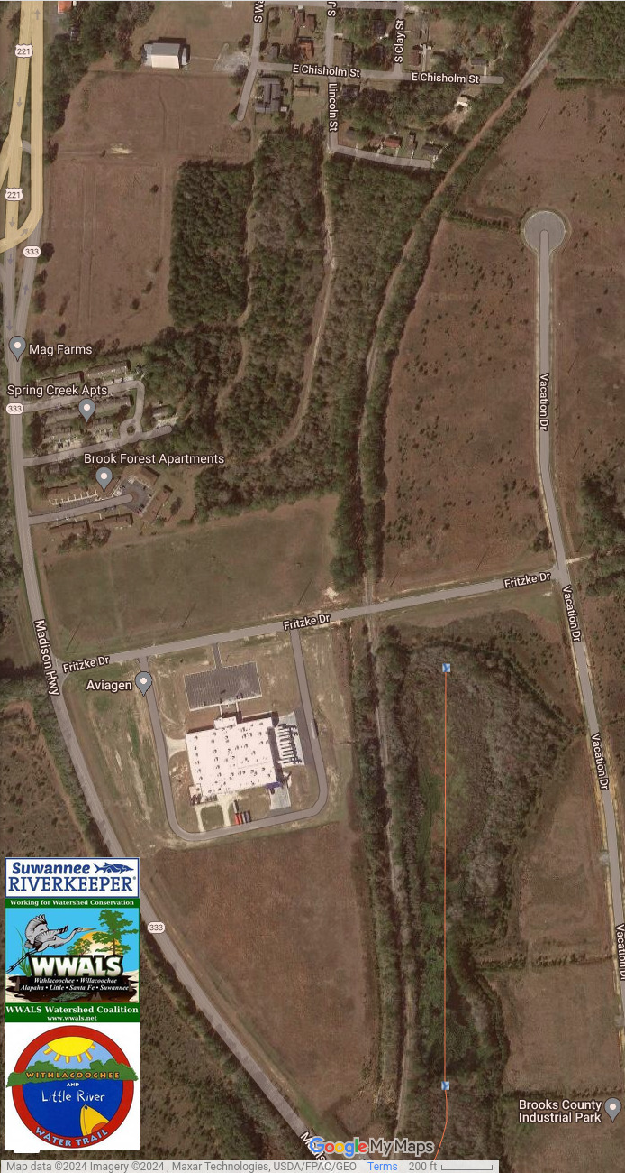
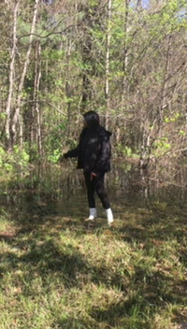
Quitman water and sewer problems

Slide 25
Next WWALS Webinar
February 8, 2024
wwals.net
wwalswatershed@gmail.com
facebook.com/Wwalswatershed
850-290-2350
WWALS Watershed Coalition
P.O. Box 88, Hahira, GA 31632

