Slide 1


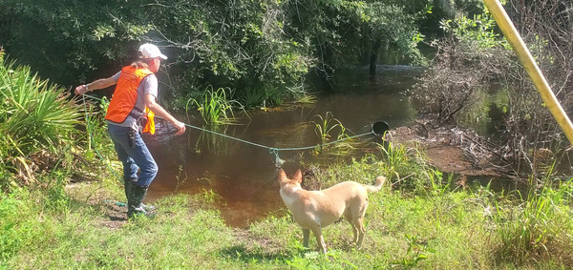
Fix Waterway Contamination
VSU & WWALS
SFY2024 Regional Water Plan Seed Grants
Notes:
https://wwals.net/issues/testing/ https://www.wwals.net/pictures/2023-06-25--wq-franklinville-withlacoochee-river/reeling-in.html

Slide 2
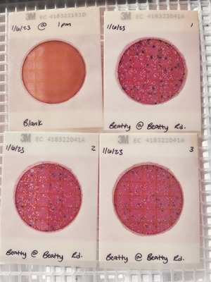
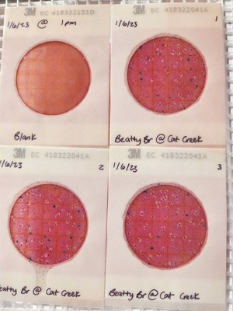
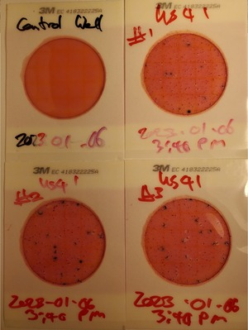
Project Goal
Determine what is contaminating the Withlacoochee River upstream from Valdosta, so we can get it fixed. (W3,333, W1,266, W1,200, 2023-01-06)
Notes:
https://wwals.net/2023/01/07/bad-creeks-and-withlacoochee-river-2023-01-06/

Slide 3
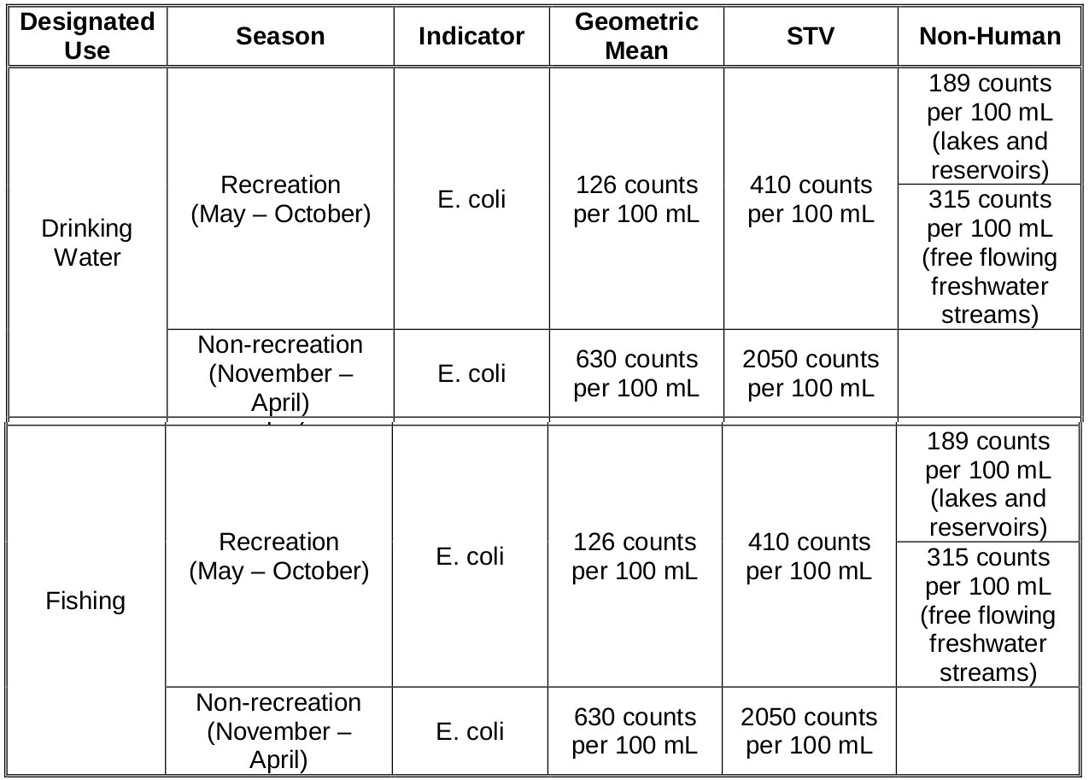
Meaning of the numbers
Preferred: less than 126
Bad single test: 410
Alert level: 1,000
Note shift to E. coli
from Fecal coliform.
Also, we have no non-recreation season in south Georgia.
Adapted from: GA-EPD
Bacteria Criteria for Drinking Water
and Fishing Designated Uses
Technical Support Document
for the Proposed Criteria
to Protect Secondary Recreators
Elizabeth A. Booth, Ph.D., P.E.
and Victoria A. Adams 8/30/2018
Page 11, Table 3-1.
Proposed Bacteria Criteria
Notes:
https://epd.georgia.gov/document/publication/tsd-bacteria-criteria-finalpdf

Slide 4
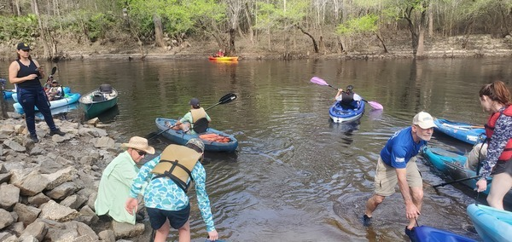
Nobody wants to fish, swim, or boat in water with fecal contamination.
Valdosta, Lowndes, Berrien, Lanier Counties, others, promoting Eco-Tourism
Mayor and Chairman’s Paddle in affected stretch of the Withlacoochee River
Notes:
https://wwals.net/2023/03/07/pictures-mayor-and-chairmans-paddle-2023-03-04/

Slide 5
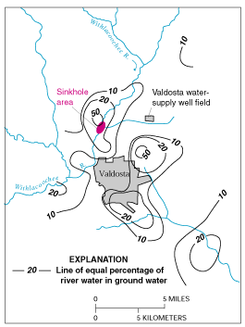
Nobody wants their well contaminated
by river water leaching through the soil.
Shadrick Sink west of the Withlacoochee River leaks river water east under the river for miles.
Valdosta sunk its wells deeper to get under the river water, avoiding expensive treatment.
In Sustainability of Ground-water Resources,
by William M. Alley Thomas E. Reilly O. Lehn Franke, 1 January 1999,
U.S. Department of the Interior, U.S. Geological Survey – Publisher,
http://pubs.usgs.gov/circ/circ1186/ in Box E on Page 63 ,
The Connection Between Surface-Water Quality
and Ground-Water Quality in a Karst Aquifer
Figure E-1. Estimated percentage of Withlacoochee River water
in ground water in the Upper Floridan aquifer, June 1991.
(Modified from Plummer and others, 1998.)

Slide 6
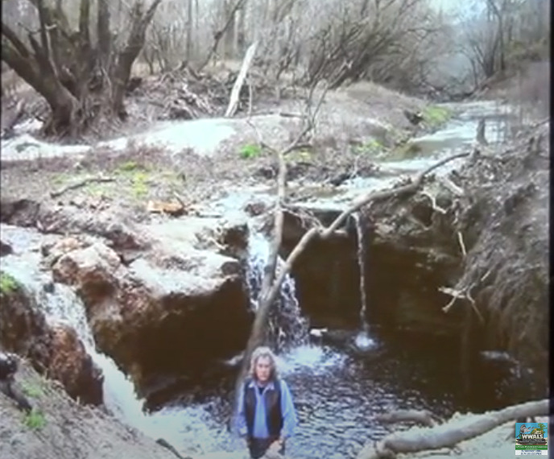
Cherry Creek Sink
Opened up in a few months in 2013 in the Withlacoochee River, just below Cherry Creek, near Shadrick Sink.
Pictured: Prof. Can Denizman standing in Cherry Creek Sink in a presentation by VSU Prof. Don Thieme for WWALS.
Notes:
https://youtu.be/MFrO6Mt10EE?si=fWwPXniEu0cdcDcJ&t=184

Slide 7
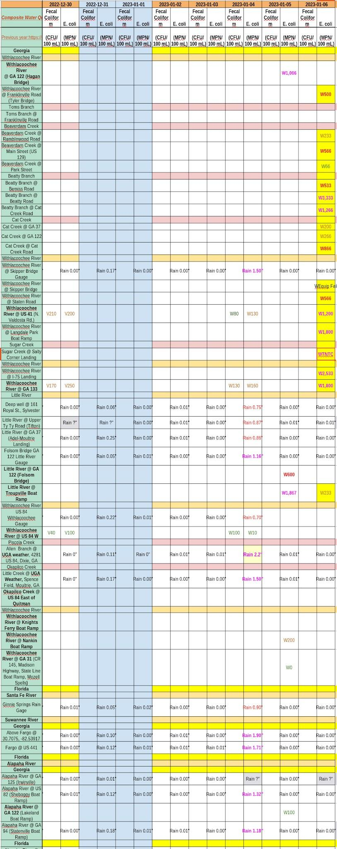
Current Practice
WWALS currently uses its own Thursday test results (usually corroborated later by Valdosta’s Friday test results) to warn people in a Friday water quality report before the weekend.
Notes:
https://wwals.net/2022/11/15/creeks-bad-ok-river-water-quality-2022-11-13/

Slide 8
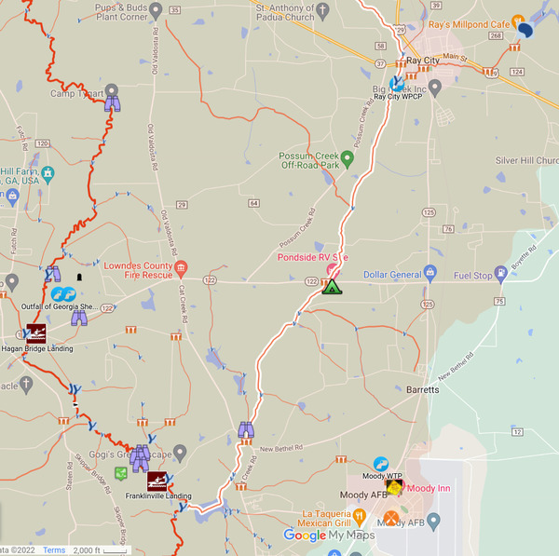
Fixing the problem(s) will be a better solution.
To fix problems, we have to test more to find the sources of contamination so we can address them.
Notes:
https://wwals.net/2022/11/15/creeks-bad-ok-river-water-quality-2022-11-13/

Slide 9
Suwannee-Satilla Regional Water Planning Council
Vision
“support the state’s and region’s economy,
to protect public health and natural resources,
and to enhance the quality of life for all citizens;
while preserving the private property rights of Georgia’s landowners,
and in consideration of the need to enhance resource augmentation
and efficiency opportunities.”

Slide 10
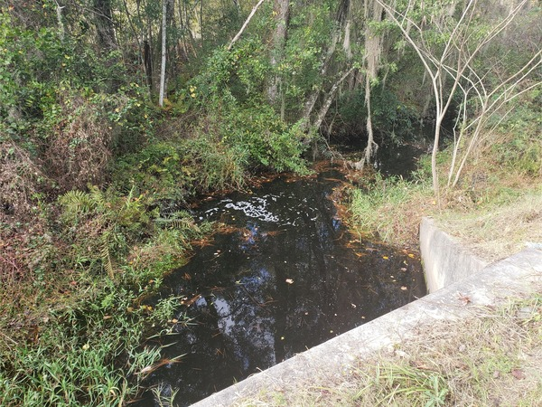
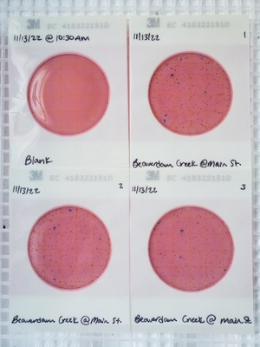
Beaverdam Creek
Thus far the problem
probably isn’t Ray City WTP:
contamination upstream.
533
Notes:
533 cfu/100 mL, Beaverdam Street @ Main Street https://wwals.net/2022/11/15/creeks-bad-ok-river-water-quality-2022-11-13/

Slide 11
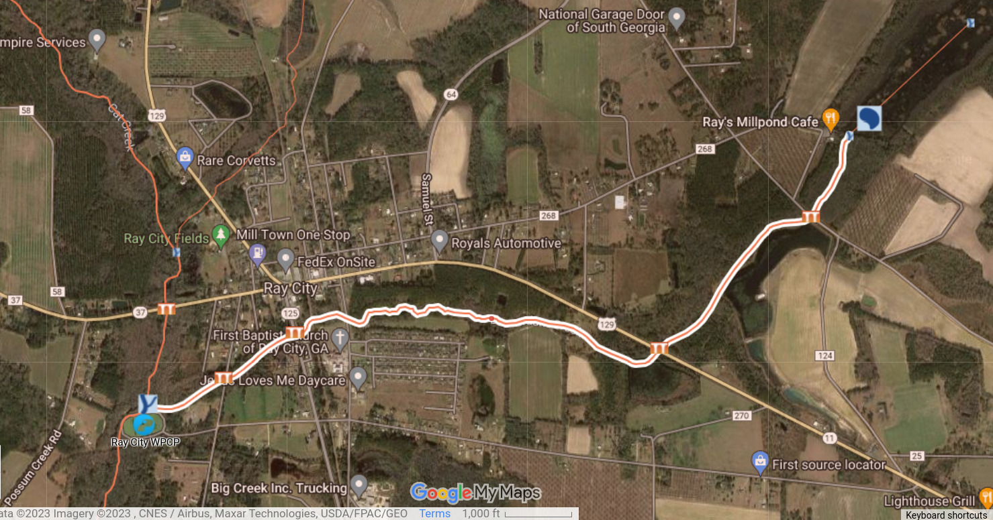
Where and What on Beaverdam Creek?
Notes:
https://www.google.com/maps/d/u/0/viewer?mid=1n4Q4zSxir_T8o4kdkOCRxeCeOrA&ll=31.0826266789567%2C-83.1908265529175&z=15

Slide 12
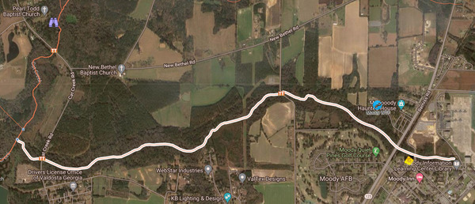
Beatty Branch
We see contamination in Beatty Branch below the WWTP.
But why also upstream at Bemiss Road? Moody AFB also wants to know.
Notes:
https://wwals.net/2022/07/15/withlacoochee-river-ok-cat-creek-bad-2022-07-14/

Slide 13
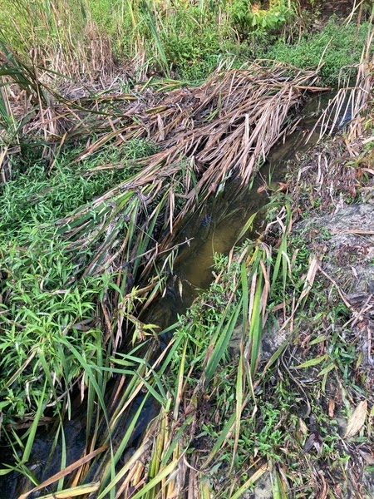
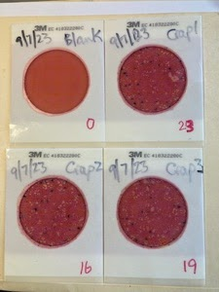
Also the Alapaha River near US 82
At the outflow creek from the Alapaha, GA, WWTP,
Heather Brasell got too-high 1,900 E. coli.
2023-09-07
Notes:
https://wwals.net/2023/09/08/filthy-upstream-withlacoochee-clean-downstream-and-little-and-alapaha-rivers-2023-09-07/

Slide 14
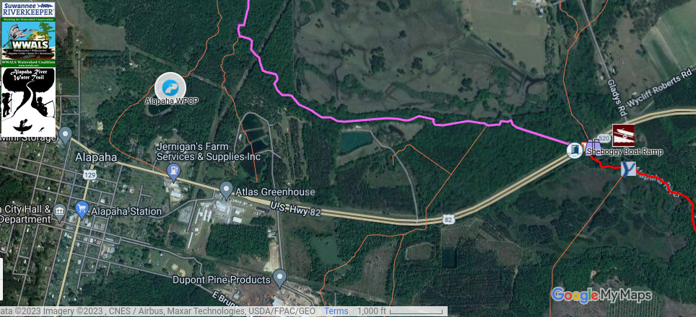
Alapaha WPCP, Alapaha River, Sheboggy Boat Ramp

Slide 15
Possible Sources
Only further testing can determine:
Wastewater treatment plants, leaky sewer lines
Septic tanks
Wildlife (deer, wild hogs, geese, etc.)
Domestic pets (cats, dogs, chickens)
Agricultural
  Cattle
  Sheep
  Chicken manure used as fertilizer
  Other

Slide 16
Trend testing does not source this contamination
GA-EPD has trend water quality results, several times a year, plus:
SGRC Regional Water Quality Assessment SEED Grant
  Frequency too low to catch contamination after big rains
Lowndes County tests quarterly, GA-EPD Stormwater Permit
  Lowndes County 2021 Annual Report:
“Fecal Coliform
“Lowndes County has not identified any point sources within the drainage areas that can be attributed to the widespread exceedances. Based on the limited data collected to date, it is the opinion of Lowndes County that the cause of the exceedances is from natural conditions.”
Notes:
https://wwals.net/?p=59355

Slide 17
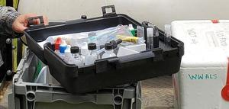
What we will test
Standard Georgia Adopt-A-Stream:
  E. coli
  Dissolved oxygen (DO)
  pH, conductivity, temperature
DNA marker testing to determine the species causing the contamination
PFAS (Per- and polyfluoroalkyl substances), aka forever chemicals
  Follow up Moody AFB 2016 report of PFAS in Beatty Branch and underground
Lead (2017 GA-EPD Lead TMDL)
Notes:
Total Maximum Daily Load Evaluation for Three Segments in the Suwannee River Basin for Lead Submitted to: The U.S. Environmental Protection Agency Region 4 Atlanta, Georgia Submitted by: The Georgia Department of Natural Resources Environmental Protection Division Atlanta, Georgia April 2017 https://www.bing.com/ck/a?!&&p=c4c0c85b62bf19e6JmltdHM9MTY5NTM0MDgwMCZpZ3VpZD0yZGNlOTc2Ny1hMzcyLTY2NDItMTY3OC04NDNhYTIzMDY3MTkmaW5zaWQ9NTI2Mw&ptn=3&hsh=3&fclid=2dce9767-a372-6642-1678-843aa2306719&psq=withlacoochee+tmdl+lead&u=a1aHR0cHM6Ly9lcGQuZ2VvcmdpYS5nb3YvZG9jdW1lbnQvcHVibGljYXRpb24vbGVhZC10bWRsLXJlcG9ydC0yMDE3L2Rvd25sb2Fk&ntb=1

Slide 18
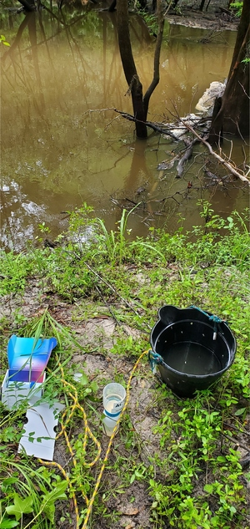
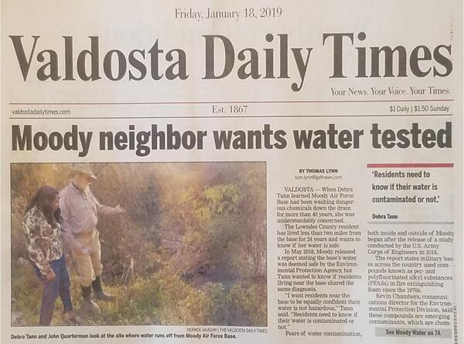
Why PFAS?
Notes:
https://wwals.net/2019/01/18/testing-for-firefighting-chemicals-in-wells-and-waterways-2019-01-18/

Slide 19
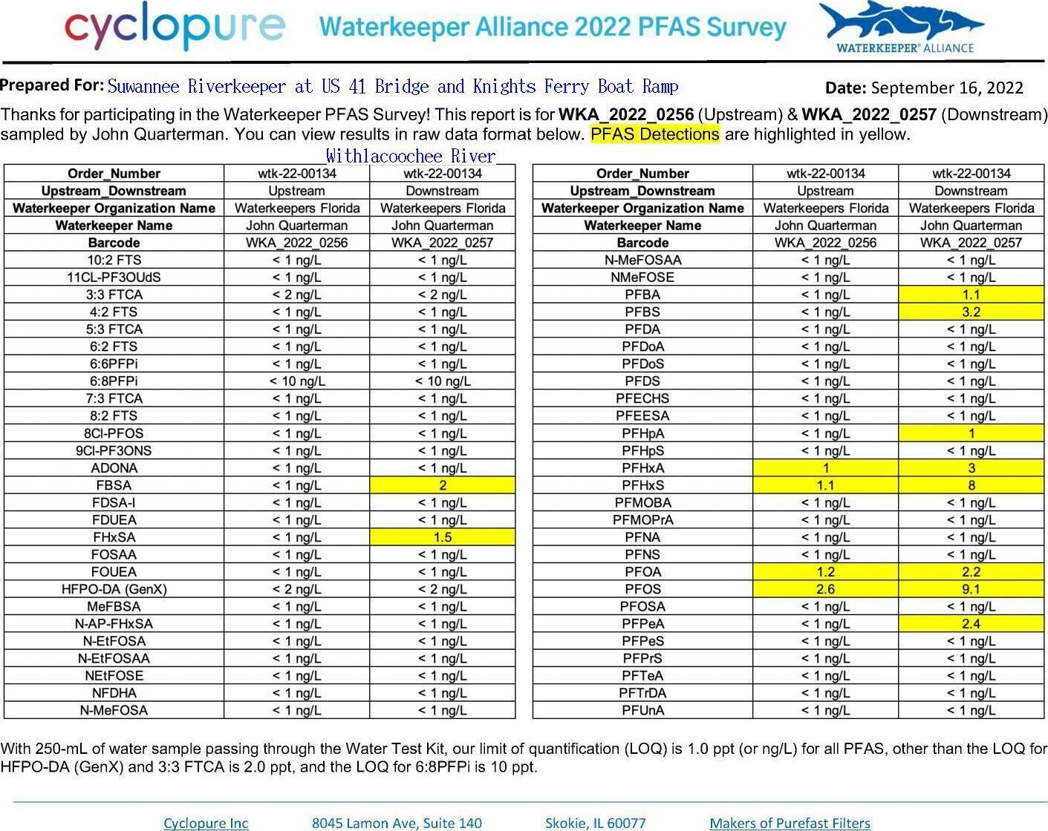
PFAS found,
Withlacoochee
River and Alapaha Fish
Notes:
https://wwals.net/2022/10/18/forever-chemicals-contaminate-withlacoochee-river-in-georgia-and-florida-2022-10-18/ https://wwals.net/2023/01/20/pfas-in-fish-in-alapaha-river-2023-01-17/

Slide 20
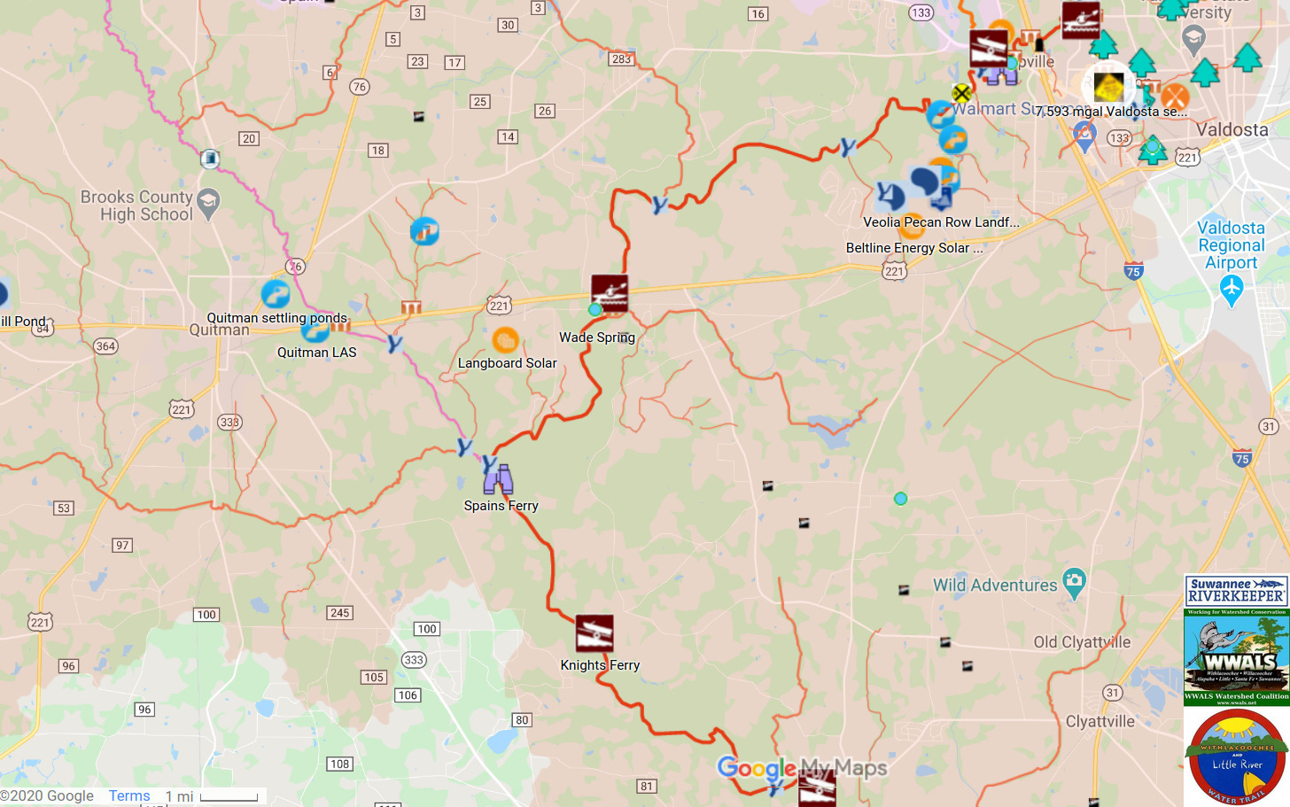
Testing to Source to Solution
Once we have determined a source, we will discuss potential solutions with the owner or manager.
We have done this successfully before in Brooks County.
Notes:
https://wwals.net/2021/06/27/cattle-and-hogs-withlacoochee-river-water-quality-status/

Slide 21
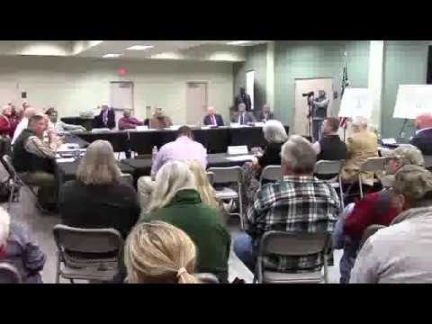
Involve GA-EPD if necessary
See GA-EPD Enforcement Order on Valdosta
In addition to a fine and many other requirements,
Requires Valdosta to test the Withlacoochee River
  40 Withlacoochee River miles, 6 sites, 3 times/week
  +1 Okapilco Creek site
WWALS did not do that alone, but we were in the middle with
  A dozen downstream Florida counties
  Local, state, and national elected officials from two states and many irate citizens
  Florida and U.S. environmental protection agencies
GA-EPD to Valdosta, July 11, 2023
  (Valdosta had sent its written report four days after a spill.)
  “In the future, please let us know once you are aware of the spill, even if it is still ongoing.
  “This allows us to know about the spill as it is occurring and also helps us inform citizens if we receive complaints/questions.”
Valdosta spills have become smaller, fewer, and with better reporting.
Notes:
https://wwals.net/2020/05/10/send-your-comment-on-ga-epd-valdosta-wastewater-consent-order-albany-herald/ https://wwals.net/2020/01/30/florida-counties-task-force-in-valdosta-about-sewage-2020-01-08/ https://wwals.net/2023/07/26/valdosta-notified-ga-epd-four-days-after-the-latest-knights-creek-sewage-spill-2023-07-06/

Slide 22
SSRWPC Management Practices: Find the Sources
PSDO-1 Collect Water Quality Data
Verification of Water Quality Resource Assessment Data and Assumptions to determine dissolved oxygen conditions. Data collection to confirm loading and/or receiving stream chemistry.
TMDL-1 Evaluate Impairment Sources
Data collection and confirmation of sources to support modify stream standards to reflect “natural sources” and/or to reflect naturally low dissolved oxygen streams.
TMDL-2 Analyze Impaired Segments and Sources
Data collection to refine river/stream reach length for impaired waters; focus on longest reaches to refine location and potential sources of impairments.

Slide 23
SSRWPC Management Practices for Human Sources
NPS-1 Study Human Impacts on Water Quality
Data collection/analysis to confirm if dissolved oxygen and/or fecal coliform is human induced.
EDU-3 Septic System Maintenance Education
Support Septic System Maintenance Programs.
OCP-1 Engage Local Governments
Encourage local governments to develop ordinances and standards to implement and/or update stormwater and land development regulations. Possible resource documents include: Georgia Stormwater Management Manual, Coastal Stormwater Supplement, and Metro North Georgia Water Planning District Model Ordinances.
EDU-2 Stormwater Education
Support Stormwater Educational Programs.

Slide 24
SSRWPC Management Practices for Agricultural Sources
NPS-2 Monitor and Address NPS Nutrient Loading
Support efforts to monitor and determine the sources of nutrient loading and other NPS impairments to rivers, lakes, and streams, and upon confirmation of source, develop specific management programs to address water quality needs.
OCP-3 Promote Integrated Planning
Encourage coordinated environmental planning, land use, stormwater, and wastewater.

Slide 25
Depending on the Agricultural Source and Problem
We may recommend:
NPSA-2: “Utilize Buffers, Field buffers, riparian forested buffers, and strip cropping to control runoff and reduce erosion”
NPSA-3: “Livestock Management, Livestock exclusions from direct contact with streams and rivers and vegetation buffers”
NPSA-4: “Manure Control, Responsible manure storage and handling”
NPSA-5: “Wetland and Forest Restoration Incentives, Incentives to restore wetlands and historically drained hardwood and other areas”
NPSF-3: “Conservation Land Use Planning, Seek long-term conservation easements or purchase development rights by willing landowners and conservation groups”
NPSF-4: “Where applicable, support United States Department of Agriculture incentive programs through the Farm Service Agency and NRCS to restore converted wetlands back to forested conditions”

Slide 26
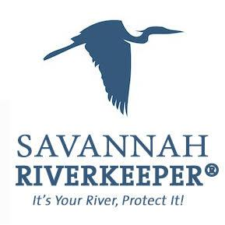
Partner Organization(s): Roles + Responsibilities
Lead: Valdosta State University
Principal Investigator: Geosciences Prof. Can Denizman
Responsibilities: Provide student testers, GIS integration, predictions
Partner: WWALS Watershed Coalition, Inc. (WWALS), IRS 501(c)(3)
Responsibilities: Coordination, testing, reporting
Partner: Savannah Riverkeeper, IRS 501(c)(3)
Responsibilities: Handle Know Your River and Newfields
Partner: Newfields
Responsibility: Subcontractor for Know Your River

Slide 27

Know Your River (KYR) Geographical Information System (GIS)
Make much more accessible, with much easier reporting of new data:
Ongoing water quality testing results from multiple organizations
Rainfall data
Sewage spill reports, fish kills, TMDL stretches
Public access points (boat ramps, fishing spots, etc.)
Helps predict contamination sources
and how far and how fast contamination goes downstream,
so we can go catch it and test where it is.
Will cover:
Valdosta MSA and Berrien County, plus:
background information for the entire Suwannee River Basin, including
watershed delineations, public landings, rainfall, wastewater permit locations, etc.
Notes:
https://www.knowyourriver.com

Slide 28
Questions and Contact
Questions?
John S. Quarterman, Suwannee Riverkeeper
850-290-2350, 229-242-0102, 229-560-4317 (mobile)
https://wwals.net
WWALS Watershed Coalition, P.O. Box 88, Hahira, GA 31632
Can Denizman, Professor of Geosciences, Valdosta State University
229.249.2744
cdenizma@valdosta.edu

