Slide 1
Ask GA-EPD:
tell everyone
when anyone spills

Slide 2
They told EPD, but not local people

Slide 3
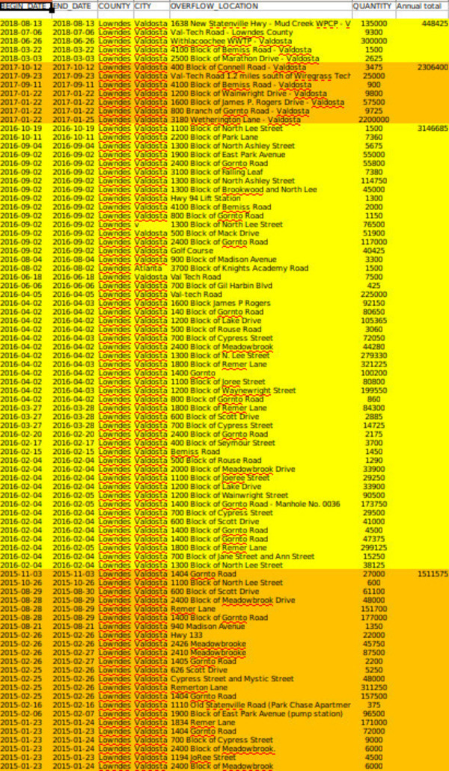
I asked Valdosta
for this list for years
FInally got it from GA-EPD.
Things are getting better.
But we never would have known
Without this EPD data.
And still there are spills.
Some Valdosta and Lowndes County
did not tell us about….
wwals.net/issues/vww

Slide 4
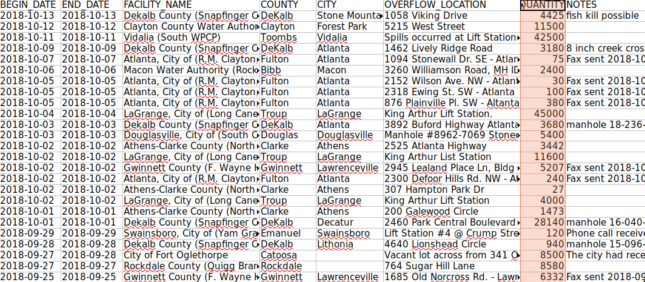
What’s in your water?

Slide 5
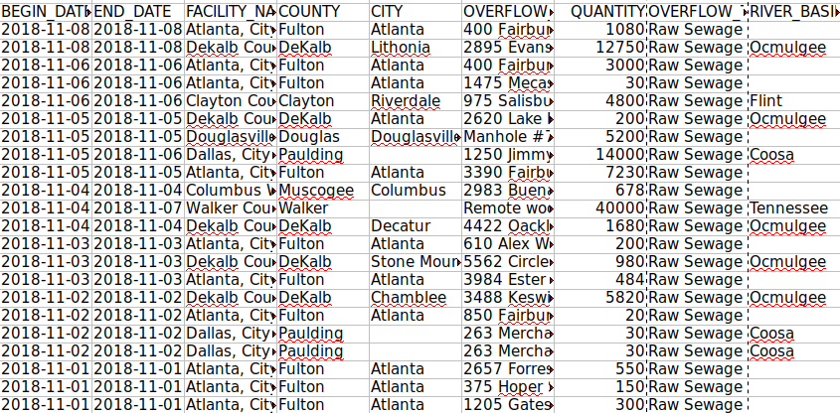
November 1-13, 2018, spills from GA-EPD

Slide 6
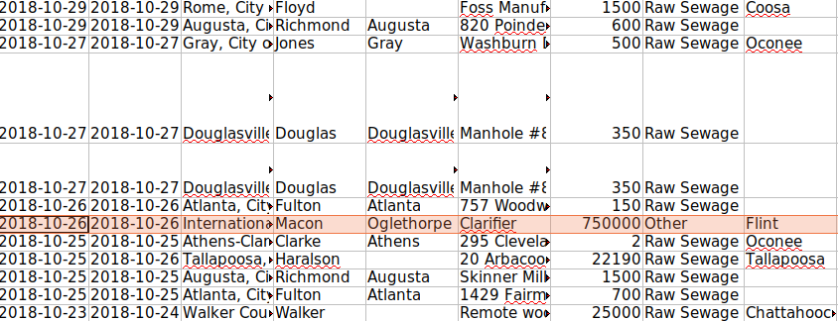
Some October 2018 spills

Slide 7
750,000 gallons, clarifier, Flint River watershed
Call to EPD on 10/27/2018. Sent email later, same day.
Notification letter sent on 10/31/2018.
Letter says that during a scheduled annual mill outage, while a repair to seal water line was being made, an incomplete isolation allowed water from the mill water clarifier to back-flow to Flint River through intake piping and to the river. Mill water clarifier contains water from river and treatment chemicals.
Chemicals are sodium hydroxide, drewflow (polymer), coagulant, millisperse (corrosion inhibitor).
Chemical feed was stopped, prior to release, due to the water outage.
Once spill identified, valve at the clarifier was closed completely.
Once mill outage is completed, incident will be evaluated further to put measures in place to prevent a recurrence of such releases in future mill outages.

Slide 8
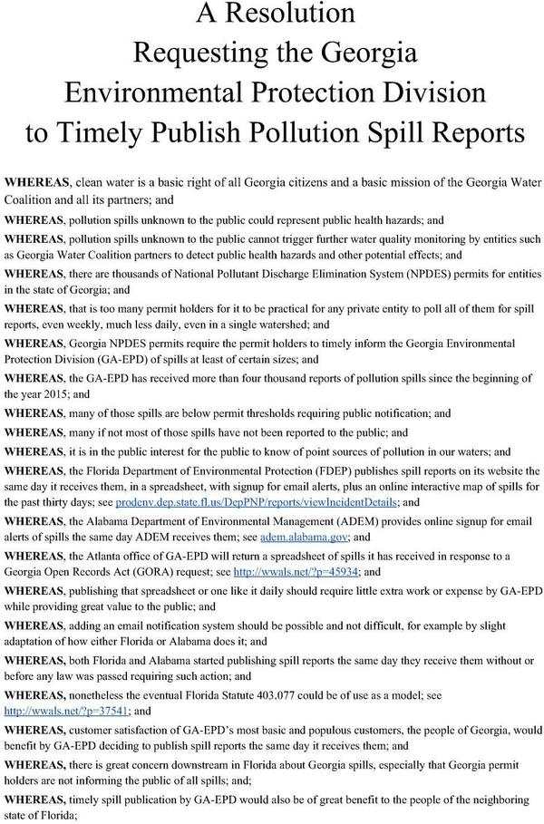
Why not publish the spreadsheet daily, EPD?

Slide 9
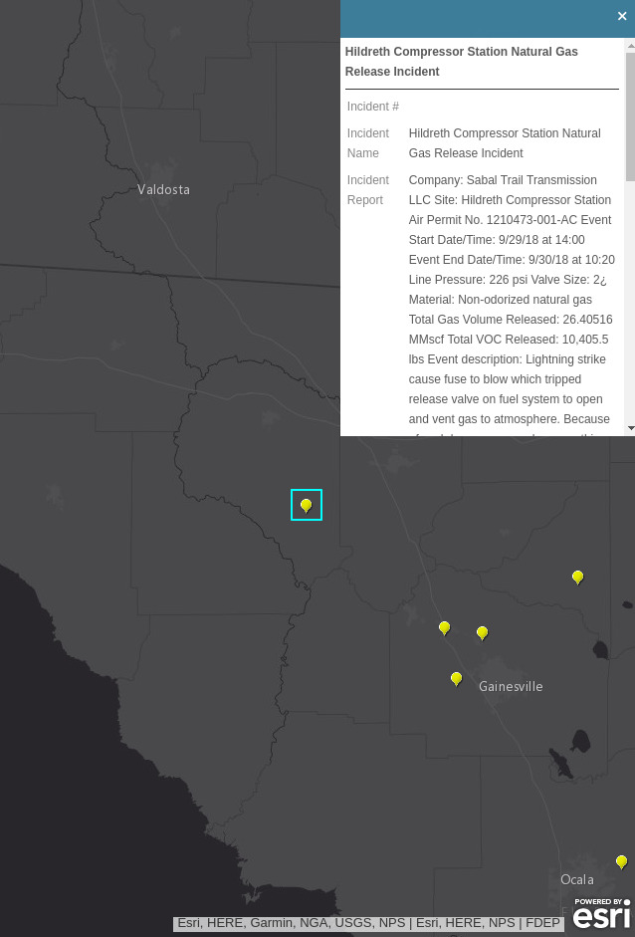
Florida does it
No sewage spills in many months
In the Suwannee River Basin in Florida.
But a Sabal Trail pipeline leak.
We only know about that because of
Florida’s daily Notices of Pollution.
Has Sabal Trail leaked in Albany, GA?

Slide 10
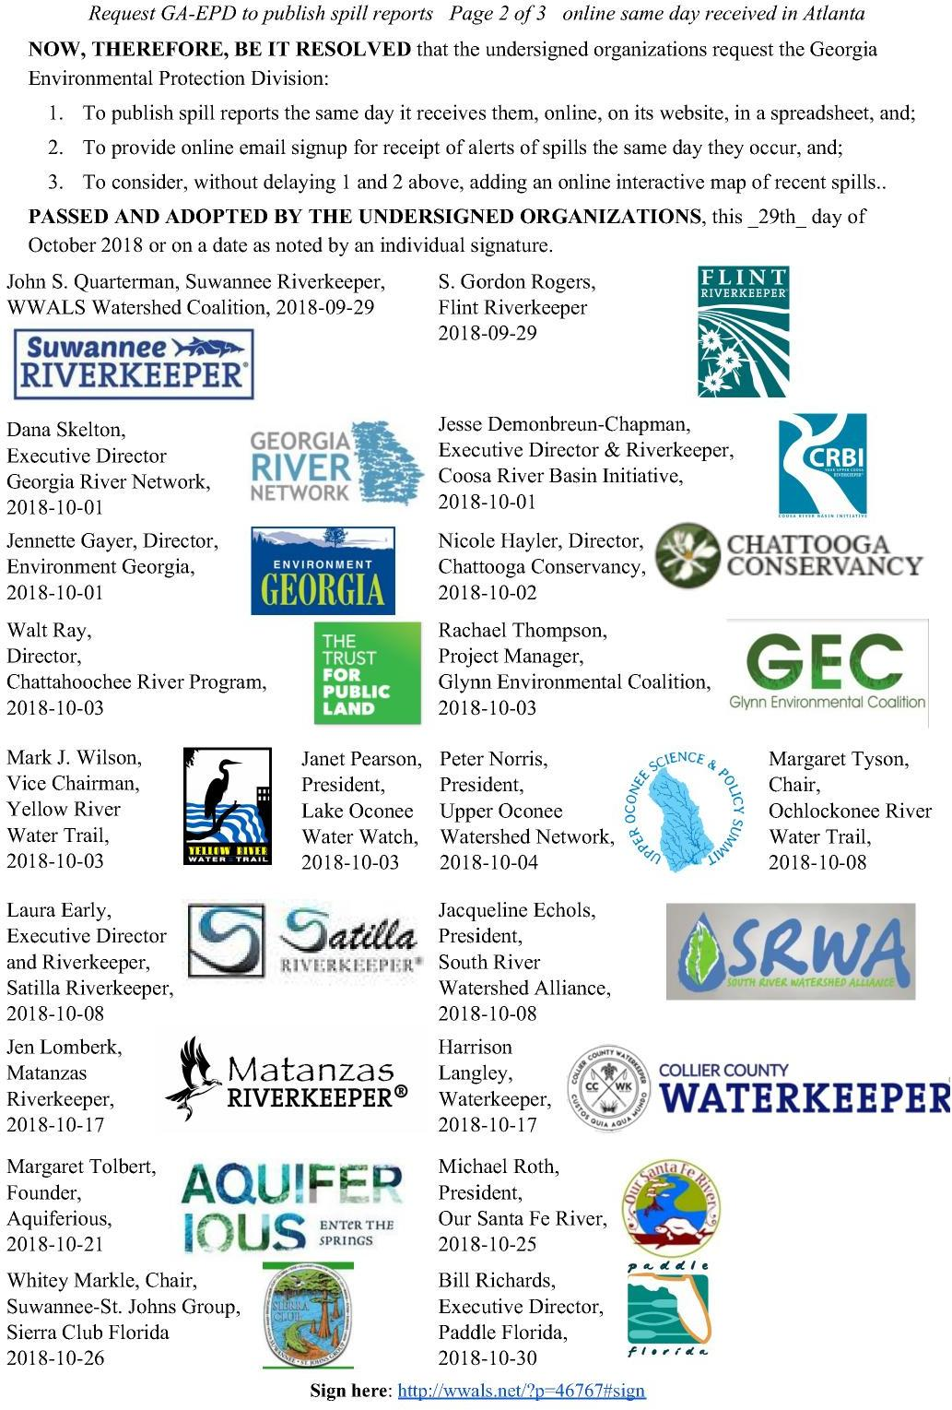
Costs you nothing; commits you to nothing

Slide 11
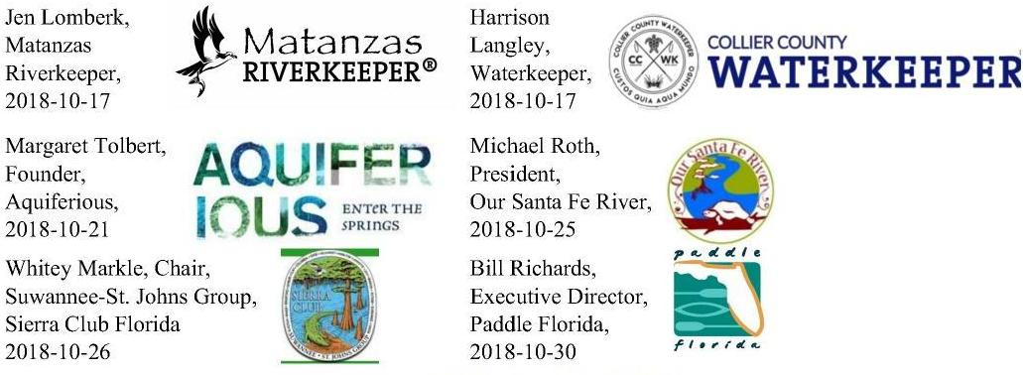
Groups are signing in Florida

Slide 12
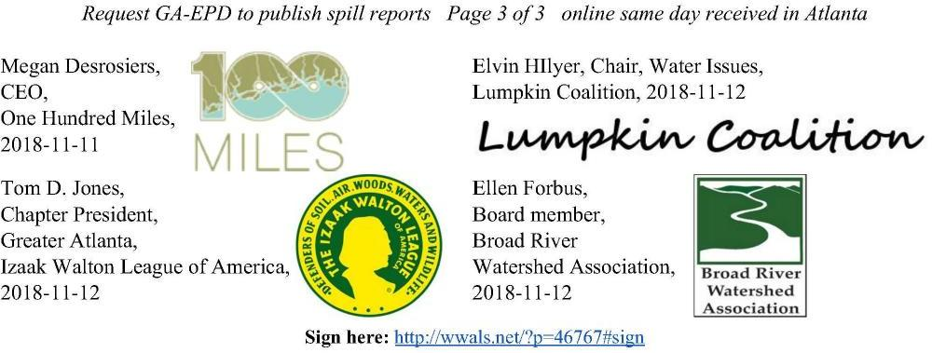
And in Georgia

Slide 13
GA-EPD did answer on November 2, 2018
John – good idea. We will get to work immediately
on the logistics to see how we can make this happen.
I’ll keep you informed of our progress.
Rick Dunn
EPD
Can’t hurt to continue encouraging him until we see
Daily spill reports on the GA-EPD website.
Sign here:​​ ​ http://wwals.net/?p=46767#sign

Slide 14
Contact:
John S. Quarterman
Suwannee Riverkeeper®
contact@suwanneeriverkeeper.org
229-242-0102
WWALS Watershed Coalition, Inc. (WWALS)
www.wwals.net
wwalswatershed@gmail.com
850-290-2350
PO Box 88, Hahira, GA 31632

