Slide 1
Water Quality Monitoring
In Florida and Georgia
Suwannee Riverkeeper®
WWALS Watershed Coalition
2018-04-19

Slide 2
Why Monitor?
Pollutants from phosphate mines and pipelines, septic tanks & sewers, cows and deer, lawns & field fertilizer,
are getting into our rivers, springs, and water wells,
affecting fishing, swimming, tourism, health, economy.
Where is it coming from? When? What is it? Who did it?
Issue safe or not advisories for landings, etc.
So we can help stop it,
Including raising political will for proper funding.

Slide 3
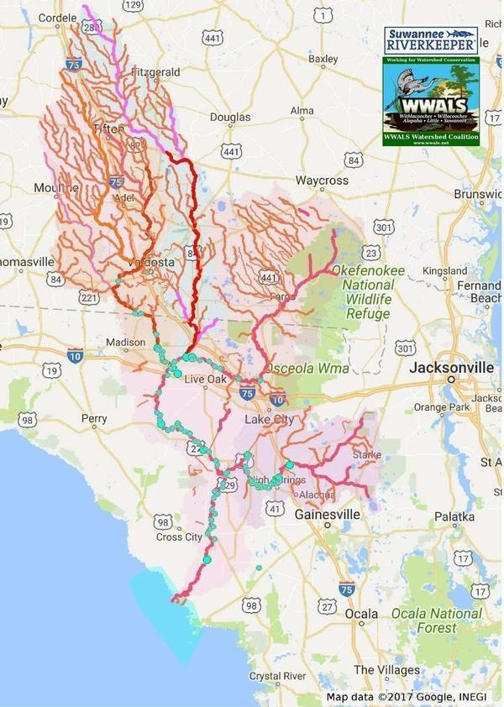
Where?
Rivers don’t stop because somebody drew a state line on a map.

Slide 4
Sample where?
Upstream and down: every landing, spring, swimming hole & pollution source
Georgia:
Every wastewater treatment plant, plus http://wwals.net/blog/?p=37618
Mud Creek, upstream and downstream of industrial area
Grand Bay, downstream of Moody AFB bombing range, esp. for lead
Florida:
Suwannee Power Plant and Pilgrim's Pride,
Dowling Park retirement,
Dairies in Suwannee County,
Old Town with all its septic tanks,
Santa Fe River @ US 129,
Santa Fe Confluence,

Slide 5
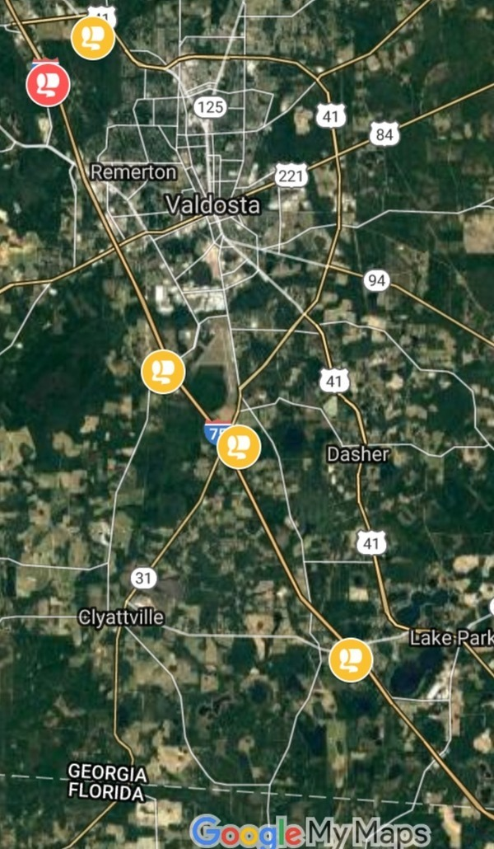
Tropical Storm Irma and after
Tifton: 250,000 gallons
2017-09-22: 250,000 gallons
Lowndes County: 31,200 gallons
2017-09-26: 25,000 gallons
2017-09-12: 6,200 gallons from 4 lift stations,
Quitman: 20-70,000 gallons
2017-09-27: 20-70,000 gallons
Valdosta: 900 gallons
2017-09-12: 900 gallons
2017-09-12: None from wastewater plants

Slide 6
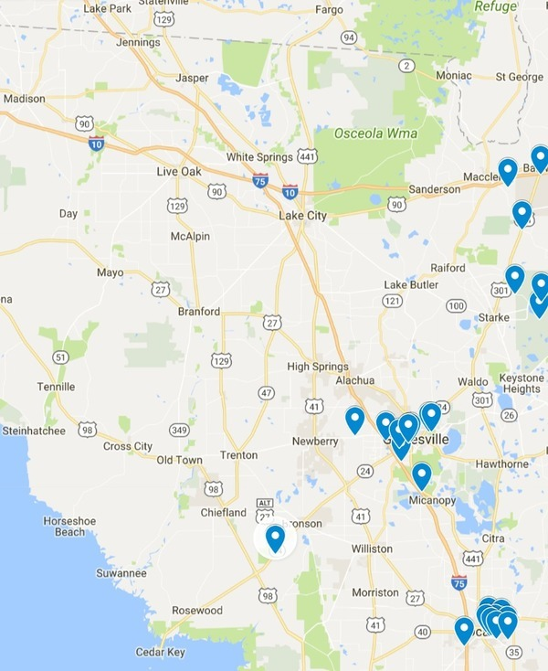
Irma in Florida
No Florida wastewater spills in Suwannee River Basin.
2017-09-18: Three Chemours mine overflows: Baker, Bradford Counties
Also shown: Two Camp Blanding vehicle accidents: Bradford County
What about septic tanks?
Sewage isn’t the whole story.

Slide 7
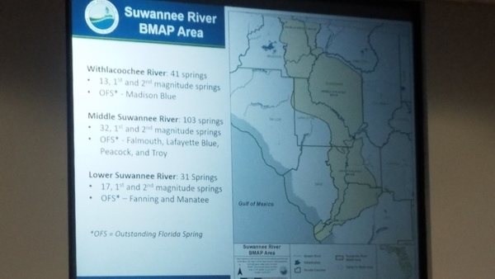
Basin Management Action Plans (BMAPs)
Nitrates from fertilizer runoff causing algae blooms, etc.
Must reduce by 83-92%, according to FDEP study.

Slide 8
Existing Data
EPA STORET
USGS: sparse and infrequent
FDEP: Florida Storet
SRWMD: frequent on some springs and stream segments
GA-EPD: Georgia Adopt-A-Stream
Cities of Valdosta, Tifton, Quitman, Adel, Moultrie, etc.
Counties of Hamilton, Lowndes, Tift, Brooks, Cook, Berrien, Colquitt, etc.
Notes:
https://www.epa.gov/waterdata/water-quality-data-wqx
https://floridadep.gov/dear/water-quality-assessment
https://waterdata.usgs.gov/ga/nwis/current/?type=quality&group_key=basin_cd
http://www.srwmd.state.fl.us/index.aspx?NID=345

Slide 9
Lots of data, lots of gaps
Need independent testing at GA-FL line
Many landings and springs have sparse or no testing
Many locations with testing have it only infrequently
Need analysis up and down the rivers, across states
To detect movements of contaminants
To localize sources of contaminants
Many different repositories and maps; interesting just to find the gaps

Slide 10
Test for what?
Four levels:
Visual or anecdotal: baseline and anomalies
Chemical: acidity to nitrates
Biological: sewage or cows?
Metallic: things that will give you cancer

Slide 11
Visual or anecdotal
Take pictures; report with description: baseline or anomalies.
Regularly in the same places if you can, preferably weekly.
Plus anywhere and anytime: the more the merrier.
No course nor certification necessary.
No special equipment: smart phone, SLR, GoPro, drone, whatever.
Georgia Adopt-A-Stream has a Visual Stream Survey Manual: https://adoptastream.georgia.gov/documents/visual-stream-survey-complete-manual
Can report using Water Reporter: https://www.waterreporter.org/

Slide 12
II. Chemical
Dissolved Oxygen (DO), pH, temperature, conductivity: standard tests.
Blackwater rivers: DO always lower and pH more acidic due to
the tannic acid from oak leaves that gives them their tea color.
Nitrates, phosphorus: very important in Florida from agricultural runoff;
see ​ Basin Management Action Plans (BMAPs)
Must take a one-day course and be certified to do chemical testing.
Testing kits or probes do cost money, chemicals also cost.
Georgia Adopt-A-Stream has a Macroinvertebrate and Chemical Stream Monitoring Manual:
https://adoptastream.georgia.gov/documents/macroinvertebrate-and-chemical-stream-monitoring-manual

Slide 13
III. Biological: for sewage and other fecal contam.
Must take a class and be certified to do biological testing.
E. coli: must keep samples cool and get to lab within four hours.
Testing equipment is inexpensive; WWALS may want to buy a kit or two.
Fecal coliform: expensive and must get to lab quickly
but an excellent followup to discoveries of E. coli.
Maybe UFL in Gainesville, FL.
UGA extension offices, can ship to Athens, Georgia, for test fee.
Realtime flouroscope test for laundry detergent markers
Cattle and wildlife don’t use laundry detergent
Can follow upstream to determine source
Expensive; need grants
Georgia Adopt-A-Stream has a ​Bacterial Monitoring Manual:
https://adoptastream.georgia.gov/documents/bacterial-monitoring-manual-complete-manual
Notes:
https://docs.google.com/document/d/1jZzH_YQYMdddZDoWMntLo072BUEOWJ4Wex1NZTEGcpI/edit#
Turner Design AquaFluor® Handheld Fluorometer and Turbidimeter
Two AquaFluors with warranty and logging for $5,360.00.
https://drive.google.com/drive/u/0/folders/0Bwetjr9zz74RM0k4WG5fME56Y0E

Slide 14
IV. Metallic: arsenic, copper, lead
Arsenic: old fence posts, previous cattle dipping, etc.,
Has been found in some wells and may be detected in streams.
Causes cancer and other diseases.
Check downstream of chicken CAFOs
Copper: check Mud Creek downstream of timber processing plant.
Lead: GA-EPD TMDL for Withlacoochee River upstream of Valdosta
And Suwannee River tributaries Suwanacoochee Creek and Jones Creek
http://wwals.net/?p=37992
UGA Extension tests for metals: fee per test plus cost of expedited shipping.

Slide 15
How frequently?
Start with monthly
Work up to weekly
Georgia Adopt-A-Stream only wants monthly
But we need to collect weekly and sometimes more frequently
To detect effluents traveling down the rivers
To post advisories
Ideally, continuous monitoring everywhere
Equipment to do that is getting less expensive

Slide 16
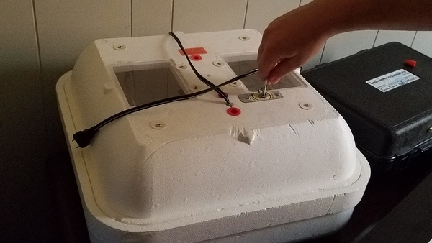
Analyze Where?
U. Florida in Gainesville?
Valdosta State?
Southern Georgia Regional Commission (SGRC) in Valdosta for E. coli
Other?

Slide 17
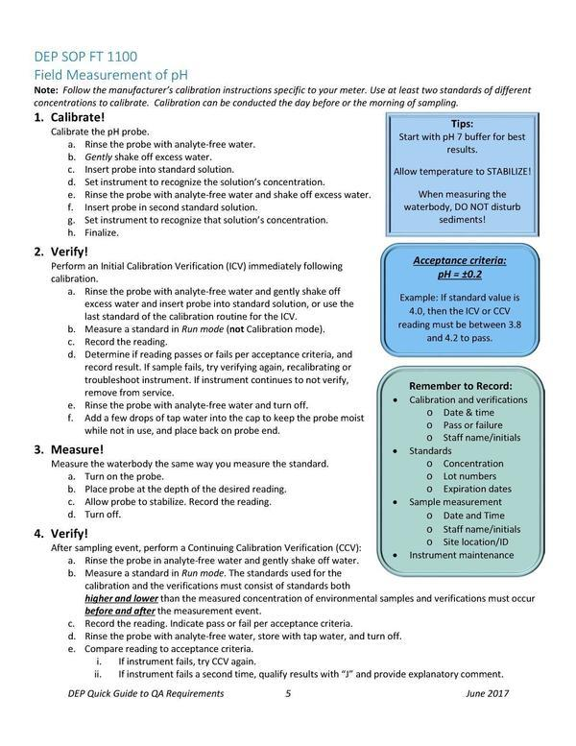
Who will certify results?
ASTM Standards
In Georgia, actionable tests have to be taken by certified testers
Certified by Georgia Adopt-A-Stream
In Florida: no state certification
Water quality monitoring programs: organize volunteer and coordinator training, field proficiency demonstrations, documentation of procedures, etc.
Notes:
http://publicfiles.dep.state.fl.us/dear/DEARweb/QA/QA%20resources/FDEP%20Quick%20Guide%20to%20QA%20for%20Volunteer%20Programs_AEQA_JUNE_22_2017.pdf

Slide 18
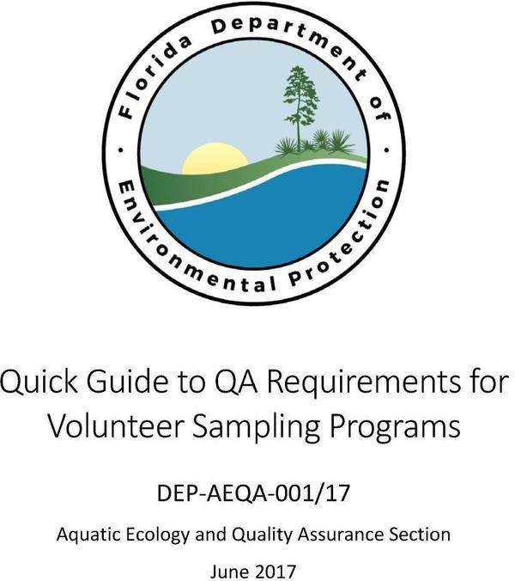
Very useful reference
Thank you, Kristin Sapp.
Notes:
http://publicfiles.dep.state.fl.us/dear/DEARweb/QA/QA%20resources/FDEP%20Quick%20Guide%20to%20QA%20for%20Volunteer%20Programs_AEQA_JUNE_22_2017.pdf

Slide 19
Funding sources (equipment, travel, lab tests, etc.)
Funding sources really like water quality monitoring:
It's not controversial.
Who wants dirty water, after all?
RC&D
Soil & Water Conservation District
Community Foundations
Public health
Corporate (even utilities)
Banks (yes, really; grants from banks)
Membership fee to join a sampling club
Crowdfunding

Slide 20
Record where?
Wanted: a single place to put visual, chemical, biological, and metallic tests
Consistent across levels
Consistent across state lines
Comparable across watersheds
Easy for individual testers or watersheds to input data
And get it back out
Well, that’s a nice dream, but it doesn’t exist.

Slide 21
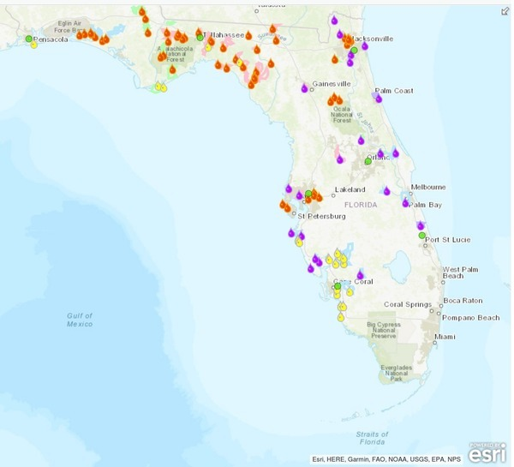
Florida repositories
FDEP
SRWMD
Florida Lakewatch
Others?
Most data by contractors,
Not volunteers
Notes:
http://wwals.net/2018/02/09/fdep-water-quality-monitoring-plans-2018/

Slide 22
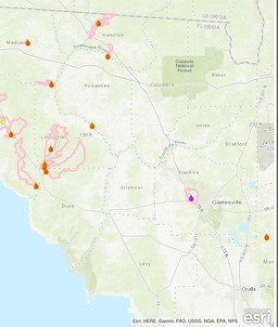
Florida: infrequent and sparse
According to FDEP.
SRWMD does more frequent sampling of certain springs; has its own maps.

Slide 23
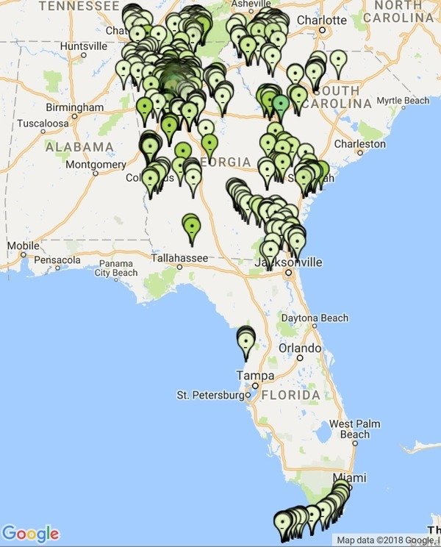
Georgia repositories
Georgia Adopt-A-Stream
Used by most Georgia Riverkeepers
Also data from AL, TN, SC, and FL
Including FL Keys and both sides of St Mary’s River.
Only certified testers can input data.
Sample by sample, not in bunches.

Slide 24
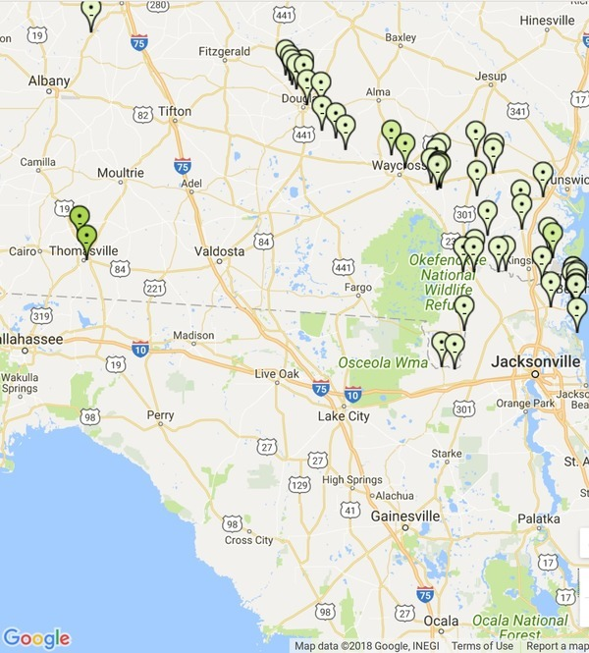
Big gap:
Suwannee River Basin
Nobody else will do this for us.

Slide 25
What about visual or anecdotal surveying?
People post on facebook, twitter, instagram, etc. all the time.
Try finding those posts later.
Water Reporter:
www.waterreporter.org/
Used by many Waterkeepers
Anybody can sign up and report pictures and text
Only group organizers can input chemical or biological test data
Group organizer can get all group data back out for other use.

Slide 26
What can you do?
Volunteer!
Sign up on the sheet here, or online at wwals.net
Sign up on Water Reporter https://www.waterreporter.org/
Join the Suwannee Riverkeeper group
Get the smartphone app
Go ahead and report pictures and text
When we’re ready, get trained for chemical, biological, or metallic testing
Meanwhile, anything you report can help detect problems for further testing

Slide 27
Report what pictures and text?
The Good Tea-colored river water Blue-green spring water Happy people paddling, Swimming, diving, fishing Gators, sturgeon, manatees Shoals exposed Shoals underwater | The Bad Deadfalls Detergent foam Algae blooms Broken sediment fences Trash and debris Erosion Invasive species | The Ugly Fish kills Fish lesions Livestock in water Effluent pipes Chemical spills Failing septic systems

Slide 28
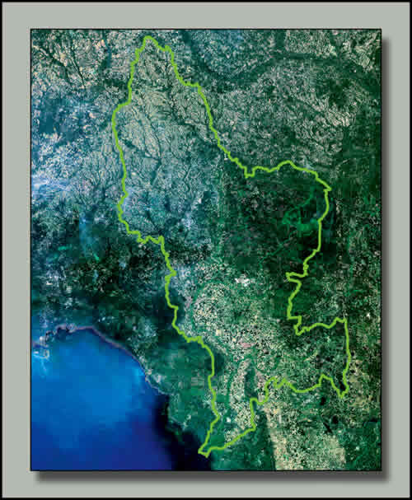
Volunteer to organize!
Suwannee River Basin:
9,950 square miles
3 hours end to end
Okefenokee Swamp
to the Gulf
Two states: FL, GA
Need local groups up and down the rivers

Slide 29
Organize what?
Procedures and documentation
help find more volunteers,
help coordinate with local governments,
help get volunteers (and maybe labs) from local colleges,
help get volunteers from local high schools and middle schools,
Help maintain the database (CS),
help with apps for collecting information,
help with social and other media for getting the results out,
help raise funds for equipment and testing?

Slide 30
It’s an opportunity
To find and fix water problems
To motivate proper funding of state and federal agencies
To motivate funding to replace septic tanks
To meet new people and do something fun and useful with them.
Let’s do it!

Slide 31
Contact
John S. Quarterman
Suwannee RIVERKEEPER®
contact@suwanneeriverkeeper.org
WWALS Watershed Coalition, Inc.
wwalswatershed@gmail.com
http://www.wwals.net
http://www.facebook.com/Wwalswatershed
https://twitter.com/wwalswatershed
P.O. Box 88, Hahira, GA 31632
(850)290-2350, (229)242-0102

