Slide 1
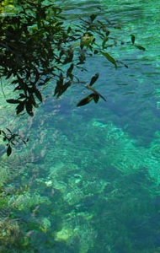
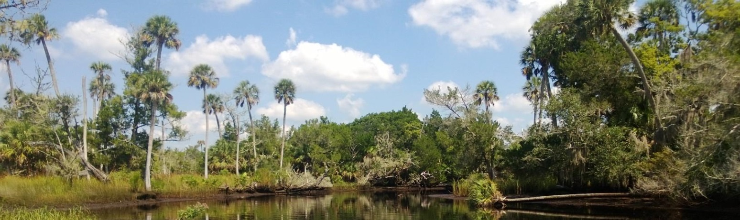
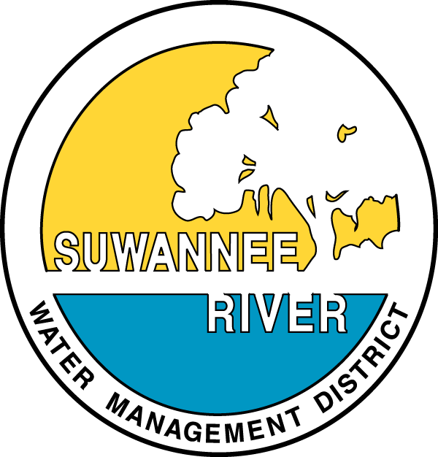




SWIM Plan Update Public Meeting
Issues & Projects
October 3 and 4, 2017

Slide 2
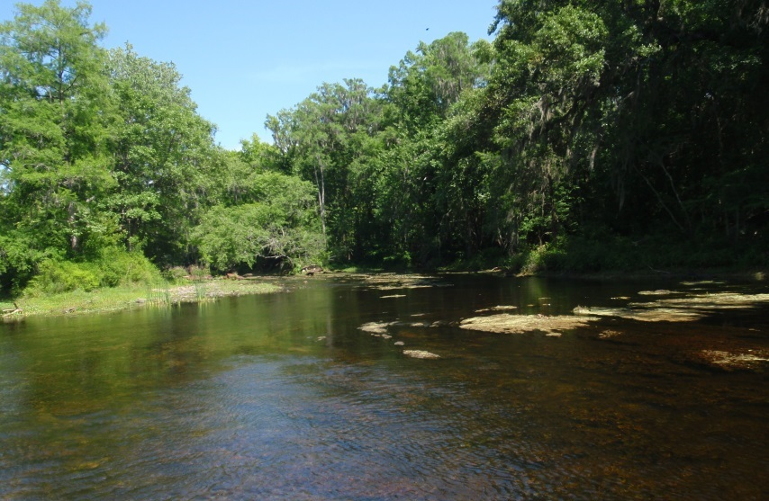
Project Schedule
Final SWIM Plans
GEBF
Funding Request
Literature Review
Stakeholder Meetings
Draft SWIM Plans
Stakeholder Meetings
March 2016
May
July
September
November
January
2017
March
May
Notes:
Ichetucknee

Slide 3
Project Objectives
Update and consolidate six existing SWIM plans into two comprehensive SWIM plans
Existing Plans | Updated and Consolidate Plans
Suwannee River | Suwannee River Basin
Santa Fe River
Alligator Lake
Aucilla River | Coastal Rivers Basin
Coastal Rivers (Ecofina, Fenholloway, Steinhatchee)
Waccasassa River

Slide 4
Surface Water Improvement and Management (SWIM) Program
Created through passage of the Surface Water Improvement and Management Act of 1987 (373.451 – 373.459, F.S.)
Law developed to address major watershed issues in identified priority water bodies throughout the State
SWIM Plans provide:
  Watershed description
  Assessment of watershed and water resource conditions
  Evaluation of accomplishments and improvements since previous SWIM Plan
  Project plan to address identified watershed needs and priorities
  Estimate of funding needs and funding alternatives

Slide 5
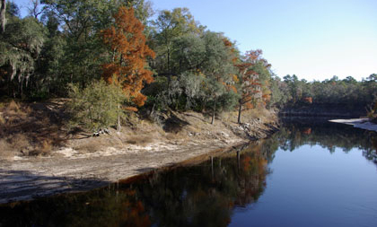
Project Goals
Identify, update, and prioritize key projects to protect and restore critical water resources
Maximize the value of the SWIM Plans by identifying leveraging opportunities with other funding sources
Prepare detailed funding request for the identified projects and initiatives to be submitted to FWC and NFWF
Notes:
Suwannee Spring

Slide 6
Management Issues and Drivers
Water Quality
  Springs, Streams and Groundwater
  Impaired waterbodies
  TMDLs & BMAPs
Water Quantity
  Springs, Streams and Groundwater
  Importance of regional hydrogeology
  Minimum Flows and Levels (MFLs)
Natural Systems
  Fish & wildlife habitats
  Land use conversions
  Habitat fragmentation
  Impacts to protected species

Slide 7
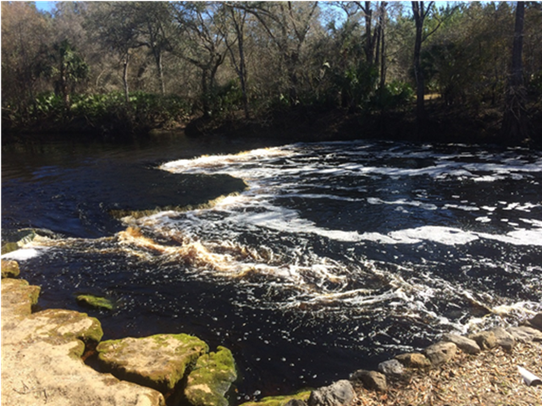
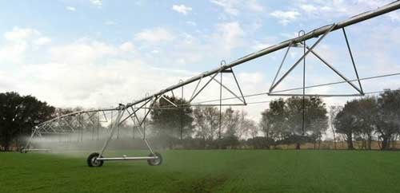
What’s Good for the Environment is Also Good for the Economy
Sustain the natural resources that support the unique character, community, and economic health of the Big Bend
  Timber
  Agriculture
  Fishing
  Ecotourism
Create opportunities and catalyze partnerships that make the region stronger
Excerpts from The Conservation Fund (2015)
Notes:
Steinhatchee Falls
The economy of the Big Bend Region, perhaps more than any other part of the state, is dependent on the natural resources that uniquely define the region
The resources include timber, agriculture, fishing, and ecotourism
Without these activities there would be little to support the local economies
By working to restore and protect the natural resources of the region, the SWIM plans will create opportunities and catalyze partnerships to make the region stronger.

Slide 8
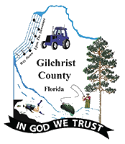
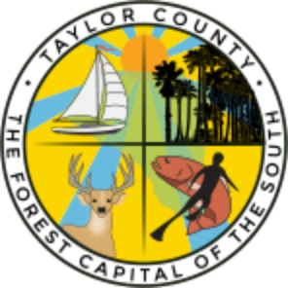
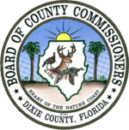


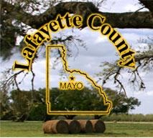
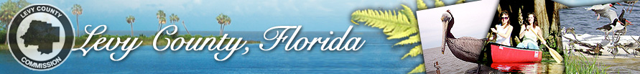
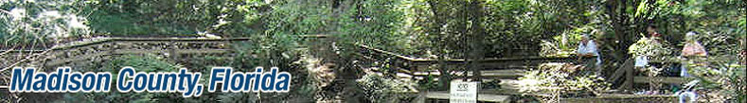

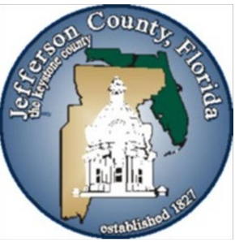



What’s Good for the Environment is Also Good for the Economy
Notes:
Steinhatchee Falls
The economy of the Big Bend Region, perhaps more than any other part of the state, is dependent on the natural resources that uniquely define the region
The resources include timber, agriculture, fishing, and ecotourism
Without these activities there would be little to support the local economies
By working to restore and protect the natural resources of the region, the SWIM plans will create opportunities and catalyze partnerships to make the region stronger.

Slide 9
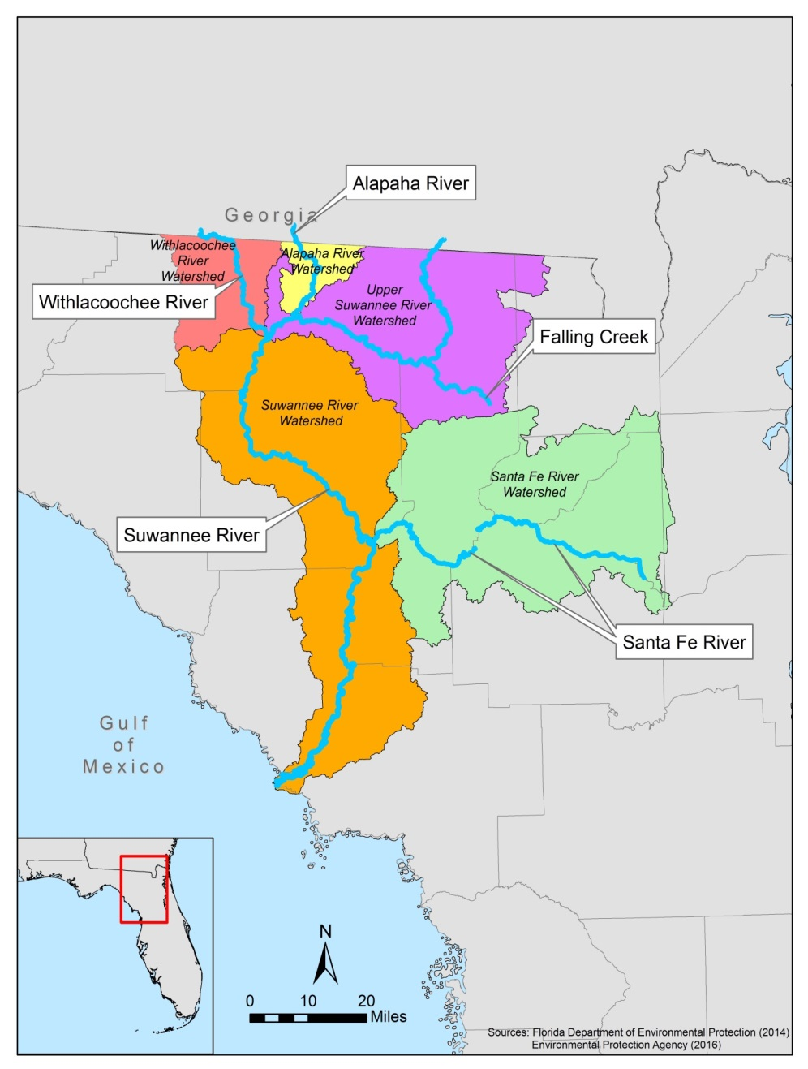
Suwannee River Basin
Withlacoochee River
Alapaha River
Falling Creek
Santa Fe River
Suwannee River
Alligator Lake

Slide 10
Suwannee River Basin
Water Quality

Slide 11
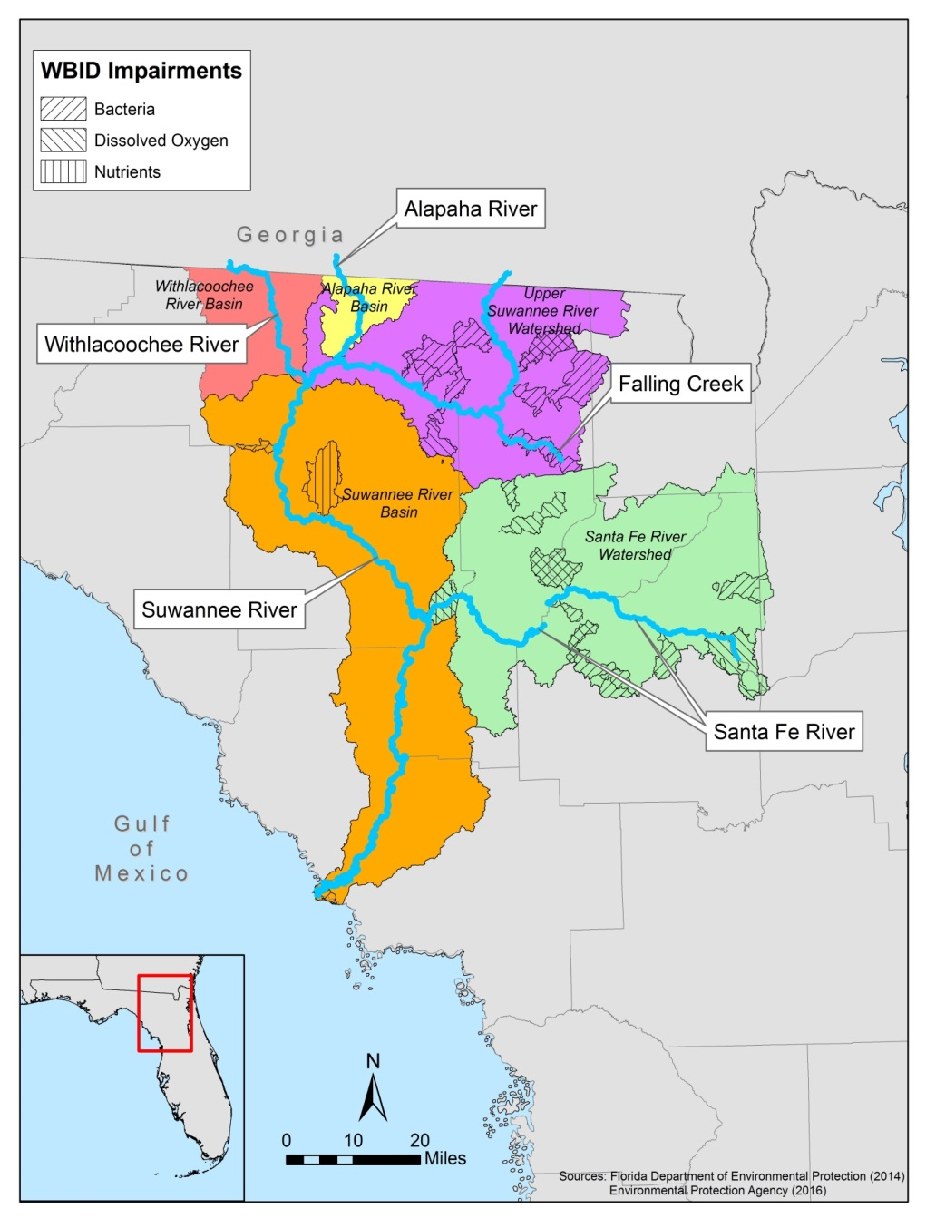
Water Quality Impairments
Impairments determined for:
  Bacteria
  Dissolved oxygen
  Nutrients

Slide 12
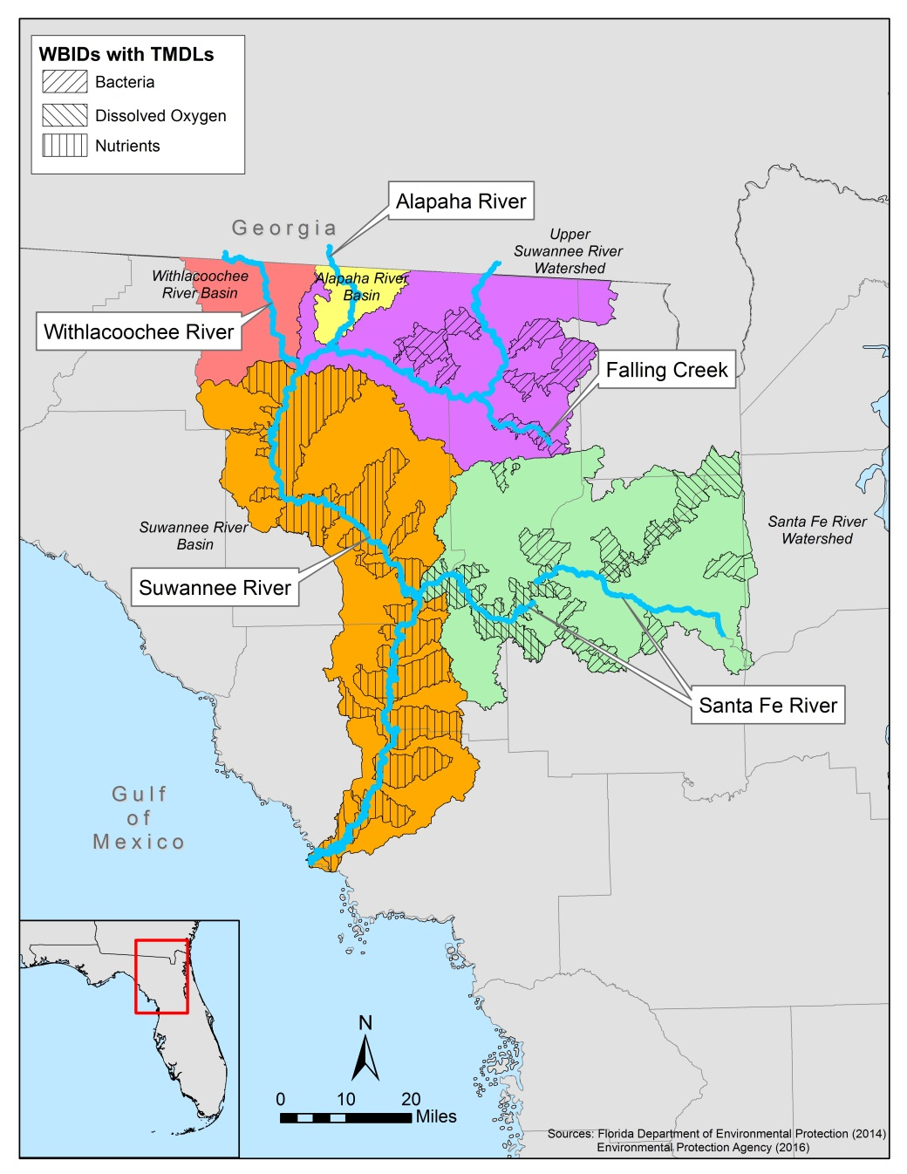
TMDL Determinations
Upper Suwannee River
  Bacteria
Suwannee River
  Nutrients (nitrate)
Santa Fe River
  Bacteria
  Dissolved Oxygen

Slide 13
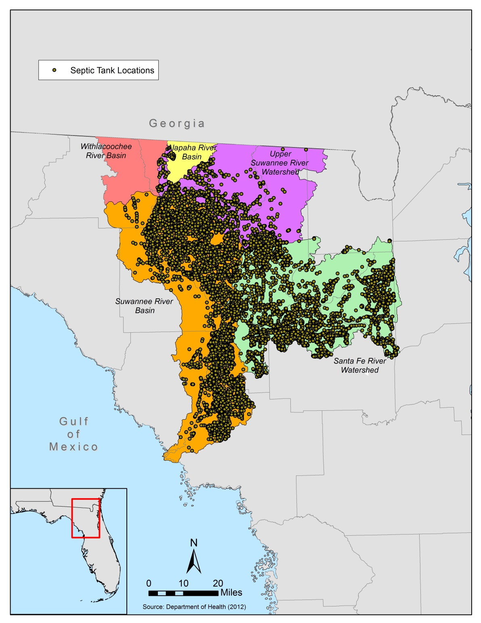
Septic Tanks in Suwannee River Basin

Slide 14
Nitrate Trends in River Flows 1989-2007
Figure from SRWMD (2007)

Slide 15
Nitrate Trends in Spring Flows 1989-2007
Figure from SRWMD (2007)

Slide 16
Water Quality Issues
Impaired water bodies
  Nutrients/DO
  Bacteria
Increasing trends in nitrate concentrations in groundwater and spring discharges in some locations
Increasing trends in nitrate concentrations in river surface waters in some locations

Slide 17
Water Quality Goals and Projects
Goals:
  Reduce nitrogen loads to surface and groundwater
  Reduce bacteria loads to surface water
Potential Projects:
  Agricultural BMPs
  Septic to sewer conversions
  Wastewater treatment upgrades
  Urban stormwater treatment
  Other

Slide 18
Suwannee River Basin
Water Quantity

Slide 19
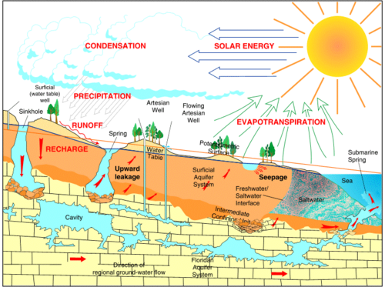
Surface/Ground Water Interaction and Travel Times
Surface water travel times = days, weeks, months
Ground water travel times = months, years, decades
Source: www.welldrillingcompany.net
Notes:
Travel time of groundwater to surface water

Slide 20
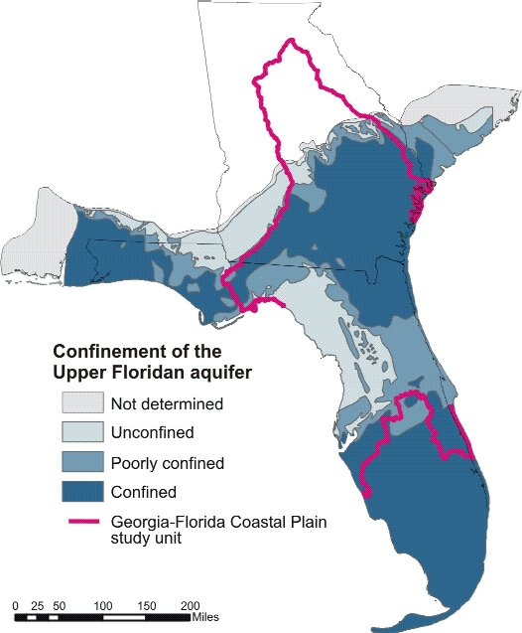
Unconfined Aquifer in SRWMD
Suwannee River WMD is mostly underlain by an unconfined or poorly confined Upper Floridan aquifer
Spring discharges from the aquifer are major contributors to river flows
Aquifer is especially vulnerable to pollution

Slide 21
Water Quantity Issues
Decreasing trends in river flows in some locations
Decreasing trends in springs discharges in some locations
Substantial projected increases in water demand

Slide 22
Water Quantity Goals and Projects
Goals:
  Increase aquifer recharge
  Decrease excessive runoff and evapotranspiration
Potential Projects:
  Agricultural BMPs
  Hydrologic restoration of over-drained lands
  Water reuse
  Water conservation
  Other

Slide 23
Suwannee River Basin
Natural Systems

Slide 24
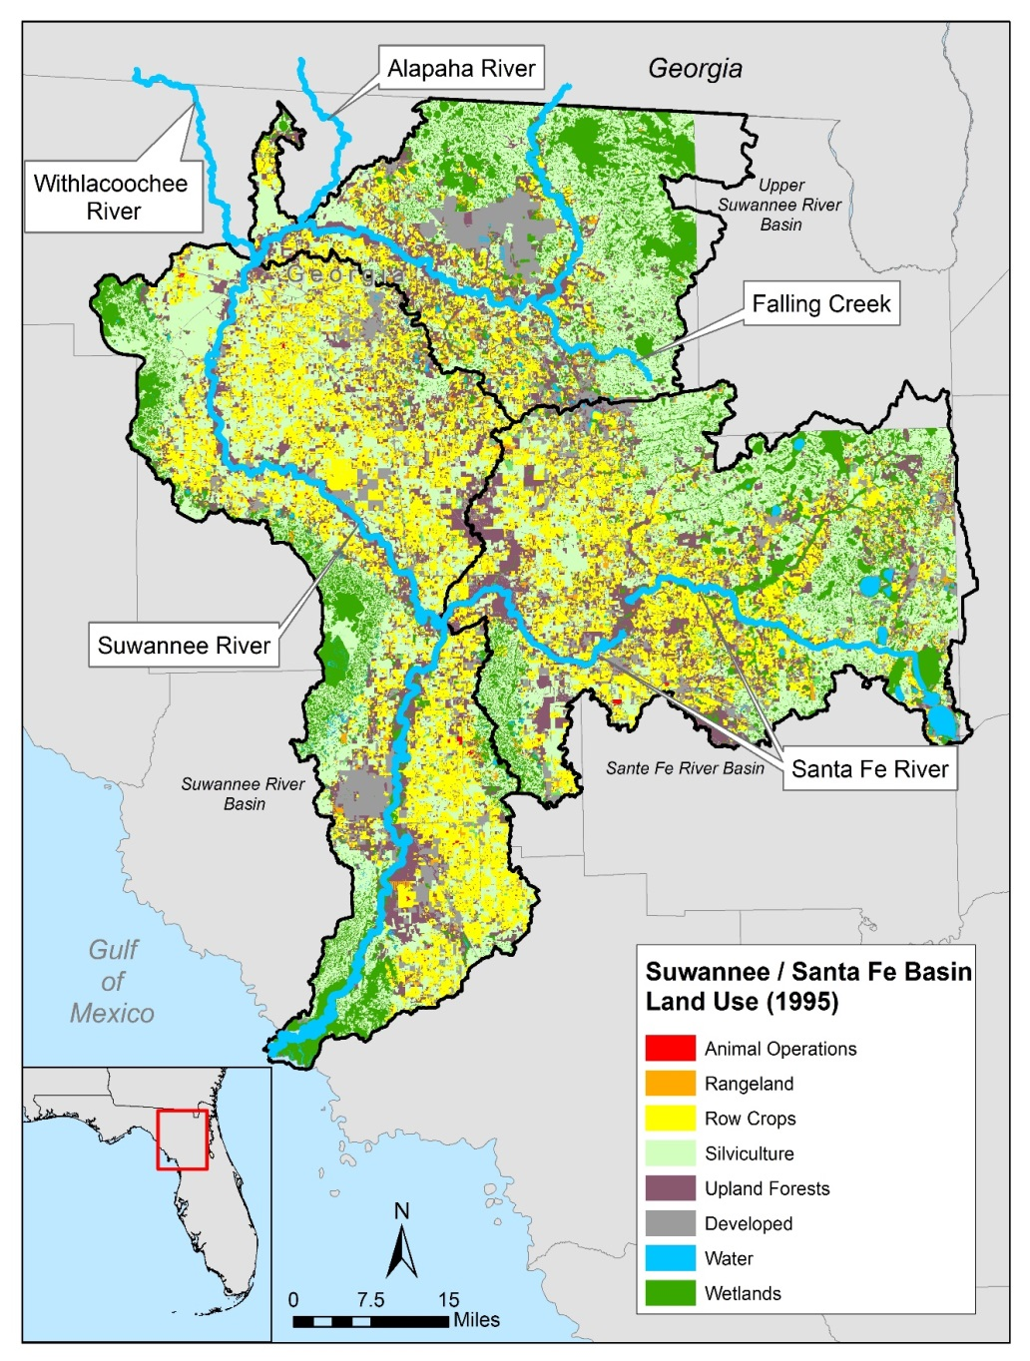
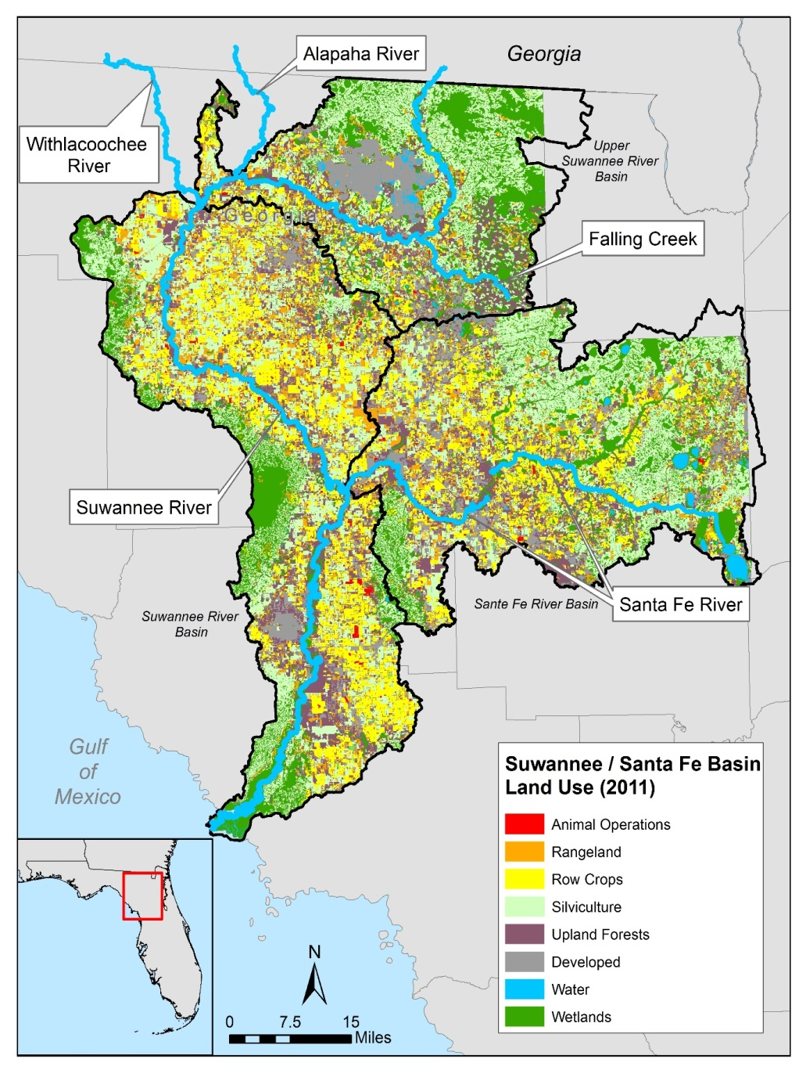
1995 vs. 2011 Land Use

Slide 25
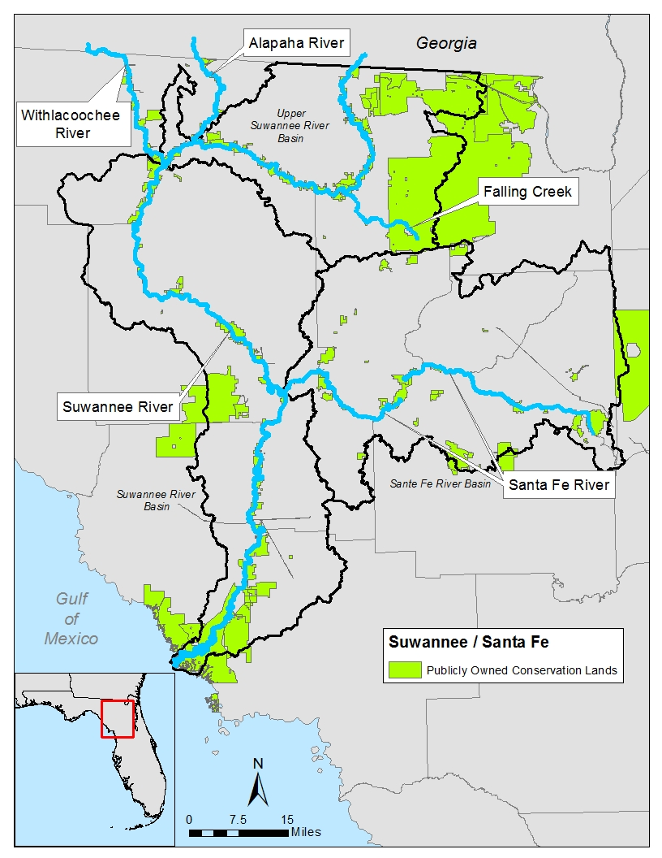
Publicly-Owned Conservation Lands
Significant publicly-owned conservation lands in the upper and lower Suwannee River basin
Limited conservation lands in Santa Fe and middle Suwannee basins

Slide 26
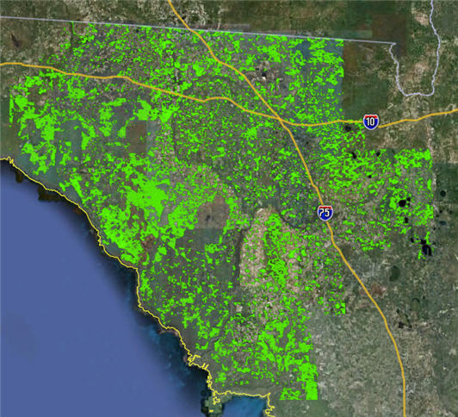
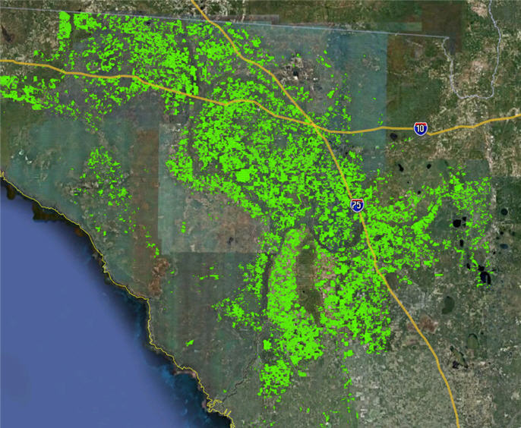
Silviculture
Agriculture
FFWCC 2009 data

Slide 27
Natural Systems Issues
Conversion of silviculture to more intense agricultural uses
Habitat fragmentation
Loss of native aquatic vegetation and expansion of nuisance algae (Lyngbya) in spring runs
Nutrient enrichment of coastal estuary and potential seagrass declines
Increase in species listings

Slide 28
Natural Systems Goals and Projects
Goals:
  Reduce existing habitat fragmentation
  Maintain and expand existing wildlife corridors
  Protect listed species and biodiversity
Potential Projects:
  Conservation of natural lands
    Public acquisition
    Conservation easements
  Habitat restoration
  Springs restoration
  Other

Slide 29
Open Discussion
All Attendees

Slide 30
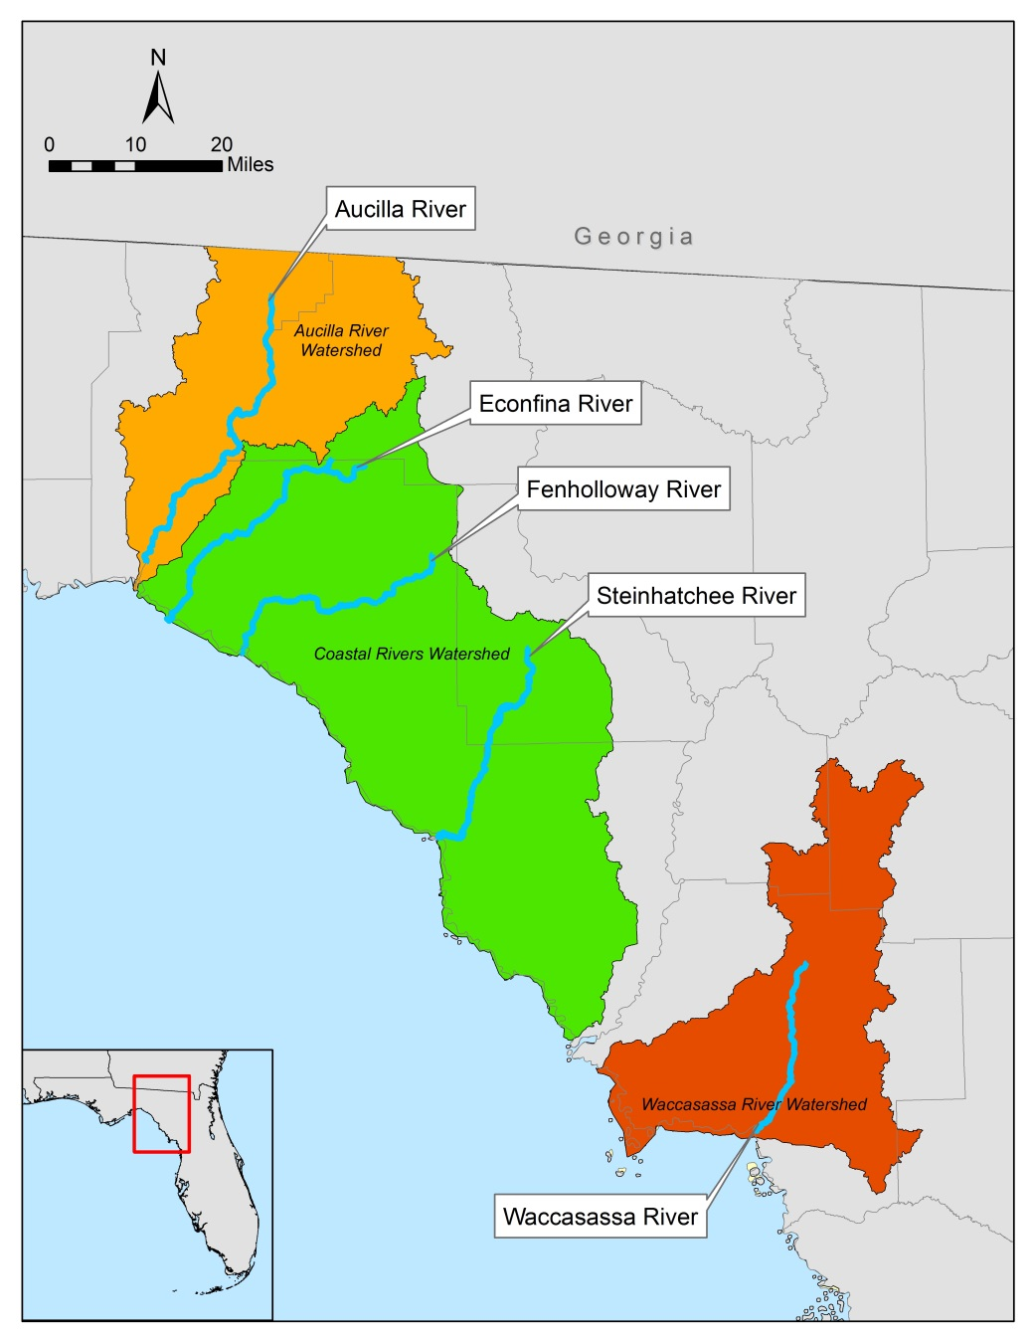
Coastal Rivers Basin
Aucilla River
Econfina River
Fenholloway River
Steinhatchee River
Waccasassa River

Slide 31
Coastal Rivers Basin
Water Quality

Slide 32
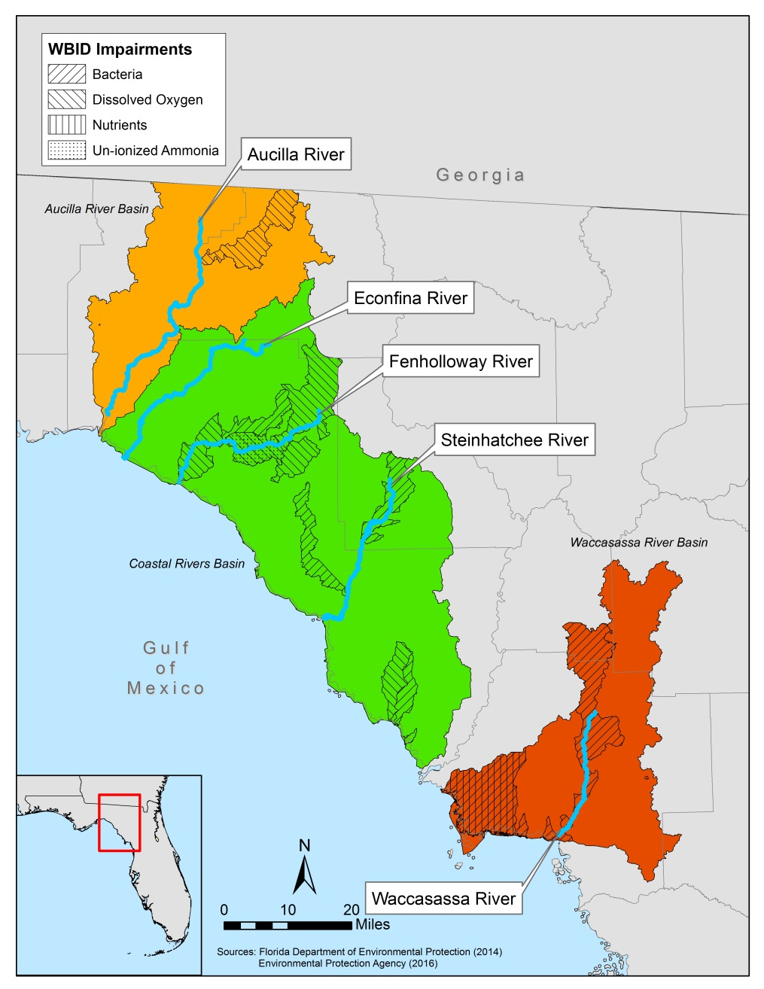
Water Quality Impairments
Impairments determined for:
  Bacteria
  Dissolved oxygen
  Nutrients
  Ammonia

Slide 33
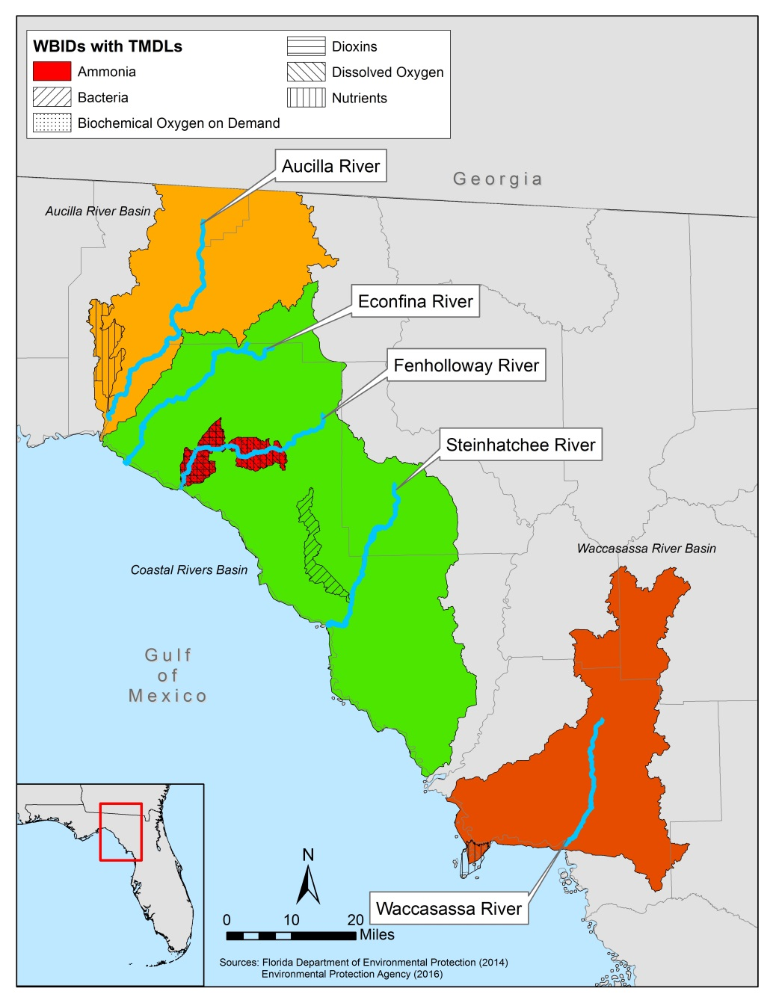
TMDL Determinations
Wacissa River
  Nutrients
Econfina River
  Ammonia
  Dissolved Oxygen
  BOD
  Dioxin
Steinhatchee River
  Bacteria
Waccasassa River
  Nutrients

Slide 34
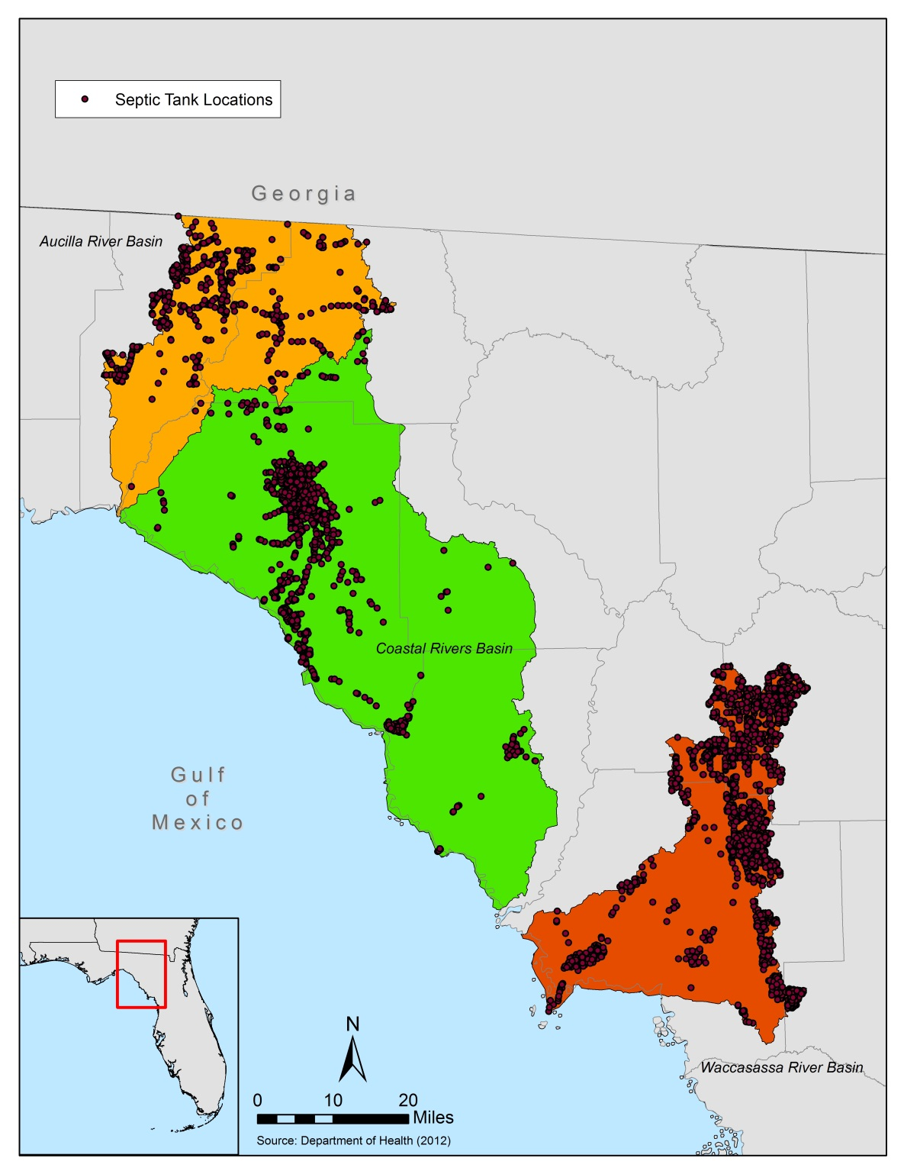
Septic Tanks in Coastal Rivers Basin

Slide 35
Nitrate Trends in River Flows 1989-2007
Figure from SRWMD (2007)

Slide 36
Nitrate Trends in Spring Flows 1989-2007
Figure from SRWMD (2007)

Slide 37
Water Quality Issues
Impaired water bodies
  Nutrients
  Bacteria
Increasing trends in nitrate concentrations in groundwater and spring discharges in some locations
Increasing trends in nitrate concentrations in river surface waters in some locations

Slide 38
Water Quality Goals and Projects
Goals:
  Reduce nitrogen loads to surface and groundwater
  Reduce bacteria loads to surface water
Potential Projects:
  Agricultural BMPs
  Septic to sewer conversions
  Wastewater treatment upgrades
  Urban stormwater treatment
  Other

Slide 39
Coastal Rivers Basin
Water Quantity

Slide 40
Unconfined Aquifer in SRWMD
Suwannee River WMD is mostly underlain by an unconfined or poorly confined Upper Floridan aquifer
Spring discharges from the aquifer are major contributors to river flows
Aquifer is especially vulnerable to pollution

Slide 41
Water Quantity Issues
Decreasing trends in river flows in some locations
Decreasing trends in springs discharges in some locations

Slide 42
Water Quantity Goals and Projects
Goals:
  Increase aquifer recharge
  Decrease excessive runoff and evapotranspiration
Potential Projects:
  Agricultural BMPs
  Hydrologic restoration of over-drained lands
  Water reuse
  Water conservation
  Other

Slide 43
Coastal Rivers Basin
Natural Systems

Slide 44
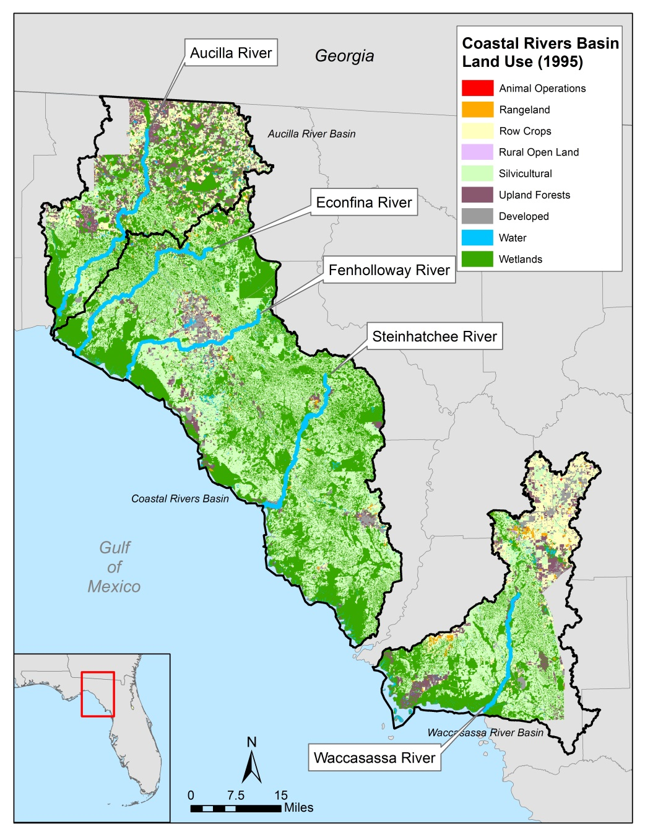
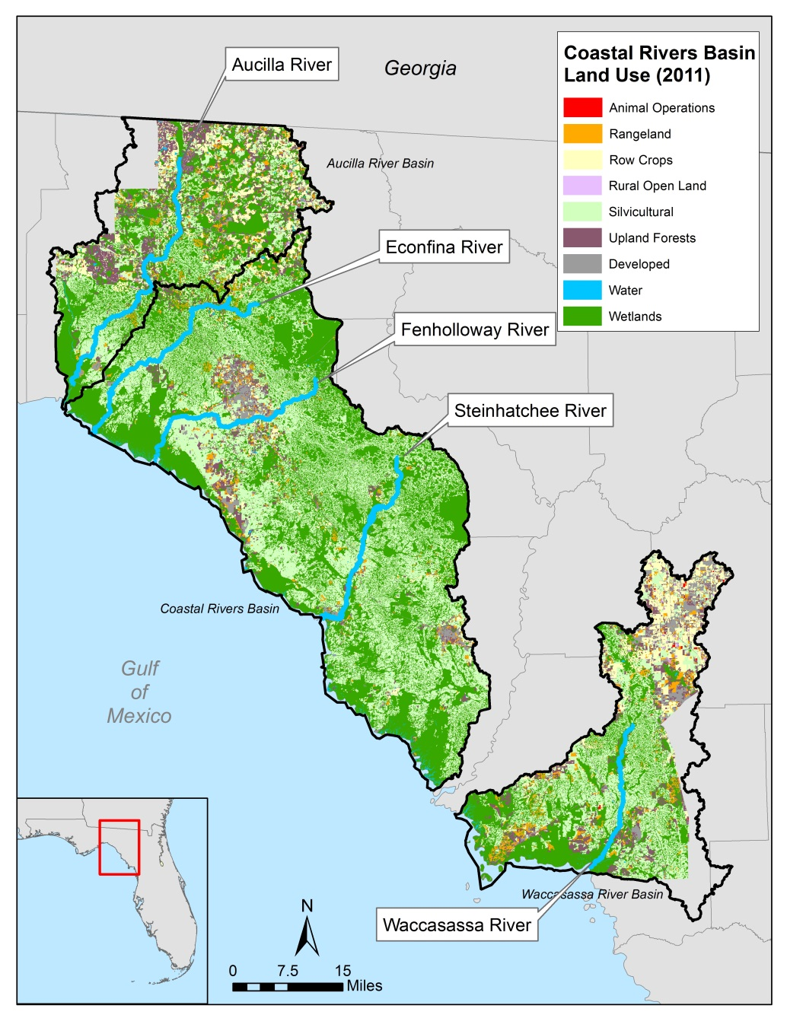
1995 vs. 2011 Land Use

Slide 45
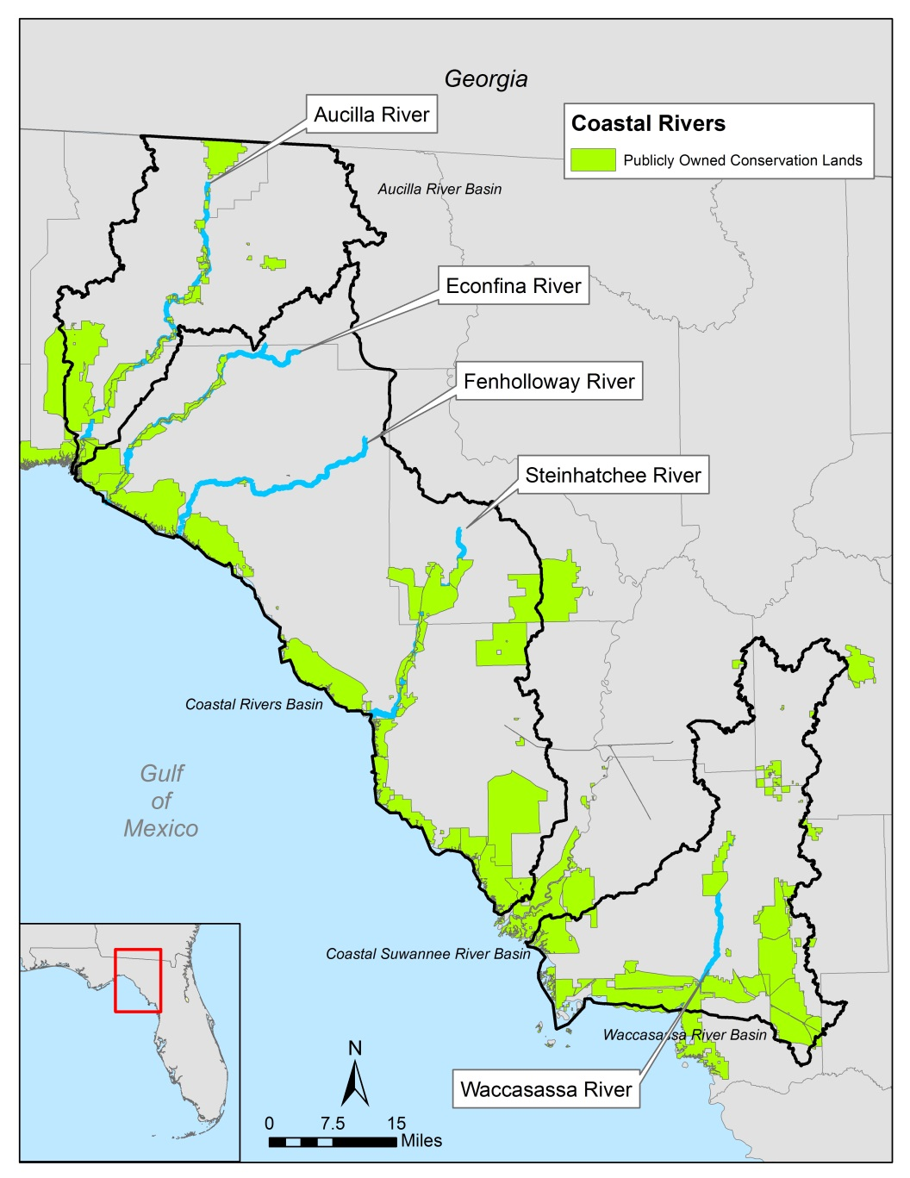
Publicly-Owned Conservation Lands
Significant publicly-owned conservation lands along the Gulf coast
Limited conservation lands in upper watersheds

Slide 46
Big Bend Seagrasses Aquatic Preserve

Slide 47
Natural Systems Issues
Conversion of silviculture to more intense agricultural uses
Habitat fragmentation
Replacement of native aquatic vegetation by nuisance algae (Lyngbya) in spring runs
Potential seagrasses losses from coastal eutrophication
Increase in protected species listings

Slide 48
Natural Systems Goals and Projects
Goals:
  Reduce existing habitat fragmentation
  Maintain and expand existing wildlife corridors
  Protect coastal seagrass resources
  Protect listed species and biodiversity
Potential Projects:
  Conservation of natural lands
    Public acquisition
    Conservation easements
  Habitat restoration
  Springs restoration
  Other

Slide 49
Open Discussion
All Attendees

